Slide 1
“Government Doctors Should Be Allowed To Do Private Practice”
Sindhu Viswanathan

Slide 2
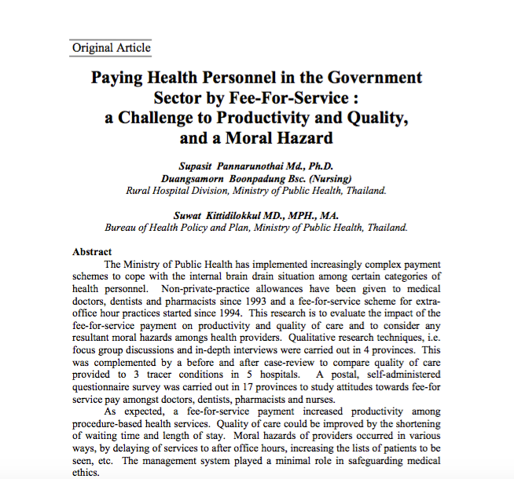

Slide 3
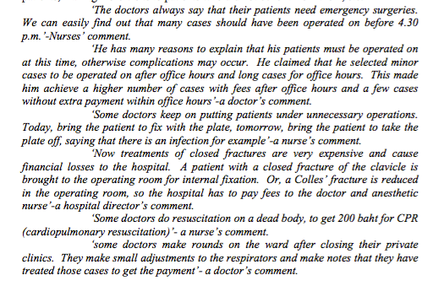

Slide 4
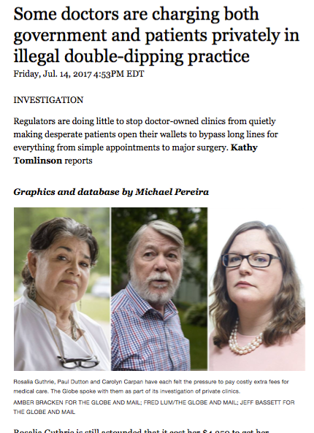

Slide 6
Fatigue, Sleep deprivation, stress..

Slide 7
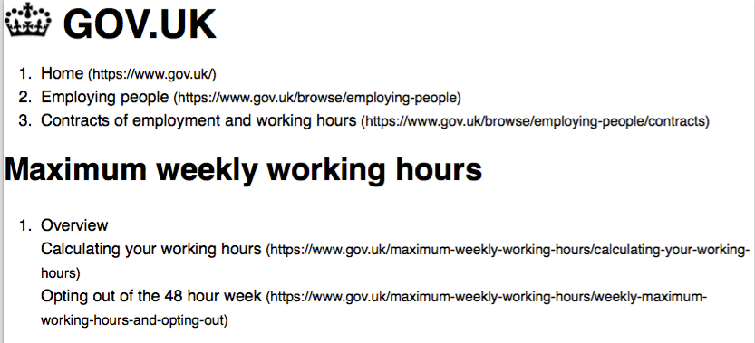

Slide 8

local data : Stress, stressors and coping strategies amongst junior doctors in a Malaysian Hospital
Small sample size (n=42)
Geographically limited (Kelantan) in 2011
General Stressor Questionnaire(GSQ)
31% distressed
Saiful,, Tan Ying Jie, Rahman. ASEAN Journal of Psychiatry, Vol. 12 (1) Jan - June 2011

Slide 9
Local Data:Physician, heal thyself: The Paradox of Anxiety amongst Junior Doctors and Work in a Teaching Hospital
Small sample size, n=89
Geographically limited (UKM) in 2013
General Stressor Questionnaire
Depressive Anxiety and Stress Scale 21
61% affected ; 47% moderate to severe
Source: Work related challenges, performance pressure, poor relationship with supervisors, poor relationship with colleagues, bureaucratic constraints
Tan SMK, Jong SC, Chan LF, Jamaludin NA, Phang CK, Jamaluddin NS. Asia-Pacific Psychiatry. 2013;5:74-81.2011

Slide 10
Local data: Exploring Burnout among Malaysian Doctors using Abbreviated Maslach Burnout Inventory
Small sample size, n=117
Geographically limited (UM), in 2013
Maslach Burnout Inventory
Hospital Anxiety and Depressive Scale
26.5% burnout
Emotional exhaustion and depersonalisation positively correlated with depression and anxiety
Zuraida AS and Zainal NZ
MJP Online Early, 02-03-15

Slide 11
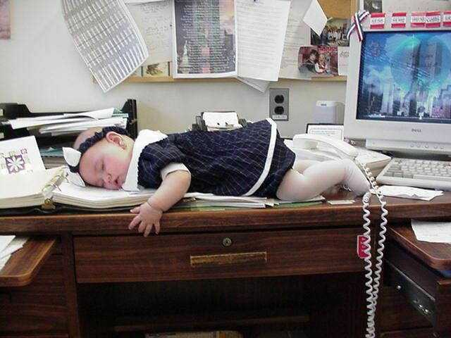

Slide 12
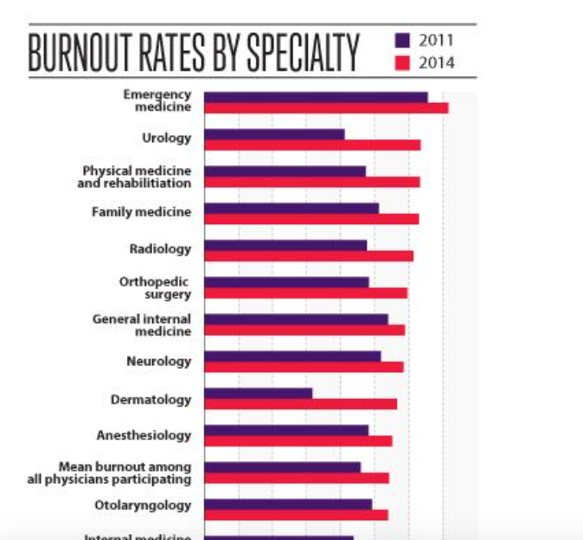

Slide 13
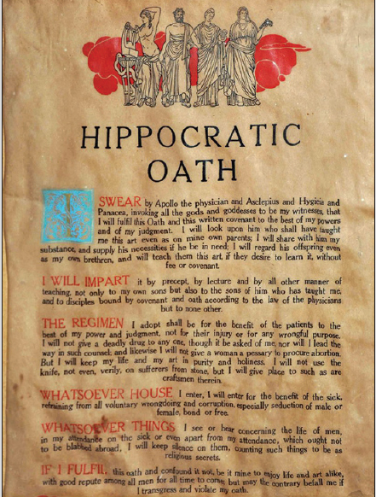

Slide 15
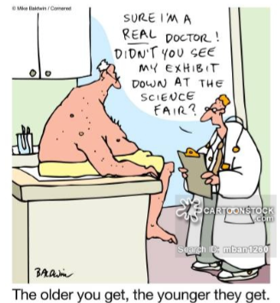

Slide 18
Thank you..

