Slide 1

KEYNOTE ADDRESS
PRIVATE-PUBLIC PARTNERSHIP IN PRIMARY HEALTH CARE
By
Dr. Chong Chee Kheong
Acting Deputy Director General (Public Health)
10th ASEAN & 7th Perak Health Conference on Primary Health Care
21st July 2017, Ipoh, Perak
Notes:
Thank you Mr Chairperson
1. Dr. Yee Meng Kehong, Organising Chairman of 10th ASEAN & 7th Perak Health Conference
2. Dr. …………………………………………
3. Dr. …………………………………………
4. Dr. …………………………………………
Good morning Ladies & Gentlemen.
The Director General for Health Malaysia extends his regrets for not being able to be here in person to deliver his keynote address at this 10th ASEAN & 7th Perak Health Conference on Primary Health Care.
I understand that the ASEAN Conference on Primary Health Care is held every two years in Ipoh and this year it is in conjunction with the 7th Perak Health Conference and participants here are from private and public sectors, comprising of specialist from various disciplines and the paramedics. The topic given for this keynote address ‘Private public partnership in primary health care’ is very fitting as it is in alignment with the Ministry of Health’s current focus on strengthening primary health care.

Slide 2

Scope of Presentation
MINISTRY OF HEALTH MALAYSIA
Overview of the Current Malaysian Health System
Challenges
Journey
Future direction
Notes:
My presentation will cover the journey, challenges and future directions of private-public partnership in Malaysia.

Slide 3
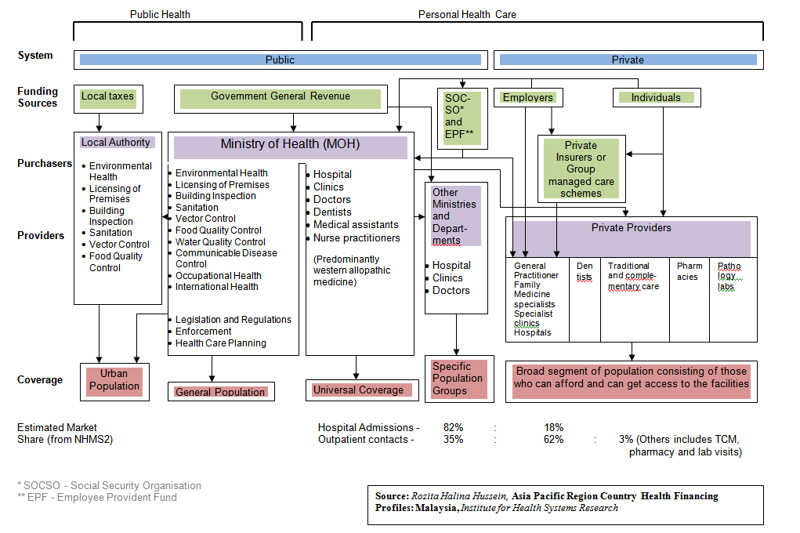
Current Healthcare System
NHMS2011 – only medical visit)
74% : 26%
49% : 51% HCDA study
Notes:
Malaysia has an efficient and widespread dichotomous public-private system which provides a very comprehensive range of health care services. From what was largely a government-led and funded public service enterprise since the time of independence, our healthcare service has over the decades, transformed into a resilient dual-tiered parallel system, with a sizable and thriving private sector.

Slide 4
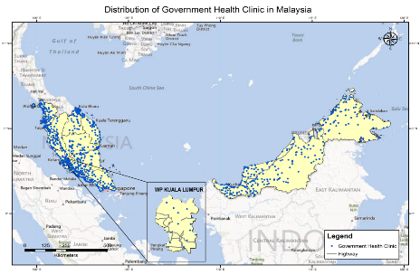
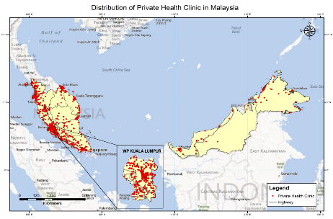
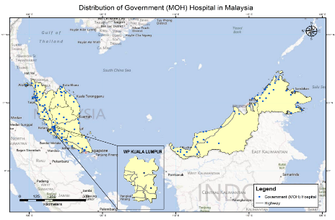
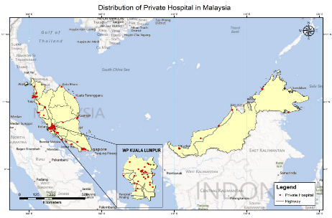
Distribution of Health Facilities
-Study on Mapping of Health Facilities and Services (by Institute of Public Health)
Notes:
Public healthcare in Malaysia is heavily subsidised, as the government is determined to maintain medical services at an affordable and accessible level. Public health facilities are fairly distributed across the country, in contrast, the private healthcare sector, while not subsidised, is thriving predominantly in the urban areas.

Slide 5
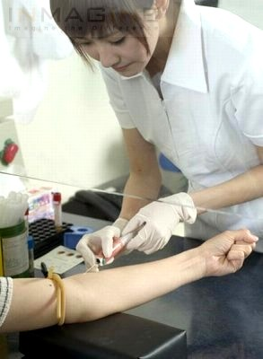
PRIMARY CARE
  Dual Function
Service at 1st point of contact
Care coordinator & gatekeeping role
Focus on preventive care & health promotion
– team-based care
Notes:
As we are aware, Primary Care through the platform of Primary Health Care is the first point of contact the population receives care, whether in the large cities or even the remote villages. At this point, care is provided to clients or patients who present themselves with undifferentiated conditions. Early signs and symptoms are windows to early management or referral to most appropriate levels nearest or fastest available. The more affordable and pervasive these first service contact points are, the more protected the population would be in securing health maintenance and health improvements.

Slide 6

Population Perspective in Primary Health Care
PHC provides primary continuing, comprehensive, coordinated whole person care to individuals, families and their communities from womb to tomb
Lifecourse Approach
Notes:
Our national health policies stress public health and health promotion, that is, ‘wellness’ as well as a ‘disease’ perspective. Even before the Alma Ata Declaration of 1978, primary health care (PHC) has been given emphasis in the Malaysian Health System but it was in the 7th Malaysia Plan (1996-2000) where it was articulated that PHC would be expanded not only in breadth of coverage but also in depth or scope of services, delivering more comprehensive services (life course approach) with a focus on wellness and preventive services, shifting from an acute care model to a coordinated and integrated long-term care model. This was our step forward towards improving greater health coverage of the population.

Slide 7
Improvement in our health status (1957 - 2013)
IMR
NMR
CDR
TMR
Notes:
Benefiting from the pervasive network of services established since independence, the achievements of the Malaysian health system can be shown in the increase in the life expectancy at birth, the reduction of the infant mortality rate, the reduction of the maternal mortality ratio. And these achievements have been attained at a relatively low cost. However, since the last decades some of these mortality data has remained somewhat stagnant.

Slide 8
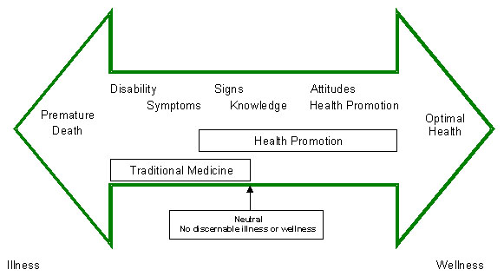
Disease/ Wellness Spectrum
PRIVATE/ PUBLIC
- Changing disease patterns
Increasing use of technology for
diagnosis and treatment
Notes:
Ladies and Gentlemen.
In today’s world of complexity and fast pace it is almost impossible to do anything alone. This is specifically accurate in the health domain where constantly changing disease patterns, rising prices, and increasing use of sophisticated technology for diagnosis and treatment have made it almost impossible to envisage any single organization providing health services without some type of established partnership. Public-private partnerships are seen as an effective way to capitalize on the relative strengths of each sectors to address problems that neither could tackle adequately on its own.

Slide 9
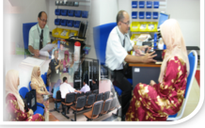
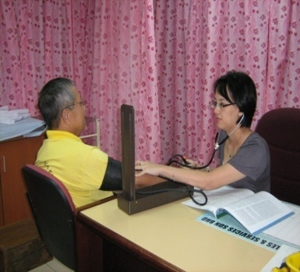
Primary Care Setting
PUBLIC
PRIVATE
TEAM
Family Medicine Specialist
Medical officers
Assistant Medical Officers
Nurses
Pharmacists
Other Allied Health Professionals
STRENGTH
3,203
  (health clinics, MCH clinics, K1M Community Health Clinics)
TEAM
GP
Clinic aides
STRENGTH
7,146 medical clinics
Notes:
The private sector has the advantage of being closest to the community as you all are the first point of contact with the health system for the public. According to 2016 Health Facts published by the Heath Informatics Centre of Planning Division, there are 7,146 registered private medical clinics in contrary to only 2,869 clinics in the public sector comprising of health clinics, Maternal & Child health clinic, K1M and community health clinics. So, there is plenty of resource in the private sector and relative heavy burden of public sector with less resource but more workload.

Slide 10



PRIVATE-PUBLIC
Public health facilities
Private health facilities
Seek care
Population
Seek care
Care delivery
Care delivery
Notes:
We must think of Private-Public Partnership as collaboration and sharing responsibilities between the two sectors which can provide synergistical positive effects on the efficiency, equity and quality of health care services for the population. Partnership should also guarantee the private practitioner are able to have consultations with the doctors in the public sectors to facilitate referral of patients for further management in public hospitals.
One of the fundamental ‘private-public partnership in primary care’ is in disease surveillance. Being the front liners early diagnosis and prompt notification of diseases such as tuberculosis and dengue are important in the implementation of prevention & control measures for these communicable diseases. The private sectors also play an important role for rapid detection of new & re-emerging diseases such as MERS-CoV & Avian Influenza.

Slide 11
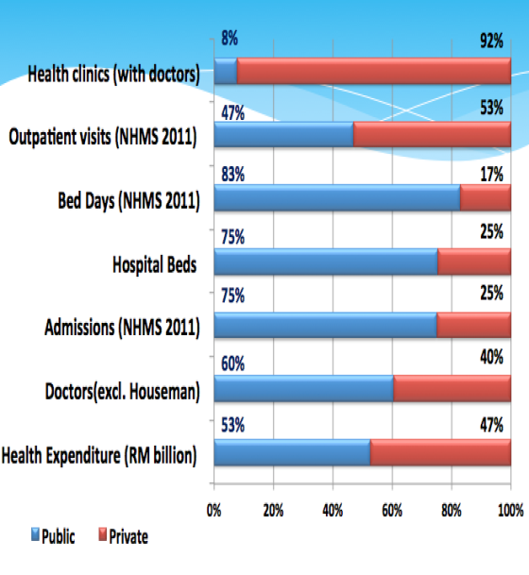
Challenges in Healthcare Delivery
Lack of integration of dichotomous healthcare system.
Unequal distribution of resources between public and private healthcare
Notes:
This slide shows the effect of a dichotomous system in the country which has led to lack of integration, imbalances and mismatches between the two
I am using 2011 figures for the purpose of comparison as the slide was generated from annual data and the 2011 National Health Morbidity Survey.
The bar in blue represents the public sector and red represent the private sector.
Over-stretched public facilities
In 2011, the public sector had only about 8% of primary care clinics with doctors but had to handle almost 47% of outpatient visits.
There are more hospitals in the private sector, but the reality is about 75% of hospital beds remain within public facilities.
The public sector takes care of nearly three quarters of hospital admissions.

Slide 12

Public & Private Sector
Resources and Workload (2014 & 2015)
10%
90%
60%
40%
34%
66%
76%
24%
81%
19%
76%
24%
52%
48%
Source: Health Informatics Center (HIC) , Family Health Development Division, NHMS 2015, MNHA Prelim (2014)
Notes:
The Ministry of Health has continuously worked tirelessly to enhance our healthcare service delivery. Our existing healthcare system has led to resource and manpower maldistribution as well as income disparities between the public and private sectors. MOH is trying to create some balance and recently we have embarked in two transformative processes.

Slide 13
Source: Lim HM,et al.PloS One.2017;12(2);e0172229
Notes:
In recognising that the private healthcare sector participation is crucial towards the development of the country, the government has taken steps to promote greater participation of the private sector in the provision all levels of healthcare services. Based on the MHSR study, there are several reasons for individuals reaching out to the private sector compared to public facilities
Long waiting time at health clinics
Not being seen by the same doctor
Perceived better services at private facilities
Private insurance coverage
The Private sector accounts for 61.4% of primary care visits (54.9% in urban areas and 6.5% in rural areas) yet there is minimal integration with public facilities to enable effective population outreach

Slide 14
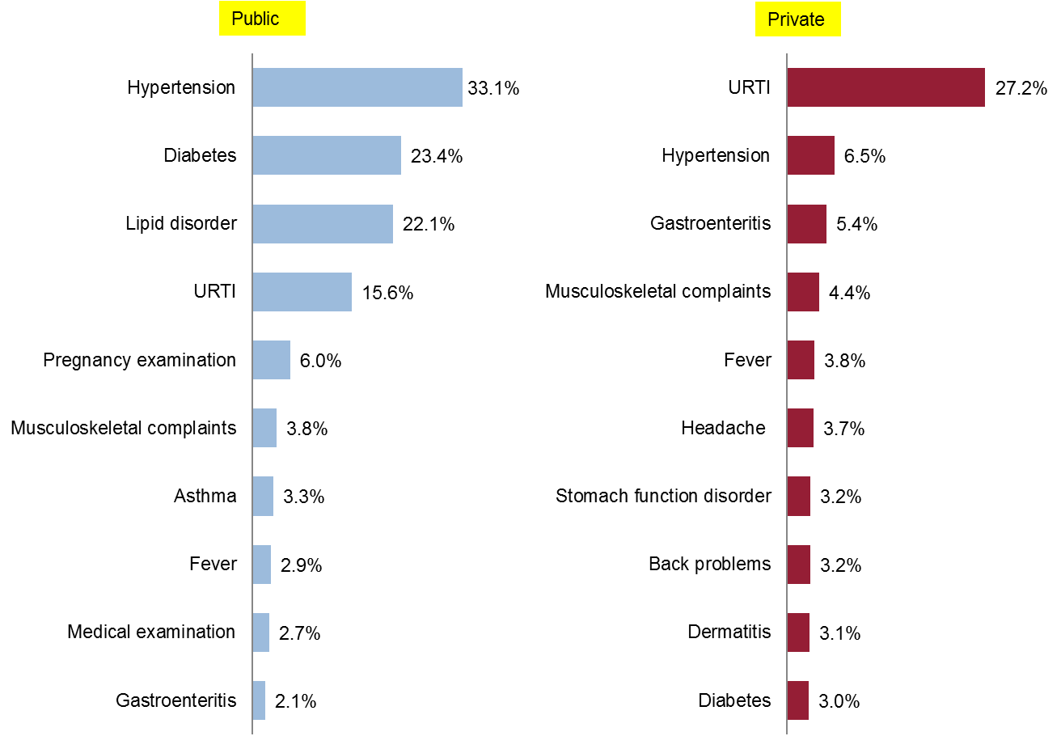
Increasing Burden of Non-Communicable Diseases
Public vs. private: top 10 most frequently managed diagnoses
Source: Sivasampu S, et al. NMCS 2014. NCRC; 2016.
Notes:
Malaysia has not been spared the global health challenges. Of the many tasks we face, our biggest challenge is the increasing burden of non-communicable diseases. We are experiencing a steep rise in the prevalence of NCDs and its risk factors. For conditions where general public awareness influences health seeking behaviour as the conditions are largely asymptomatic. The top 3 diagnoses managed in the public sector are all NCDs, accounting for 50.8% of all diagnoses managed in health clinics. In terms of patient volume, public clinics account for 84.1% of diabetes management in primary care, 77.5% for hypertension, and 84.0% for lipid disorder.

Slide 15
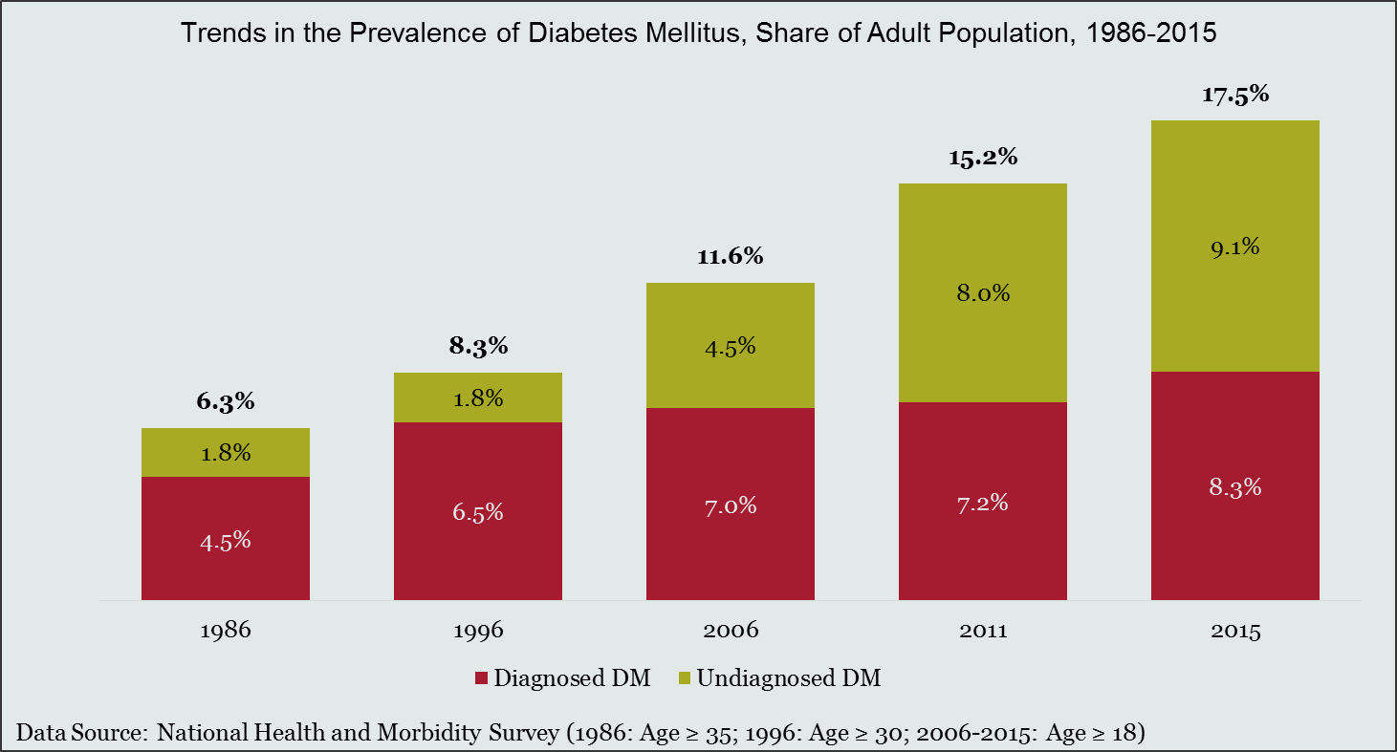


Diabetes mellitus: Rapidly growing prevalence in 1986–2015, with most of the increase in undiagnosed cases
Notes:
We want a healthy Malaysian society as the prevalence of NCD have risen especially in heart diseases, diabetes, obesity, hypertension. The prevalence of diabetes had tripled from 6.3 per cent to 17.5 per cent from 1986 to 2015.

Slide 16

Hypercholesterolemia: Rapid increase in prevalence in adult population in 2006–2015, 80% of adults with HCL undiagnosed
Notes:
While hypercholesterolemia has doubled (23 per cent to 48 per cent) from 2006 to 2015. More alarmingly, more than 50 per cent of these cases are not diagnosed and the number continues to increase. This has cost the country RM22.6 billion. Productivity of the country will be reduced if it’s population is unhealthy.

Slide 17







Other Challenges in Healthcare Delivery
Rising cost of healthcare
Existing and emerging communicable diseases
Aging population
Rising public expectations
  Role of social media in providing health information
  The “informed” community does not always mean better understanding of health issues
  Anti vaccination movements
  Patients’ complaints
Notes:
Other challenges include rising cost of healthcare, existing and emerging communicable diseases, an aging population and rising public expectations.

Slide 18
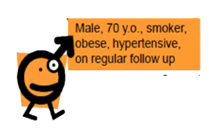




Integrated Intervention
Referral to Rehab
Respiratory
Mobility
Elderly : Advice for carers, home intervention, prevent falls, scheduled dementia screening
Screening : mental status, sexual problem, Prone to Fall, Dementia screening
Screening : lipid levels, glucose levels
Screening : Physical – Inguinal hernia
Diet management for chronic diseases
eg hypertension
Hypertension : Management of disease & Complications
Physical Activity : Advice, Counseling
Referral to dietician / nutritionist
Smoking : Pamphlet (Universal)
Referral to surgery
Smoking : Advice (Intermediate)
Diabetes : Management of disease & complications
Dental referral
Smoking : Counseling (Advanced)
Notes:
With the rise of chronic diseases, the focus is now firmly in the direction of integrated, comprehensive, people-centred primary care. As health professionals now recognize, these diseases cannot be prevented or managed in the absence of a strong primary care infrastructure. A health system where primary care is the backbone and family doctors are the core delivers the best health outcomes, at the lowest cost, and with the greatest user satisfaction. This is where the partnership between private and public can play an important role in tackling the interventions.

Slide 19
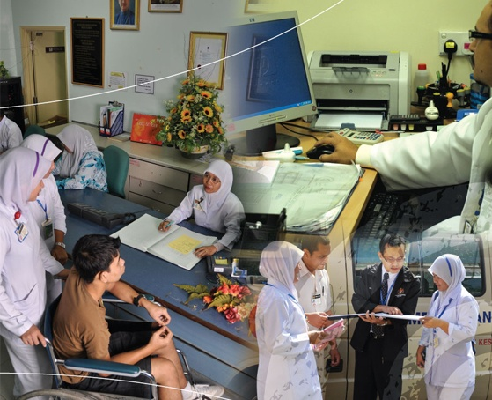
BUSINESS PROCESS RE-ENGINEERING
Strengthening of primary health care
Focus on prevention as priorities
Improving organisational capacity (infrastructure and human resource)
Increasing efficiency
Notes:
And in our current strategic direction, the Ministry of Health has again expressly articulated the strengthening of primary health care and the focus on prevention as priorities, in addition to the other pillars of improving organisational capacity in terms of infrastructure and human resource for health as well as increasing efficiency through business process re-engineering.

Slide 20
Family Doctor Concept
ONE Family Doctor to One Family
Scope
FULL PRIMARY HEALTH CARE
NCD SCREENING
CHRONIC DISEASES MANAGEMENT
MCH
ORAL HEALTH
Notes:
In the 10th Malaysia Plan, we have initiated efforts towards system-wide reforms of the healthcare delivery system transformation which will be carried out in phases, starting with primary health care, hence our immediate efforts to strengthen primary health care and implement the family doctor concept. A designated population in the clinic’s operational area will be assigned to a particular primary health care team led by the doctor. His team will include nurses and allied health staff, and will be responsible for analyzing the health status of his population as well as plan and design the interventions and services tailored to this population and subsequently the monitoring of effectiveness of these services.

Slide 21

Vision For Health
“A Nation Working Together for Better Health”
A nation working together for better health
Notes:
In the 11th Malaysia Plan (2016 – 2020), the government plans to continue to provide the universal access of quality healthcare to the community. the Ministry of Health Strategic Plan 2016–2020 identifies a vision of a “nation working together for better health”. Family doctor concept will be strengthened to increase coverage for health care. Mapping of facilities, human resource and services is being done so that planning to reduce gaps can be targeted.

Slide 22
CHALLENGES
To prevent, delay the onset, or detect and control NCDs in a cost-effective manner through systematic identification of individuals at different risk levels and provision of targeted interventions according to risk levels
EnPHC System
Community Empowerment
Initiatives related to improving the current ways in which information about population level risk is collected, used and shared
Initiatives related to improving the current ways in which front-line community organisations are empowered, accountable and supported to impact on population health outcomes
Strategic Communications
Information and Communication Technology
Notes:
The first process is called Enhanced Primary Healthcare. We will use the existing primary healthcare system since it reaches the remotest parts of Malaysia and realign primary care towards modern needs. This transformation process involves in redesigning primary care to meet the demand of non-communicable diseases. We need to have an integrated team approach within the primary healthcare system and support the family doctor concept be it public and private to ensure continuity of healthcare. There will be emphasis on promotive and preventive components with population screening and provide early intervention and counselling to those who are newly diagnosed with NCDs. We are optimistic that if we are successful in engaging the community, tackling the war against NCD’s will actually reduce the burden on the healthcare delivery system at different levels.

Slide 23
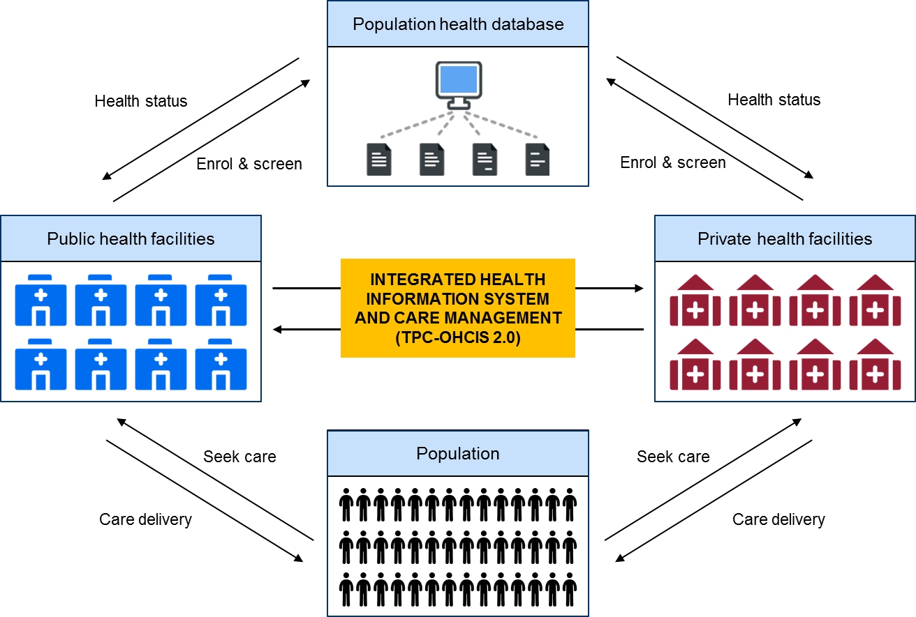
Pilot project for EnPHC
  Initiative concept/details/highlights:
  Implementing agency:
  Family Health Development Division (BPKK), Ministry of Health
  Key stakeholders identified:
Medical Practice Division, MOH
DHOs, KKs, GPs
MMA and other GP associations
  Required resources
  Investment: RM 466,720
  Implementation timeframe
Start date: April 2017
End Date: April 2019
  Key milestones
Initiative will begin engagement with GPs within the catchment areas of the 20 intervention KKs to pilot public-private data sharing and integration into the Population Health Database.
August and November 2017: Workshops to establish the framework for partnership
September 2018: The EnPHC system for GPs is ready to be used
Notes:
A pilot project on integrated Enhanced Primary Healthcare will commence in July 2017 to store medical records of 300,000 Malaysians. This project will be implemented in 20 health clinics in Selangor and Johor. The electronic medical records of 30 million Malaysians would be introduced through a seamless transition of care between the public and private sectors within five years.

Slide 24
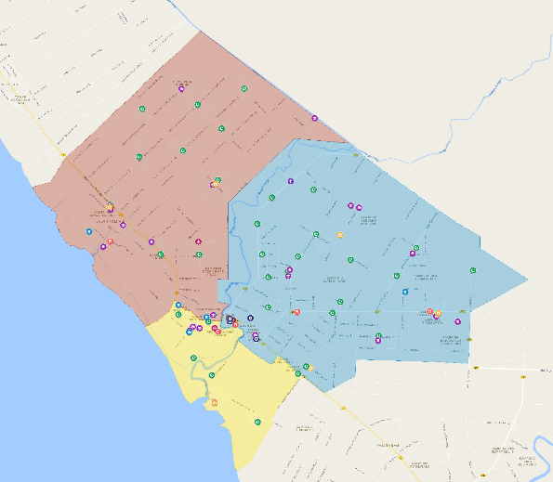













FAMILY DOCTOR CONCEPT
Family Health Team C
Family Health Team A
KD SUNGAI SIREH
KD SUNGAI BURUNG
KD SAWAH SEMPADAN
HOSPITAL TANJUNG KARANG
KD TIRAM SETIA
KK TANJUNG KARANG
KD SUNGAI GULANG-GULANG
Family Health Team B
KD BAGAN PASIR
Notes:
With the Enhanced PHC, clients/ patients at the health clinics will be assigned Family Health Teams. They will be seen by the same team led by the same doctor at every visit. The quick assessment and response will reduce congestion and waiting time. A thorough and risk-based screening will be done by the team to determine proper intervention required.

Slide 25
FINANCIAL SYSTEM
Patient
Additional services
(Out of pocket/ private health/ Voluntary Health Insurance
PHC
Public Private
Secondary, tertiary & other care
Public Private
Refer/admit
Receive
treatment
Home
Notes:
DRAFT Pls do not circulate or cite
SULIT
The second area of intervention will be on the financial system through developing a voluntary health insurance scheme. This will be a state-run scheme, non-profit oriented and be on a voluntary basis. And its basic function will be to provide health insurance and to play an important role in health service purchasing from the private sector. Though this intervention we hope to create a bridge between the public and private health sectors thus allowing the gradual reduction of the overcrowding in public sector into the private sector. With this, we are confident we can utilize the unused capacity of human resource and facility usage within the private sector. MOH also want to bring on board the private sector in complementing the public-sector initiatives in transforming primary care into outcome based well defined measurable systems. Through this intervention both the public and private sector can support each other towards combating the epidemic of non-communicable diseases.
25
SULIT
SULIT
11 August 09

Slide 26

THANK YOU
Notes:
In closing, I would like to thank the Chairperson and committee once again for this invitation. Thank you all for your unyielding support and dedication towards improved partnership in primary health care.

