Slide 1
Immunisation Issues
Challenges and Solution

Slide 2
Scope
importance of vaccination in Health Care
issues
local and global challenges
solutions

Slide 3
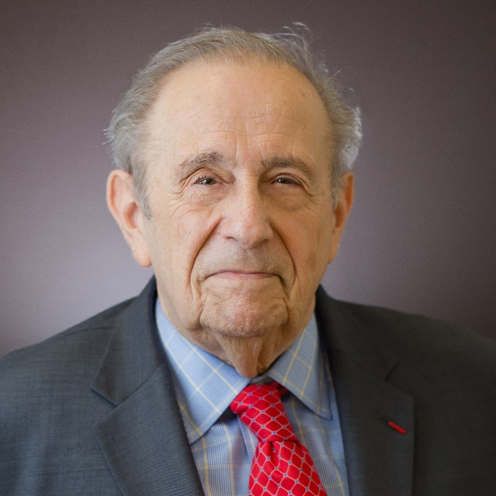
Vaccines 4th Edition
Vaccination has greatly reduced the burden of infectious diseases
Only clean water, performs better.
Plotkin SL, Plotkin SA. A short history of vaccination.
In: Plotkin SA, Orenstein WA, eds. Vaccines, 4th edn. Philadelphia: WB Saunders; 2004: 1-15.

Slide 4
Ten Great Public Health Achievements
United States, 1900-1999
  Vaccination
  Motor-vehicle safety
  Safer workplaces
  Control of infectious diseases
  Decline in deaths from coronary heart disease and stroke
  Safer and healthier foods
  Healthier mothers and babies
  Family planning
  Fluoridation of drinking water
  Recognition of tobacco use as a health hazard
MMRW April 02, 1999 / 48(12);241-243

Slide 5
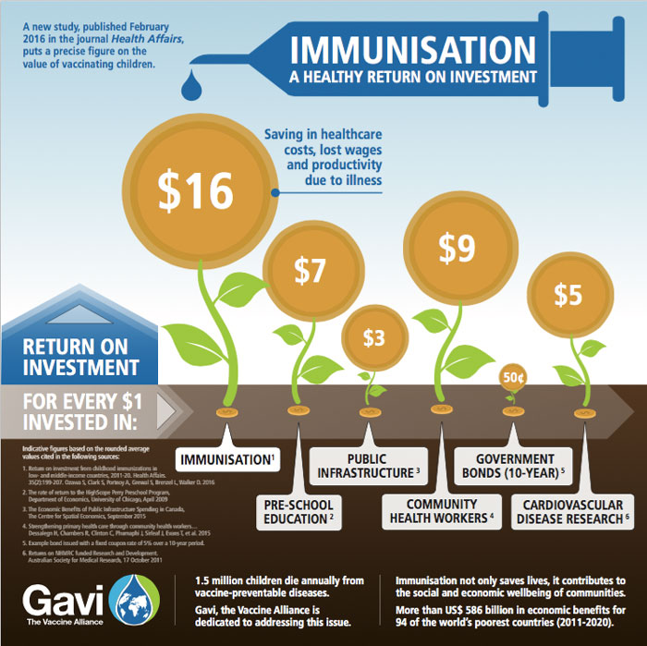
¹ Ozawa S, Clark S, Portnoy A, Grewal S, Brenzel L, Walker D.G. Return on investment from childhood immunization in low- and middle-income countries, 2011-20. Health Affairs. 2016 Feb;35(2): 199–207

Slide 6
WHO-most cost-effective health investments
estimated to avert between 2 and 3 million deaths each year.
strategies that make it accessible to even the most hard-to-reach and vulnerable populations.
  defined target groups
  delivered effectively through outreach activities
  does not require any major lifestyle change.
http://www.who.int/topics/immunization/en/

Slide 7
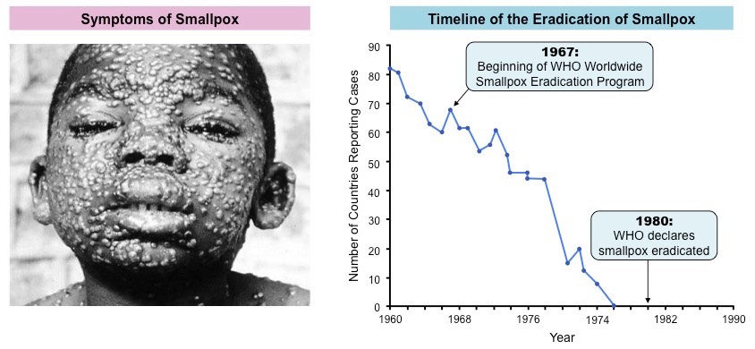
Small Pox
Last case in Somalia 1977

Slide 8
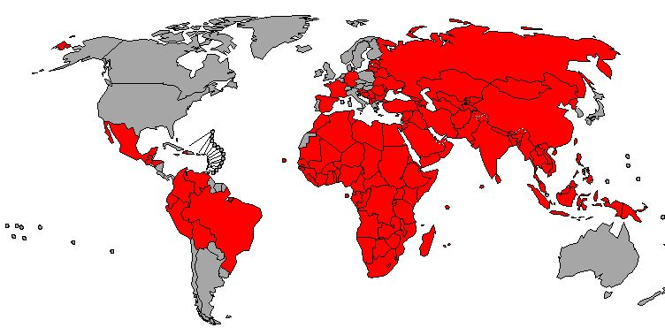
Polio Eradication Progress, 1988 – 2015
Last reported case in Malaysia 2000WHO/POLIO database, as of Aug 2016
Certified polio-free regions (126 countries)
Not certified but non-endemic (65 countries)
Endemic with wild poliovirus ( 2 countries)
The boundaries and names shown and the designations used on this map do not imply the expression of any opinion whatsoever on the part of the World Health Organization concerning the legal status of any country, territory, city or area or of its authorities, or concerning the delimitation of its frontiers or boundaries. Dotted lines on maps represent approximate border lines for which there may not yet be full agreement.
© WHO 2016. All rights reserved
WHO

Slide 9
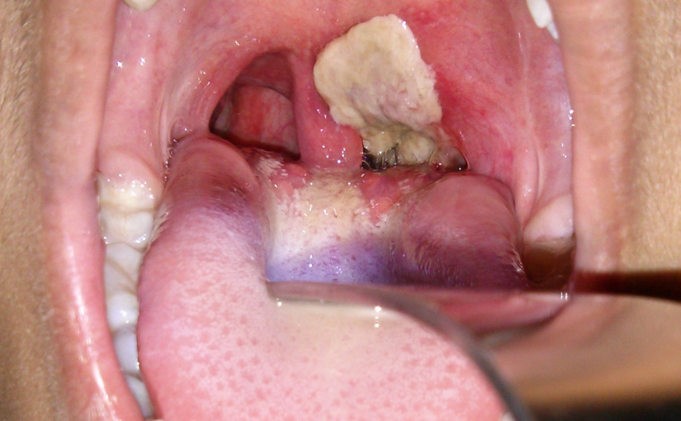
Diphtheria
http://www.theayurveda.org/

Slide 10
Haemophilus influenza b
Haemophilus influenzae meningitis in Malaysia.
Nearly one-half (48%) of all bacteriologically proved cases were caused by Haemophilus influenzae type b (Hib)
Pediatr Infect Dis J. 1998 Sep;17(9 Suppl):S189-90 Hussain IH¹

Slide 11
What the issues
Mortality and morbidity due to vaccine preventable disease
Immunisation Coverage
Re-emergence of vaccine preventable disease
Falling vaccination rates
Global vs Local
Underdeveloped vs Developing/Developed

Slide 12
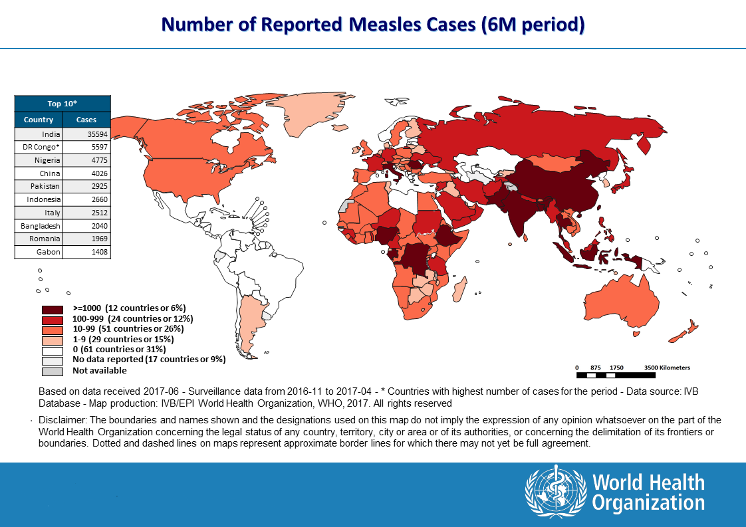
Number of reported measles 2017

Slide 13
Vaccine Preventable Disease Global
WHO July 2017

Slide 14
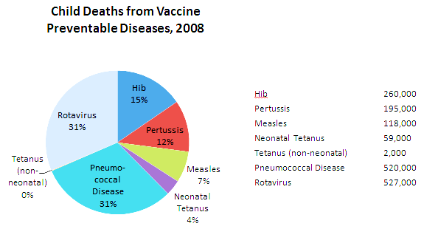
Estimated deaths <5 years of age VPD

Slide 15
What the issues
Mortality and morbidity due to vaccine preventable disease
Immunisation Coverage
Re-emergence of vaccine preventable disease
Falling vaccination rates

Slide 16
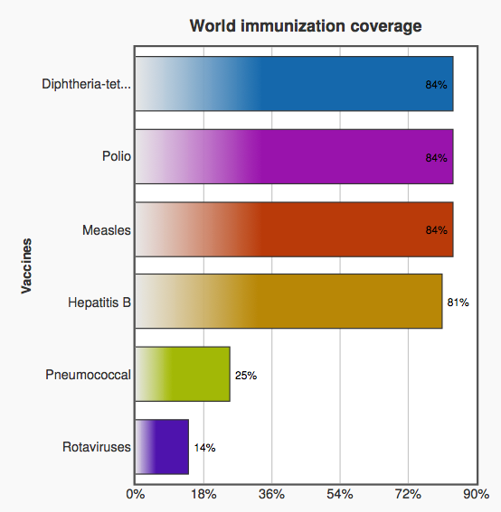
2015
falls short of global targets
Global Vaccine Action Plan (GVAP) - 90% DTP3 vaccination coverage
Source:
WHO
http://www.who.int/mediacentre/factsheets/fs378/en/

Slide 17
19.4 million infants not immunized (DTP3), 2015
Source: WHO/UNICEF coverage estimates 2015 revision. July 2016 / United Nations, Population Division. The World Population Prospects - the 2015 revision". New York, 2015.
Immunization Vaccines and Biologicals, (IVB), World Health Organization.
194 WHO Member States. Date of slide: 28 July 2016.

Slide 18
Haemophilus influenzae type b (Hib)
Hib vaccine had been introduced in 191 countries by 2015
Global coverage 3 doses of Hib vaccine is estimated at 64%
great variation between regions
  Americas -estimated at 90%
  Western Pacific 25%
  South-East Asia Regions 56%
http://www.who.int/mediacentre/factsheets/fs378/en/

Slide 19
Vaccination rates
Country wealth
Social unrest and war
Infrastructure and geography
Education

Slide 20
What the issues
Mortality and morbidity due to vaccine preventable disease
Immunisation Coverage
Re-emergence of vaccine preventable disease
Falling vaccination rates

Slide 21
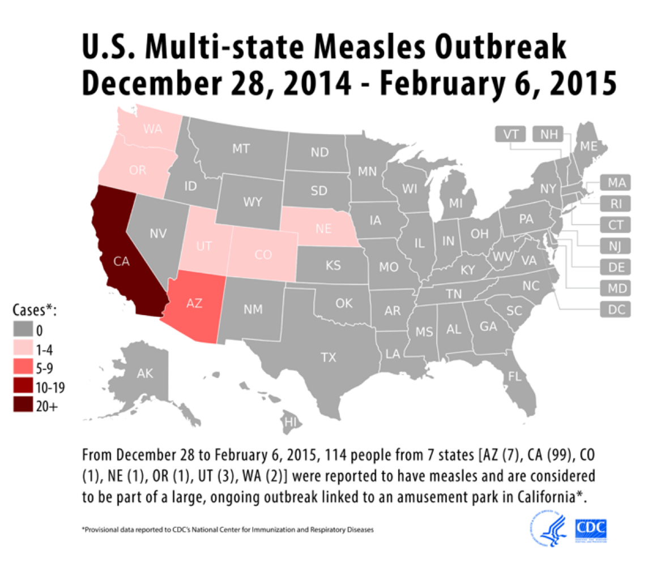
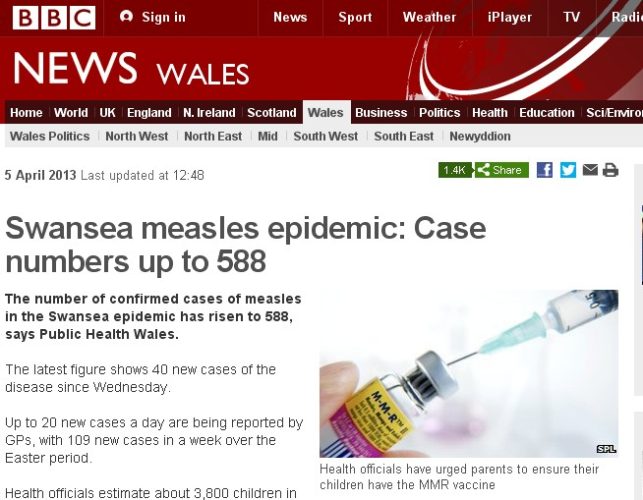
Measles outbreaks

Slide 22
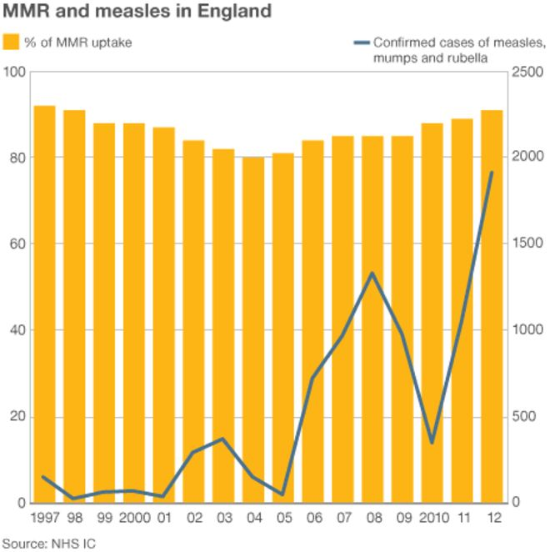
Measles outbreak UK

Slide 23
Incidence Diphtheria, Measles and Pertussis
Malaysia 1980-2016
 | 1980 | 1990 | 2000 | 2012 | 2013 | 2014 | 2015 | 2016
Diphtheria | 131 | 9 | 1 | 0 | 4 | 2 | 4 | 31
Measles | 8'727 | 563 | 6'187 | 1'868 | 195 | 221 | 1'318 | 1'569
Pertussis | 97 | 24 | 42 | 217 | 222 | 500 | 939 | 298

Slide 24
PERATUS PENCAPAIAN UCI MALAYSIA TAHUN 2012-2016 (ELB)
Vaksin | Tahun
 | 2012 | 2013 | 2014 | 2015 | 2016
DTaP 3 | 99.7 | 97.8 | 96.8 | 99.4 | 99.4
Hep B 3 | 98.7 | 96.3 | 96.3 | 98.6 | 99.5
MMR | 95.5 | 95.3 | 93.4 | 93.1 | 95.7
KKM

Slide 25
MCV1 coverage by districts in Malaysia
MCV1 coverage | 2008 |  | 2009 |  | 2010 |  | 2011
 | n | % | n | % | n | % | n | %
≥95% | 94 | 67.7 | 72 | 51.8 | 70 | 49.6 | 72 | 51.1
90 - <95% | 23 | 16.5 | 19 | 13.7 | 19 | 13.5 | 19 | 13.5
80 – <90% | 19 | 13.7 | 26 | 18.7 | 29 | 20.6 | 24 | 17.0
50 - <80% | 2 | 1.4 | 22 | 15.8 | 23 | 16.3 | 25 | 17.7
<50% | 1 | 0.7 | 0 | 0 | 0 | 0 | 1 | 0.7
Total districts | 139 | 100 | 139 | 100 | 141 | 100 | 141 | 100
KKM

Slide 26
Vaccine Effectiveness
2 doses of MMR
  97% effective for measles (range: 67%–100%)
Program effectiveness – 92%
Tetanus ~100%
Pertussis wanes with time
https://www.cdc.gov/vaccines/vpd/mmr/hcp/about.html

Slide 27
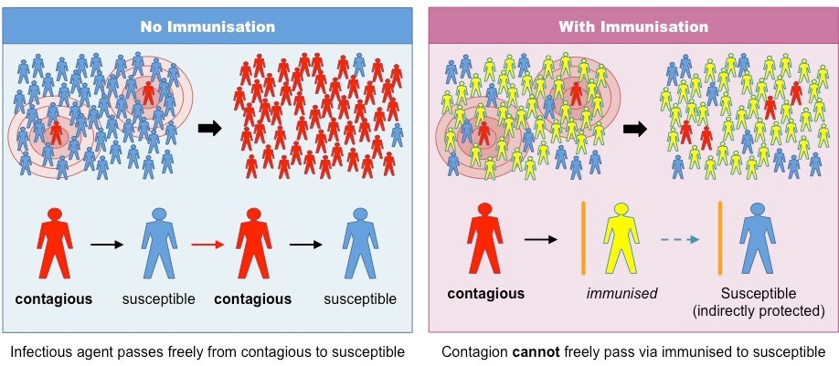
Why do we need high immunisation rates
Herd immunity
To protect non responders
To protect those who have contraindications to immunization
http://ib.bioninja.com.au/higher-level/topic-11-animal-physiology/111-antibody-production-and/vaccination.html

Slide 28
Challenges and solutions
Public/Parents
  Vaccine rejection and hesitancy
  Knowledge and motivation
  trust
Pharma
  Development and research Cost
  Supply
  Future vaccines
  Combination vaccine
Immunisation program issues
  Defaulters
  Catch up immunisation
  Coverage
  Cost

Slide 29
Challenges and solutions
Public/Parents
  Vaccine rejection and hesitancy
  Knowledge and motivation
  trust
Pharma
  Development and research Cost
  Supply
  Future vaccines
  Combination vaccine
Immunisation program issues
  Defaulters
  Catch up immunisation
  Coverage
  Cost

Slide 30
Progression of an Immunization Program
Decreased incidence of vaccine-preventable disease
Decreased awareness of risks associated with disease
Increased relative prominence of vaccine adverse events
Loss of public confidence
Chen, in Vaccines, Plotkin and Orenstein (eds), 1998, 1144-1163

Slide 31
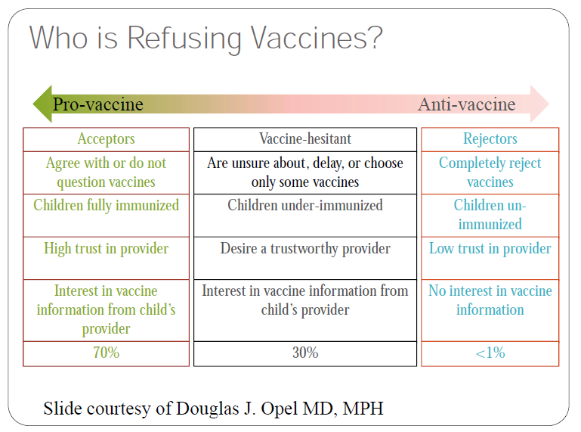

Slide 32
Bilangan Penolakan Imunisasi (Malaysia) 2013-2016
KKM

Slide 34
Myths employed by anti vaccine movement
Too many, too early in infancy
“bad things “ are in vaccines
Vaccines are linked to autism

Slide 35
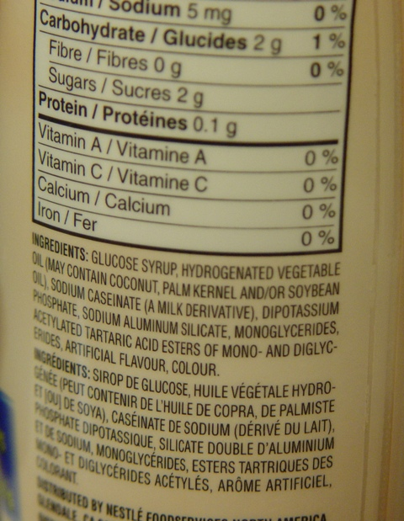
Myth : “bad things in vaccine”
1. Aluminium → Concern regarding toxic build up in the body
By 6 months of age
Vaccines 4mg
Breast milk 10mg
Infant formula 30 mg
Soy formula 120mg

Slide 36
Mercury
Thimerosal → linked to neurological damage/autism
Ethylmercury not methylmercury
has been taken out of vaccines as a precaution

Slide 37
Other concerns : Religious Reasons
KKM and JAKIM has certified that vaccines are permissible for the use of Muslims
More information regarding religious aspects of vaccination - www.e-fatwa.gov.my

Slide 38
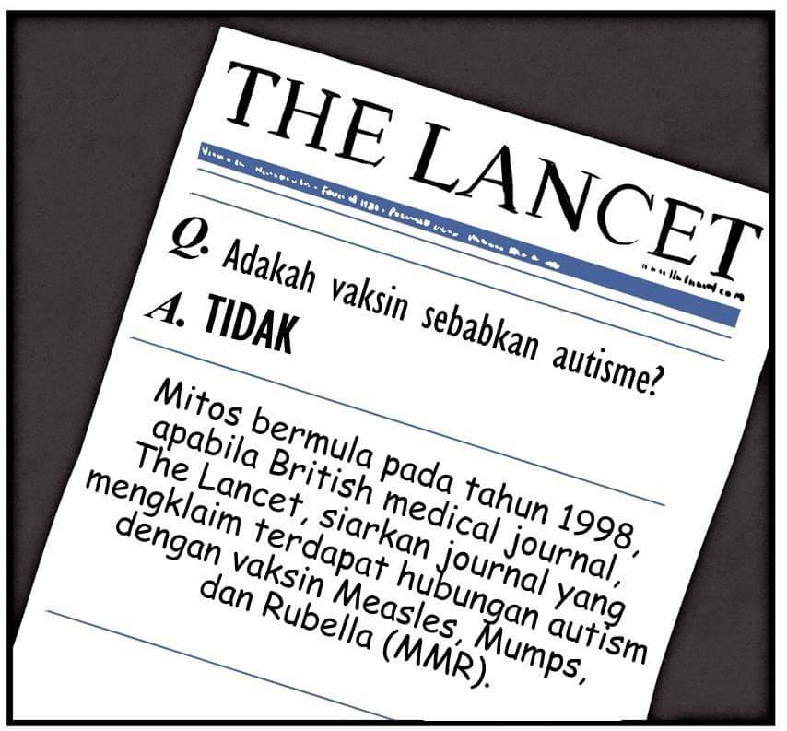
Myth : MMR vaccine causes Autism
Postulated by Andrew Wakefield –linked 12 children
Fraudulent paper was published →disproved
Many large well designed RCT were conducted →NO LINK WITH AUTISM

Slide 39
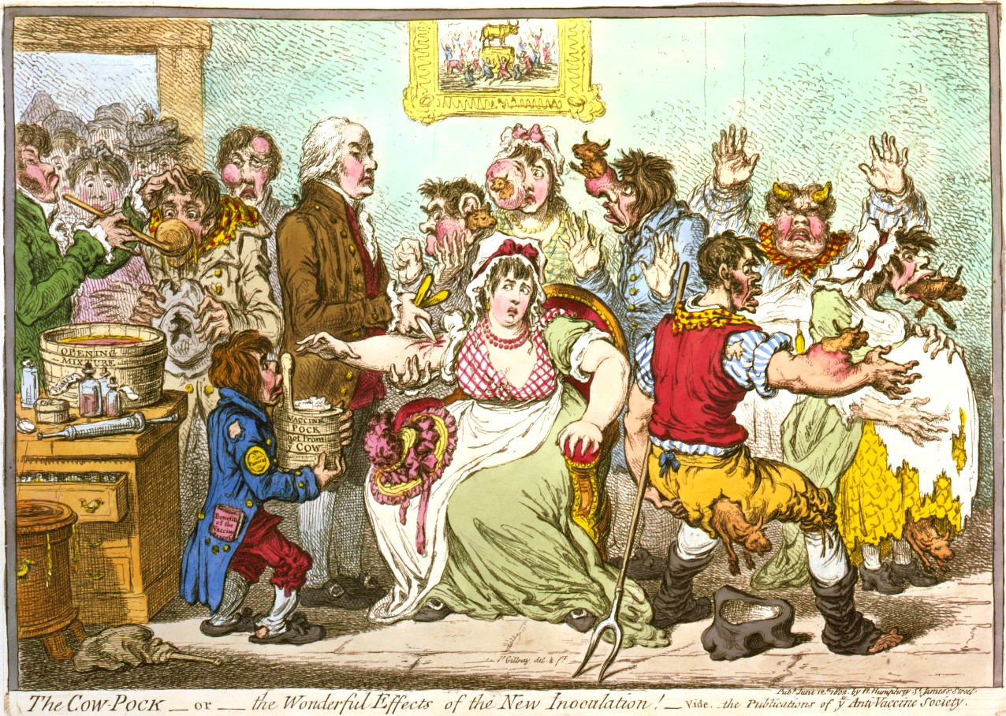
Caricatured a scene at the Smallpox and Inoculation Hospital at St. Pancras, London

Slide 40
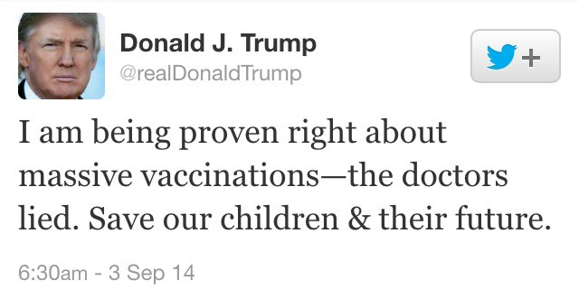
Twitter

Slide 41
DTaP vaccine side-effects
Mild Problems (Common) 1:4
  Fever
  Redness or swelling
  Soreness or tenderness
  Fussiness
Moderate Problems (Uncommon)
  Seizure (jerking or staring) (about 1 child out of 14,000)
  Non-stop crying, for 3 hours or more (up to about 1 child out of 1,000)
  High fever, over 105°F (about 1 child out of 16,000)
Severe Problems (Very Rare)
Serious allergic reaction (less than 1 out of a million doses)
Several other severe problems have been reported after DTaP vaccine. These include:
  Long-term seizures, coma, or lowered consciousness
  Permanent brain damage.
These are so rare it is hard to tell if they are caused by the vaccine
http://www.nhs.uk/Conditions/vaccinations/Pages/5-in-1-vaccine-side-effects.aspx
https://www.cdc.gov/vaccines/vac-gen/side-effects.htm

Slide 42
National Immunization Technical Committee
Pharmacovigilance Program on the Safety of Vaccines
adverse events following immunization
Vaccine Adverse Event Reporting System(VAERS)
allow reporting by general public on vaccine adverse events
allowing public to access the data as VAERS – build trust

Slide 43
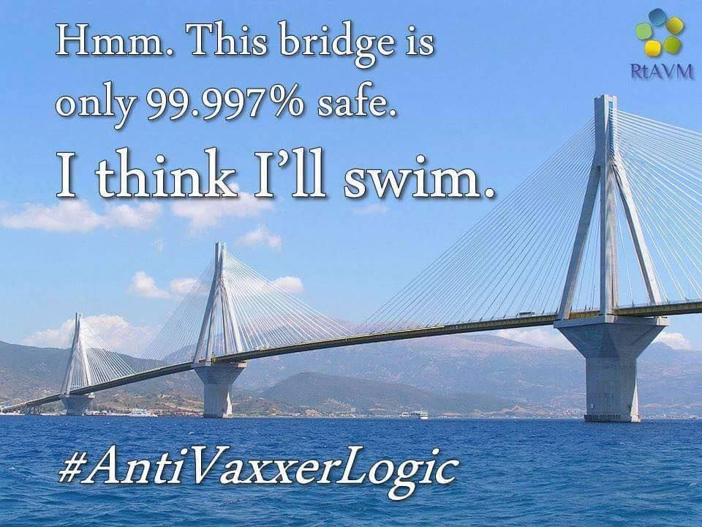
Anti vaccine movement

Slide 44
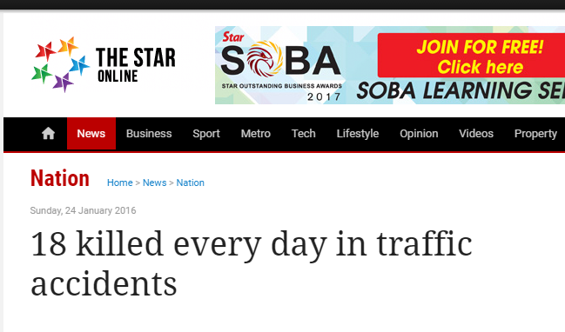
MIROS -RTA Statistics Data
6017 deaths
16 daily
21.5 per 100,000 population

Slide 45
MIROS -RTA Statistics Data
6017 deaths
16 daily
21.5 per 100,000 population
4120 serious injuries
11.3 per day
13.3 per 100,000 population

Slide 46
Solutions
Equip with knowledge
Educate
Use social Media
Engage religious leaders

Slide 47
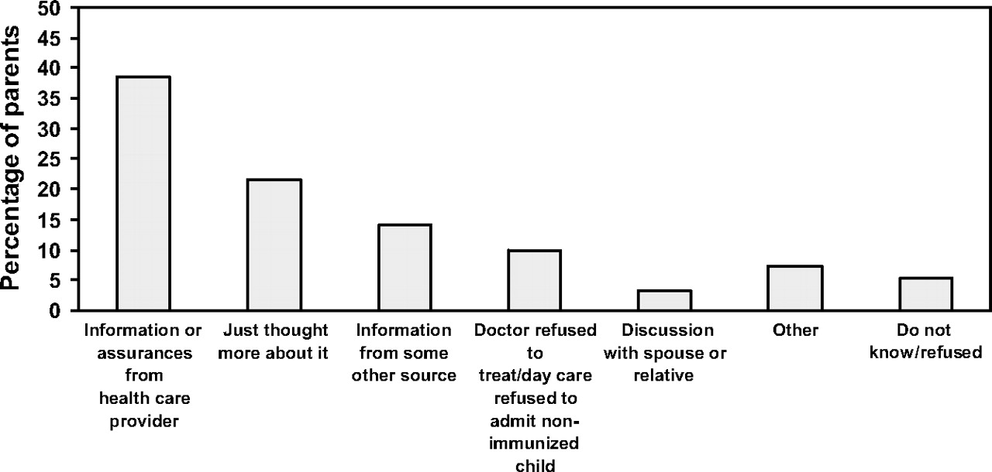
Why Parents Who Planned To Delay/Refuse Vaccine Changed Their Minds
Gust et al Pediatr 2009;122:718
Notes:
It is important to note that parents trust their doctors more than any other source. Doctors need to be able to discuss vaccine safety concerns and provide accurate information.

Slide 48
Use “stories” rather than theories parental intent to vaccinate-
Focus on those diseases that are still seen and they can understand, and tell stories about children who did not get vaccines.
Presenting information on disease risk
Dramatic Personal accounts
Pictures of children with disease
Correcting autism misinformation

Slide 50
Issues and solutions
Public/Parents
  Vaccine rejection and hesitancy
  Knowledge and motivation
  trust
Pharma
  Development and research Cost
  Supply
  Future vaccines
  Combination vaccine
Immunisation program issues
  Defaulters
  Coverage
  Cost

Slide 52
Passive defaulters
Children with incomplete immunisations-(3%) often access to services is issue-”passive defaulters”
  Younger mothers
  lone parents
  larger families
  baby had a least one hospital admission

Slide 53
MCV1 coverage by districts in Malaysia
MCV1 coverage | 2008 |  | 2009 |  | 2010 |  | 2011
 | n | % | n | % | n | % | n | %
≥95% | 94 | 67.7 | 72 | 51.8 | 70 | 49.6 | 72 | 51.1
90 - <95% | 23 | 16.5 | 19 | 13.7 | 19 | 13.5 | 19 | 13.5
80 – <90% | 19 | 13.7 | 26 | 18.7 | 29 | 20.6 | 24 | 17.0
50 - <80% | 2 | 1.4 | 22 | 15.8 | 23 | 16.3 | 25 | 17.7
<50% | 1 | 0.7 | 0 | 0 | 0 | 0 | 1 | 0.7
Total districts | 139 | 100 | 139 | 100 | 141 | 100 | 141 | 100
KKM

Slide 54
Opportunistic Immunisation
always ask for immunisation history
check Home based records
offer convenient location and timing
  Private – Public partnership
employ reminder

Slide 55
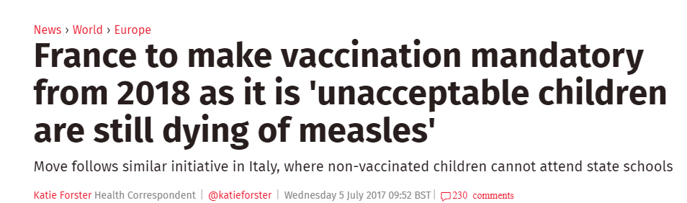

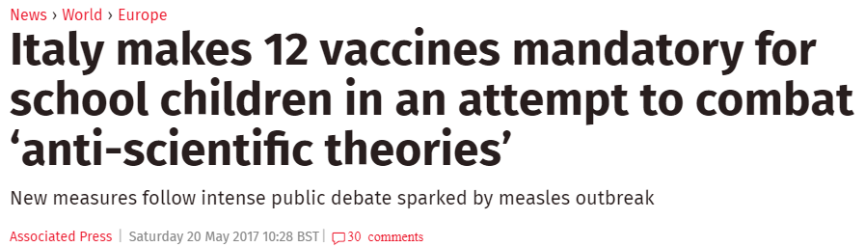
Legal enforcement

Slide 56
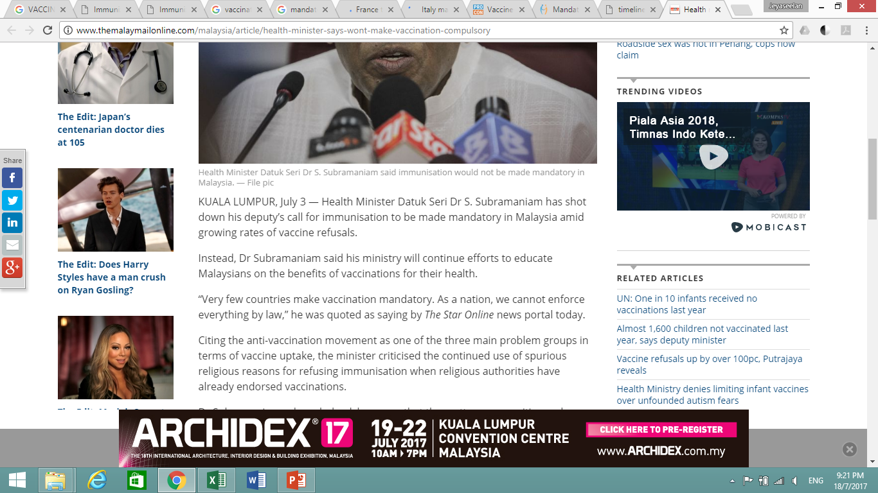
Enforcement
Australia - ‘No Jab No Pay’ and other immunisation measures
every state in the United States requires children to be vaccinated before attending school
www.themalaymailonline.com

Slide 57
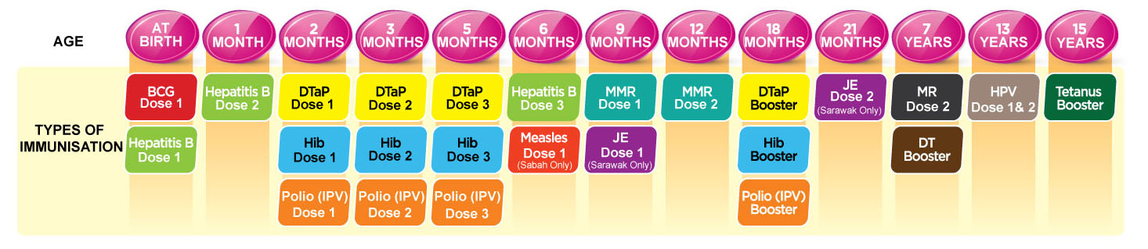
Cost
EIP Number of vaccination has increased
Additional vaccine need good surveillance and research
  pneumococcal, rotavirus

Slide 58
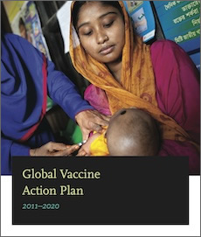
The Global Vaccine Action Plan (GVAP) ― endorsed by the 194 Member States of the World Health Assembly in May 2012 ― is a framework to prevent millions of deaths by 2020 through more equitable access to existing vaccines for people in all communities.
Target free of vaccine preventable disease by 2020

Slide 59
Issues
Public/Parents
  Vaccine rejection and hesitancy
  Knowledge and motivation
  trust
Pharma/Vaccine research
  Cost
  Supply
  Novel administration
  Future vaccines
  Combination vaccine
Immunisation program issues
  Defaulters
  Catch up immunisation
  Coverage
  Cost

Slide 60
Cost
Research and manufacturing
New vaccine – 500million USD
Vaccines in pipeline – no guarantee of success
Undertaken only by large pharma
Need new vaccines – HIV, Malaria, TB
Private – Public partnership
  IVI Seoul
  GAVI
  Initiative for Vaccine Research

Slide 61
Future vaccines - Vaccine research
HIV - Immunology
Many vaccines in the pipeline
  HIV, Malaria, TB
Research funding
  Public – Private partnership
  WHO’s Initiative for Vaccine Research (IVR)
  International Vaccine Institute (IVI)
  GAVI

Slide 62
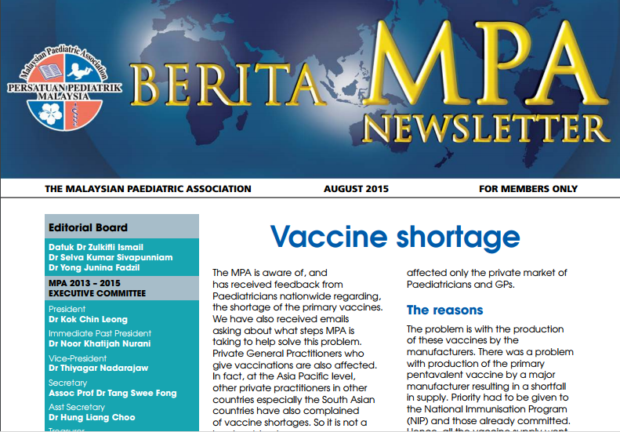

Slide 63
Vaccine Security
Sensitive supply chain - small number of manufactures
Purchasing has become complex
Divergent needs of developed vs developing countries
Some manufactures have stopped cheaper vaccine
Competition among pharma
Stockpile vaccines
UNICEF
  help support middle-income countries with their procurement
  efficient health supply chains
https://www.unicef.org/supply/index_vaccine_security.html

Slide 64
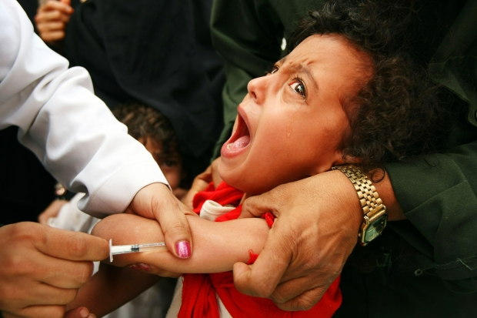
Novel Administration

Slide 65
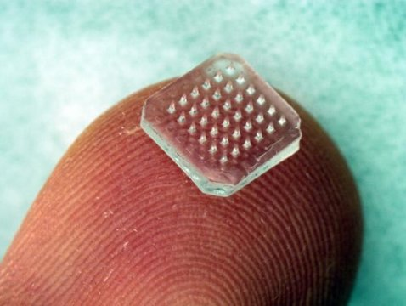
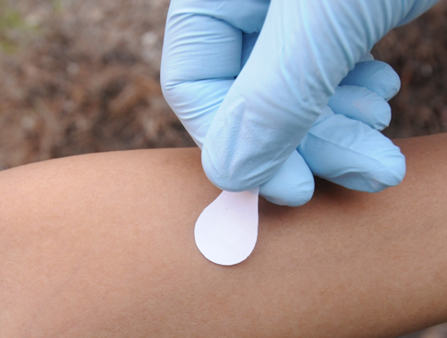
Microneedle Patch Vaccination
Skin patch
Dissolves
Heat stable – cold chain required
Minimal training
Self administered
Georgia Institute of Technology and the Centers for Disease Control and Prevention (CDC)

Slide 66
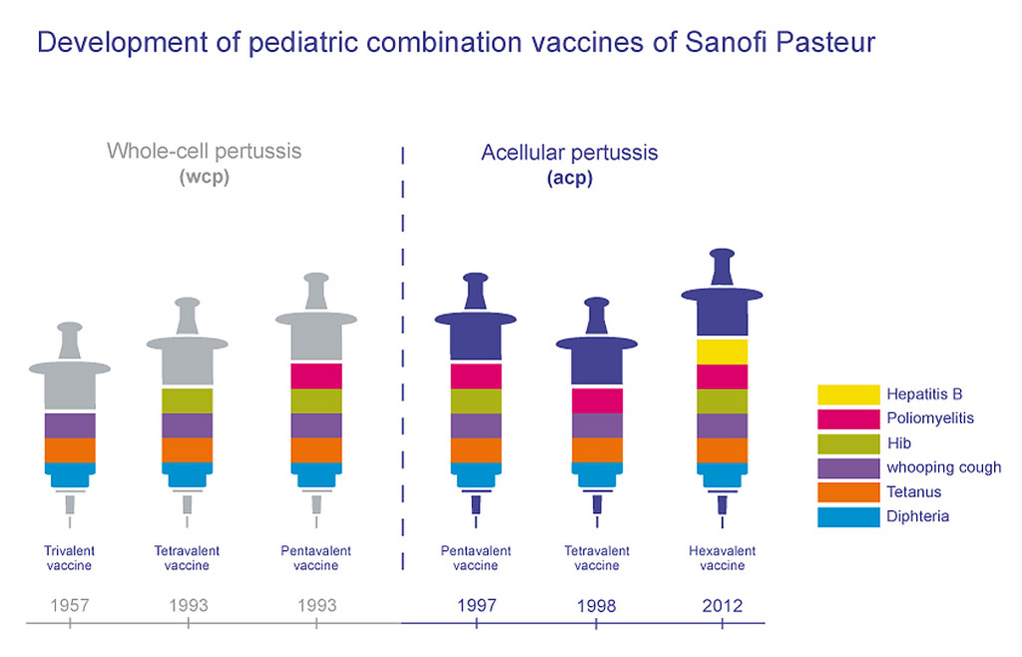

Slide 68
Adult Vaccination
Vaccine preventable disease
shift to adults
  Chickenpox
pertussis vaccination
  Cocoon
flu vaccination
needs good surveillance
booster vaccination required

Slide 69
Summary
Motivation is decreasing as vaccination programs become successful
Malaysia overall rates are high but have pockets of inadequate rates
Increased efficiency to manage defaulters
Need to engage the leaders who can influence vaccine refusers
Promote research for new vaccines and methods of administration
Surveillance - are we winning or moving to another battle ground

Slide 70
Thank You
Acknowledgement
Dr Haema Shunmugam
Dr Maldano YA
Dr Adliah Md Soid

