Slide 1
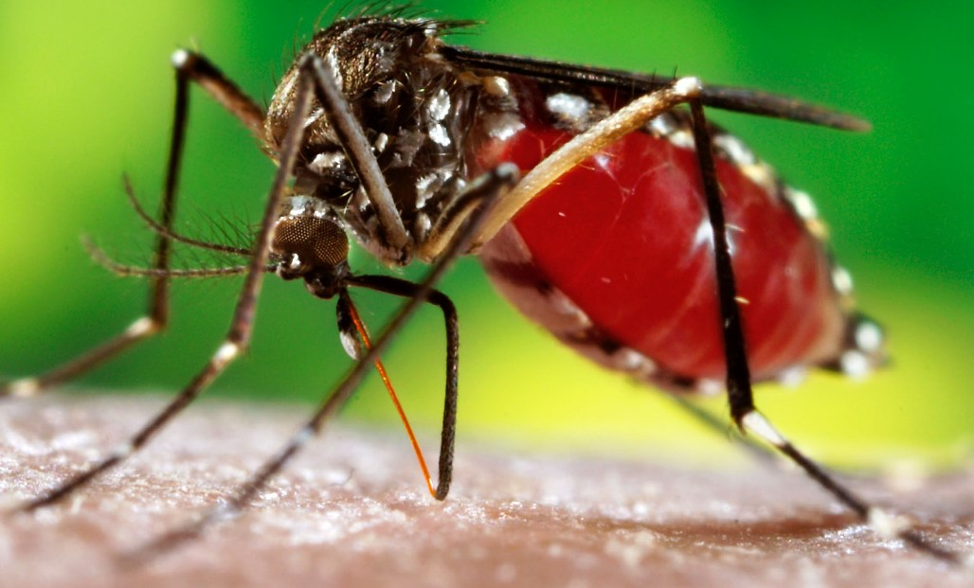
Dengue Issues & Challenges
Dr. Thiruchelvam Mathiarasu
Assistant Director UD54
Vector Borne Disease Control Unit
Perak State Health Department

Slide 3
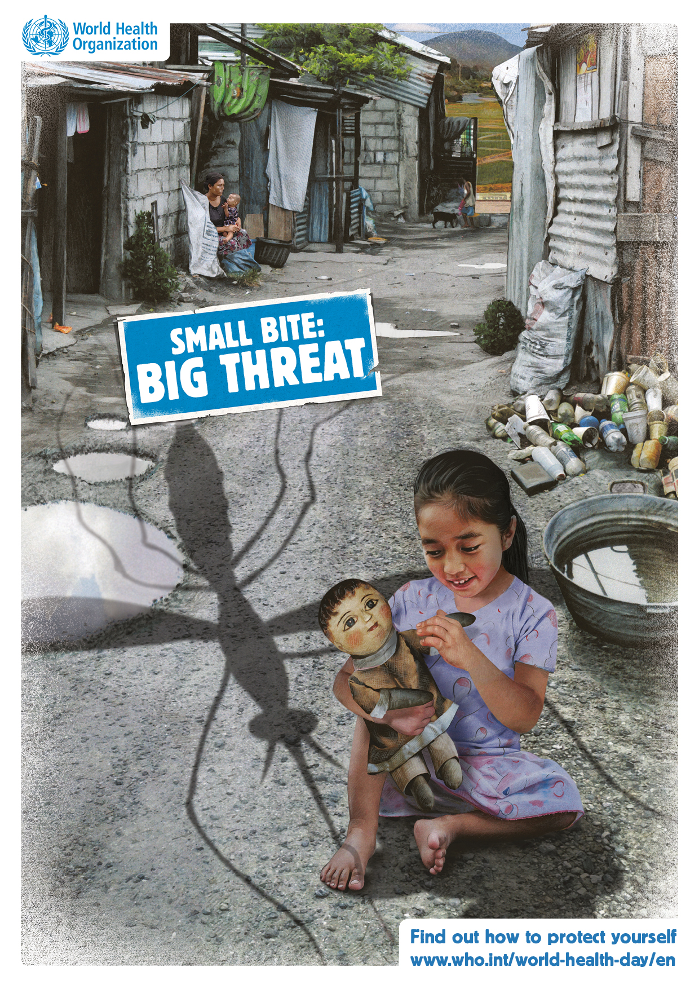

Slide 4
Global Dengue Situation
1950 - 1000 case/year
2015 - 3 million cases/ year
128 Countries reporting outbreaks
4 billion people at risk of infection
Estimated about 300 million people are infected with dengue virus annually ( Bhatt et al, 2013)
Source : WHO

Slide 5
Source : WHO

Slide 6
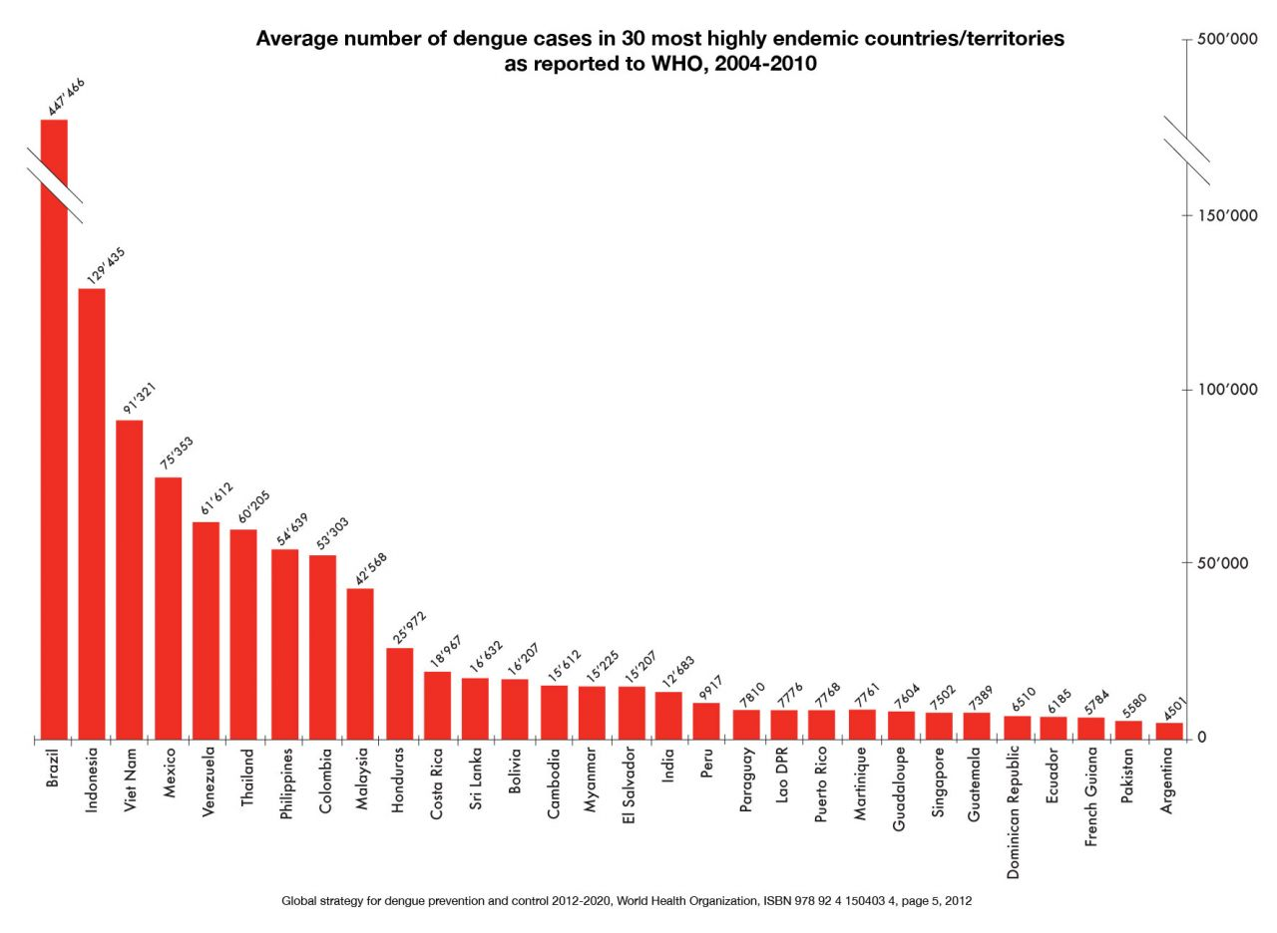
Source : WHO

Slide 7
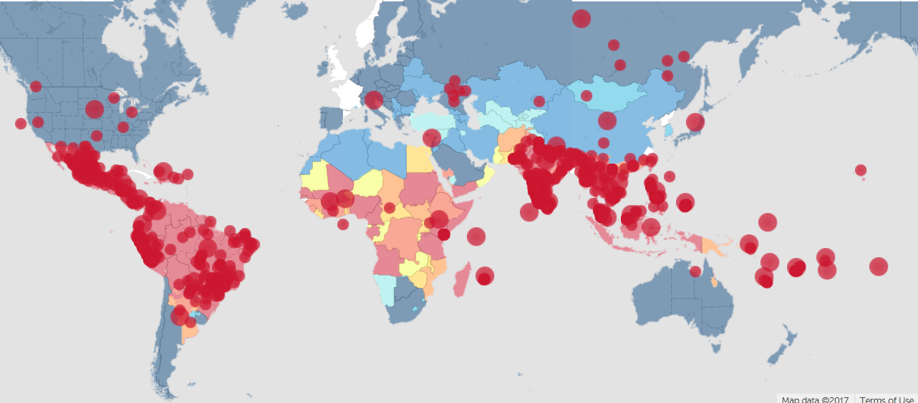
Outbreaks Reported in the Last 3 months
Source- www.healthmap.org

Slide 8
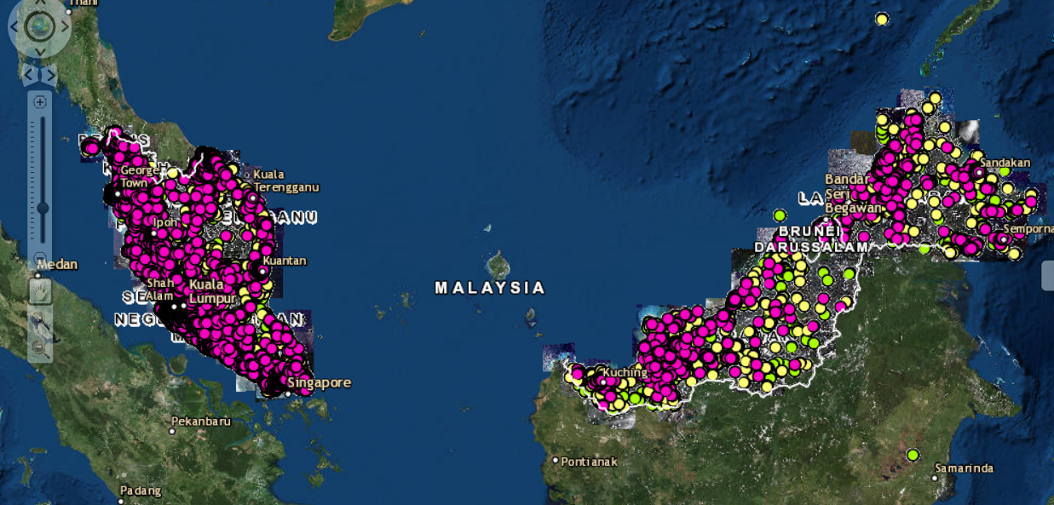
Dengue Case Mapping in Malaysia (2015-2017)
Source : SPWD idengue

Slide 9
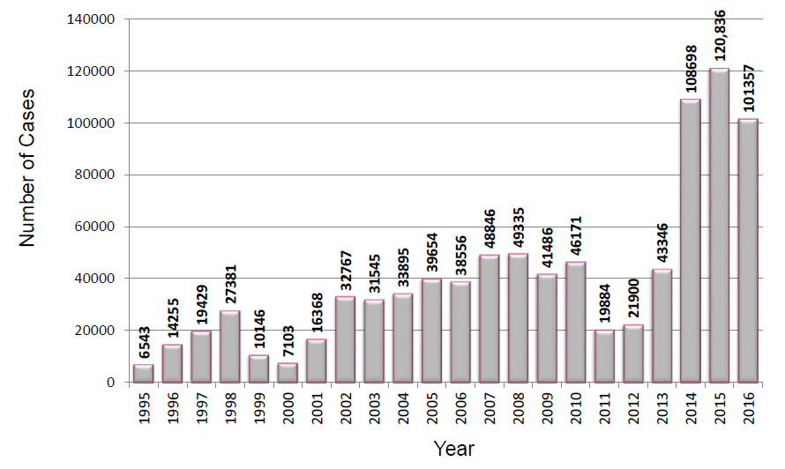
Trend Of Dengue Cases in Malaysia 1995-2016
Source : idengue

Slide 10
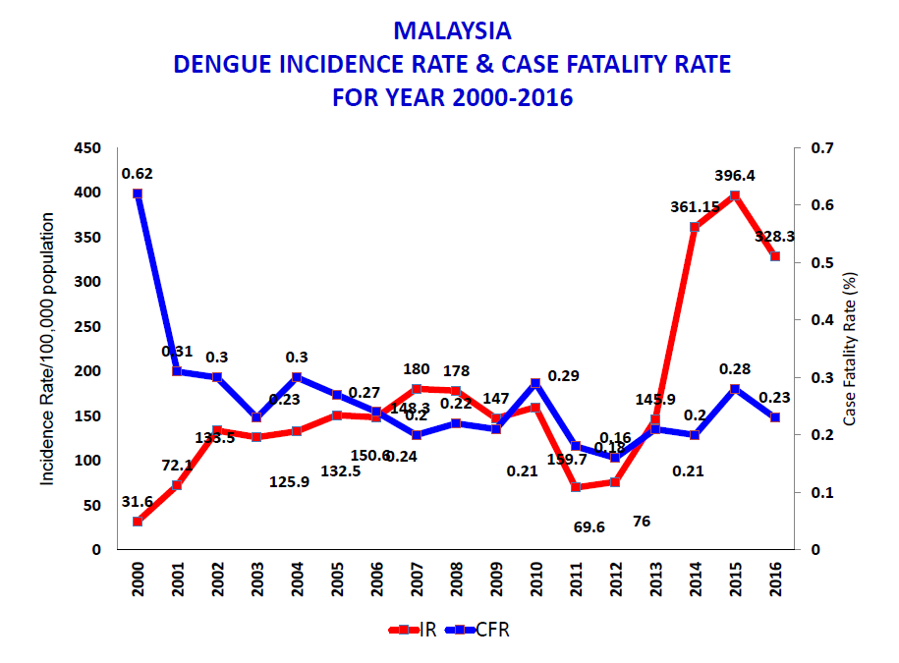
Dengue Incidence Rate & Mortality Rates in Malaysia from year 2000-2016
Source : idengue

Slide 11
Trend of Dengue Deaths in Malaysia from 1995-2016
Source : idengue

Slide 12
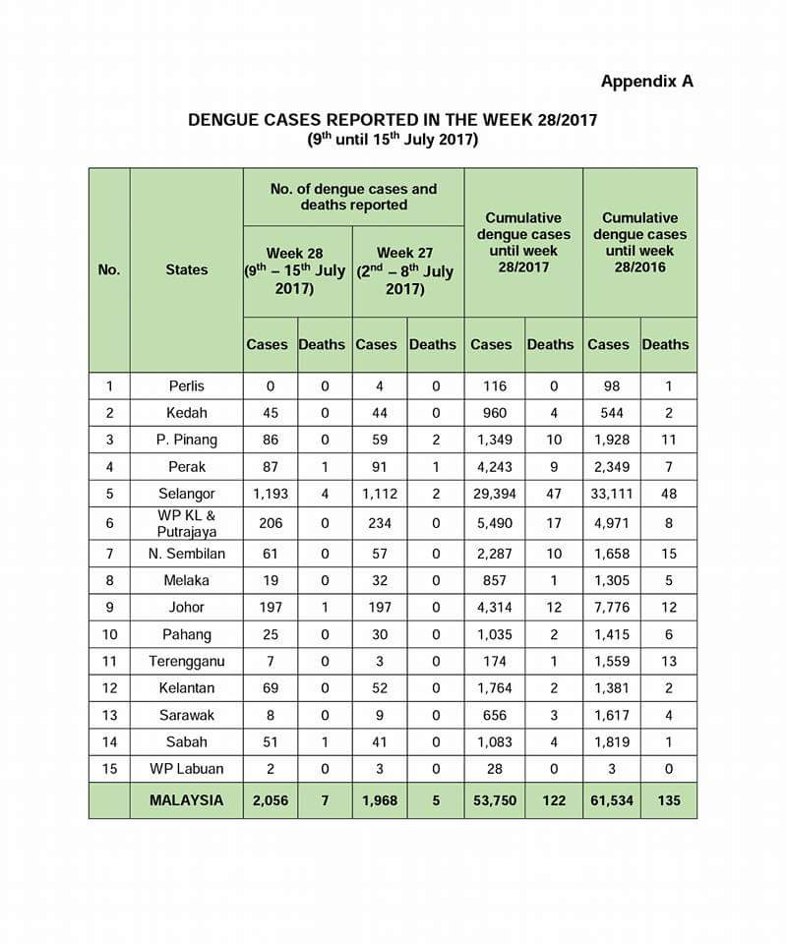
Dengue Cases By State In Malaysia 2017 (Data till 15.07.2017)
Source: Facebook CPRC MOH Malaysia

Slide 13
Dengue Cases & Mortality Rates in Perak from 2006-2017 (Till 15 July 2017)

Slide 14
Trend Of Weekly Dengue Cases In Perak From 2012-2017 compared to 5 year median cases
Source : Perak State Health Department

Slide 15
Dengue cases By District in Perak till EW 28 2017 compared to same period 2016
District | 2016 | 2017 | % of change from 2016 | Deaths
Kinta | 1296 | 2629 | 102.9 | 2
Manjung | 284 | 177 | -37.7 | 0
Hilir Perak | 126 | 97 | -23.0 | 0
Kuala Kangsar | 114 | 205 | 79.8 | 2
Batang Padang | 117 | 178 | 52.1 | 0
LMS | 129 | 457 | 254.3 | 2
Kampar | 74 | 220 | 197.3 | 1
Perak Tengah | 33 | 70 | 112.1 | 0
Kerian | 75 | 59 | -21.3 | 1
Hulu Perak | 101 | 93 | -7.9 | 0
Muallim | 0 | 58 | 100.0 | 0
PERAK | 2349 | 4243 | 80.6 | 8
Source : Perak State Health Department

Slide 16
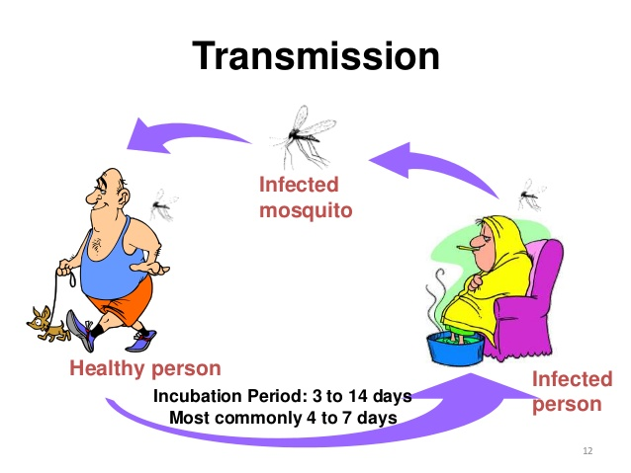
Transmission Of Dengue

Slide 17
How To Prevent Dengue?
Host (Human)
Vector
Agent
(Virus)
Environment

Slide 18
Break The Aedes Life Cycle

Slide 19
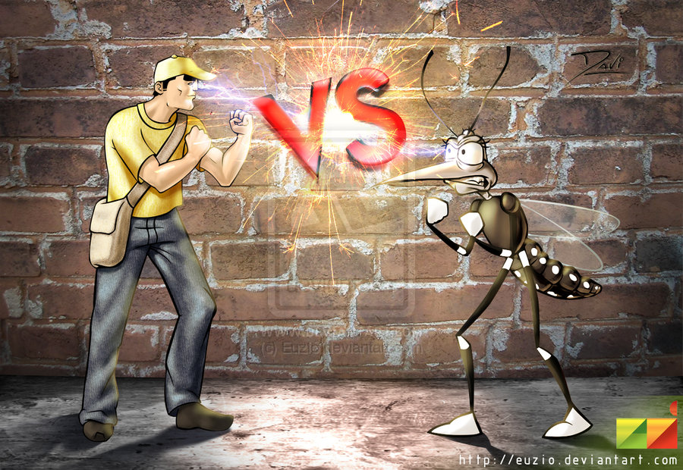
Issues & Challenges in Fighting Dengue?

Slide 20
Issues & Challenges
The Virus
The Aedes Mosquito
Our Climate & Environment
Inefficient Control & Prevention Measures
Burden on MOH & High Cost
Human Factor

Slide 21
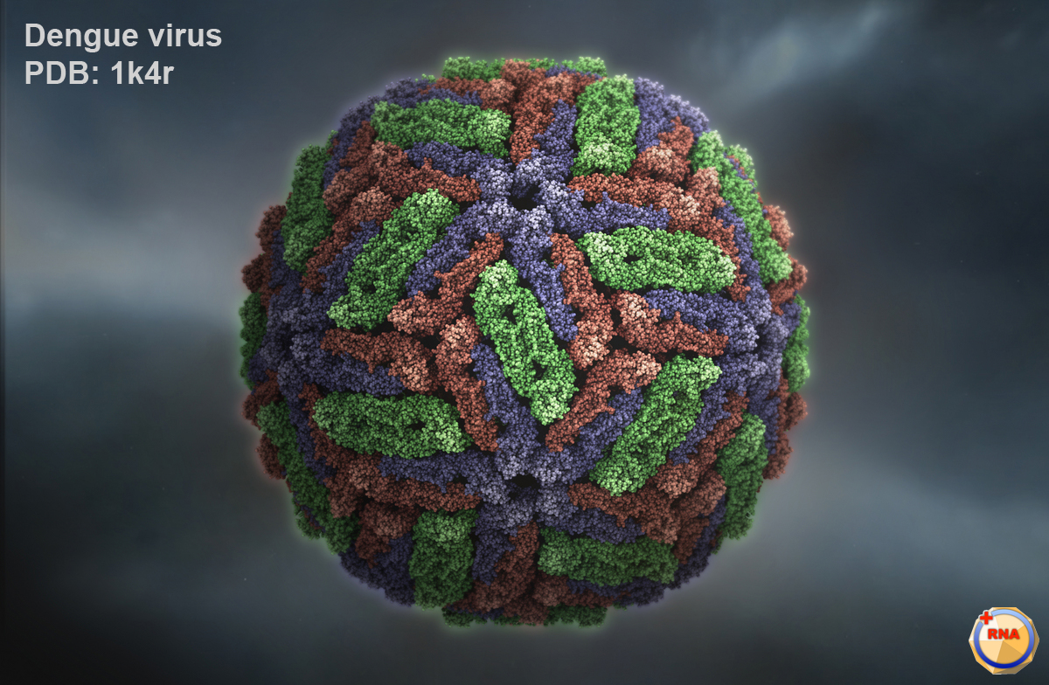
The Virus
4 serotypes
No Vaccine which is effective against all 4 serotypes
Serotype Shift
Serotype Mutation
No Antiviral Drug

Slide 22
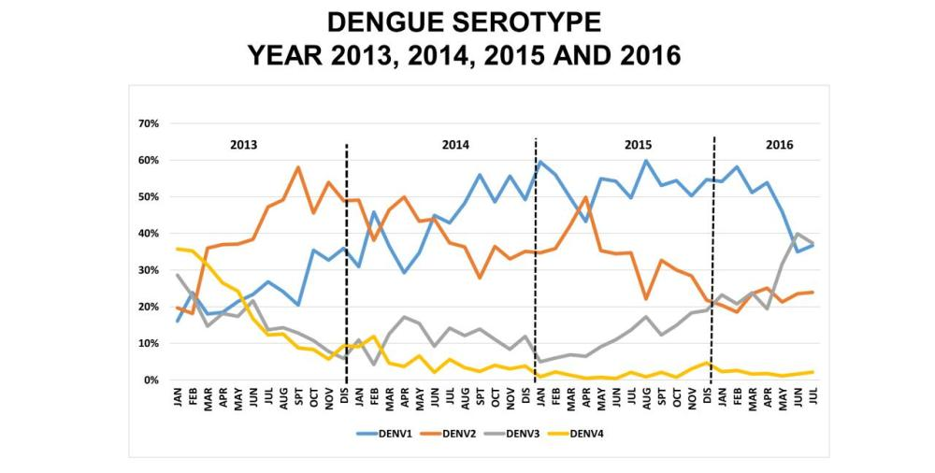
Source : CPRC MOH Malaysia
Sumber:http://kpkesihatan .com

Slide 23
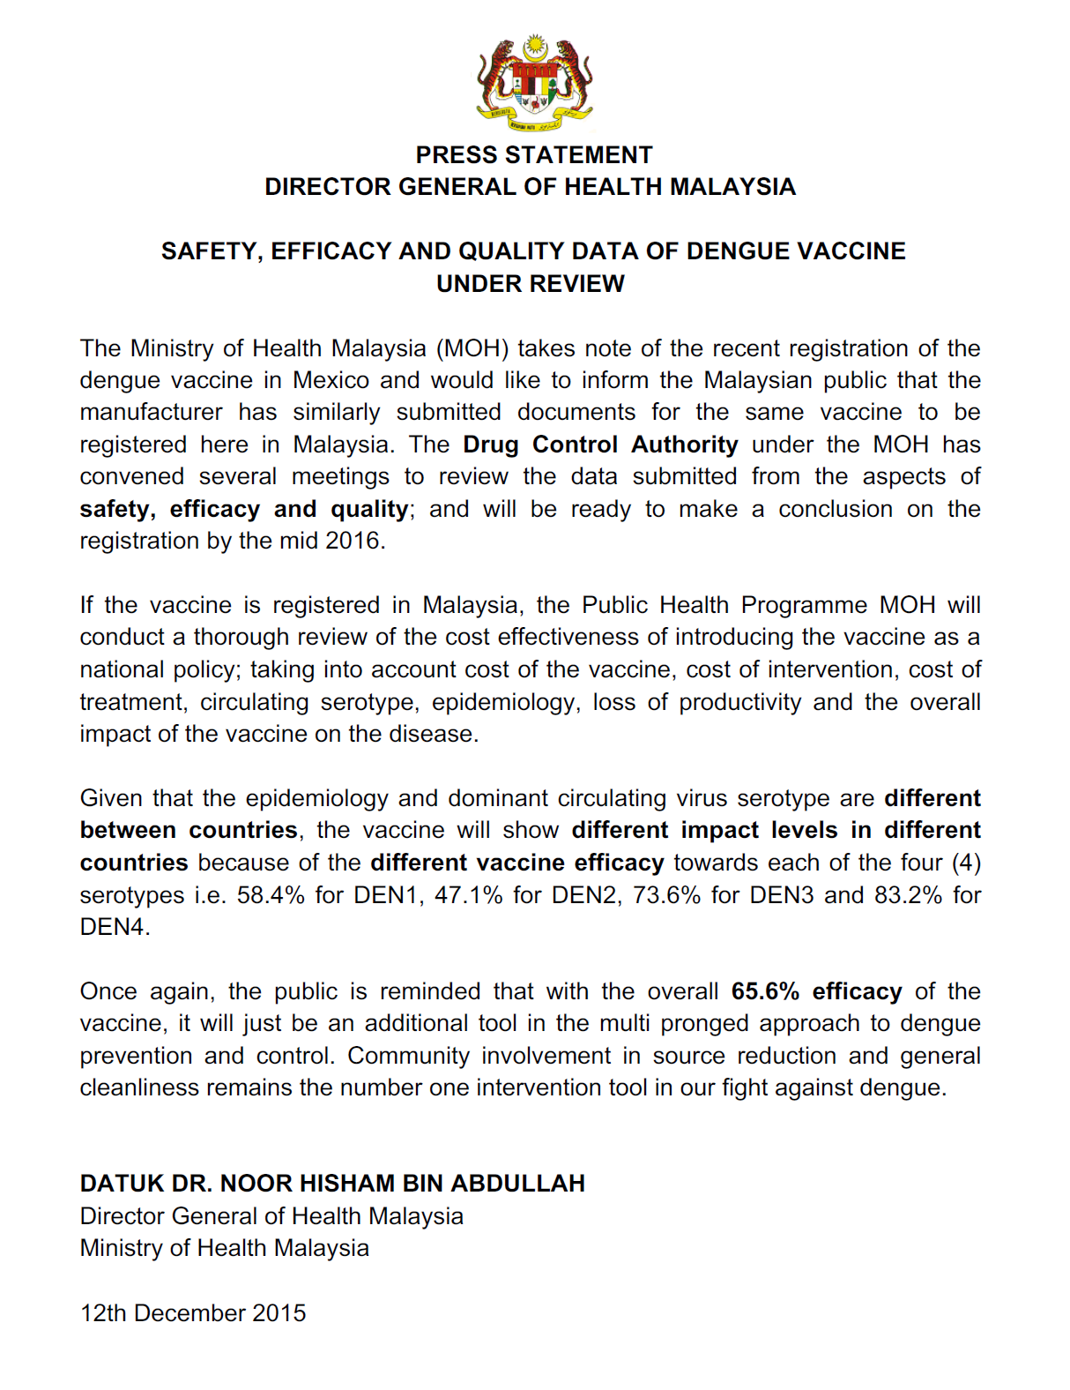

Slide 24
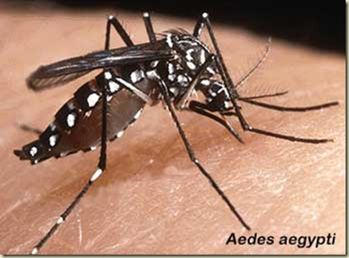
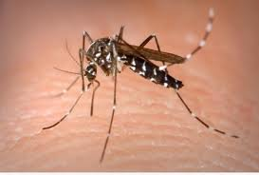
Vectors
Transmited by female AEDES mosquito bites
Usually aedes aegypti & aedes albopictus
Peak Biting period is during dawn (5.00-8.00am) & dusk ( 5.00-8.00pm)
Aedes albopictus

Slide 25
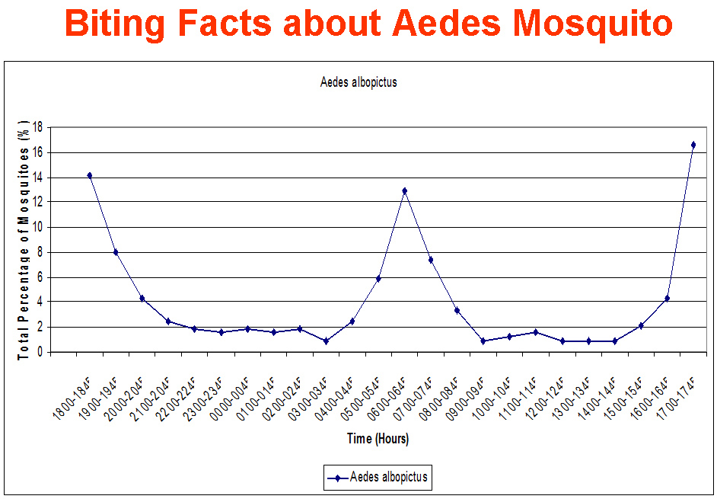

Slide 27
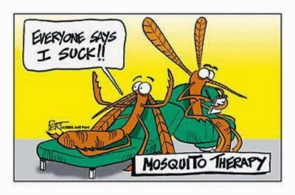

Slide 28
Super Efficient Vector
Aedes aegypti : primary vector, Aedes albopictus: secondary vector
Mosquito life cycle (7-10 days), eggs - 70 – 100 eggs/spawn, weather resistant up to 6 months,; Adults (♀ ~ 30 days, ♂ ~ 7 days)
Gonotrophic cycle – 3 days. Able to lay eggs 6 – 10 times/lifetime.
Transovarial transmission and infective lifelong
Immediately Infective when interrupted while biting dengue patient
Time of Active biting = Active period of humans

Slide 29
Climate & Environment
Hot & Humid condition whole year
Ideal breeding conditions for aedes
Abundant natural & man made breeding areas everywhere

Slide 30
Climate & Environment
Empty/ unmaintained lands
Poor Environment Cleanliness/ waste disposal
Cryptic Breeding Sites
Rapid Development & Urbanisation
High Rise Buildings/ residential areas
Building Structures / infrastructures Designs

Slide 31
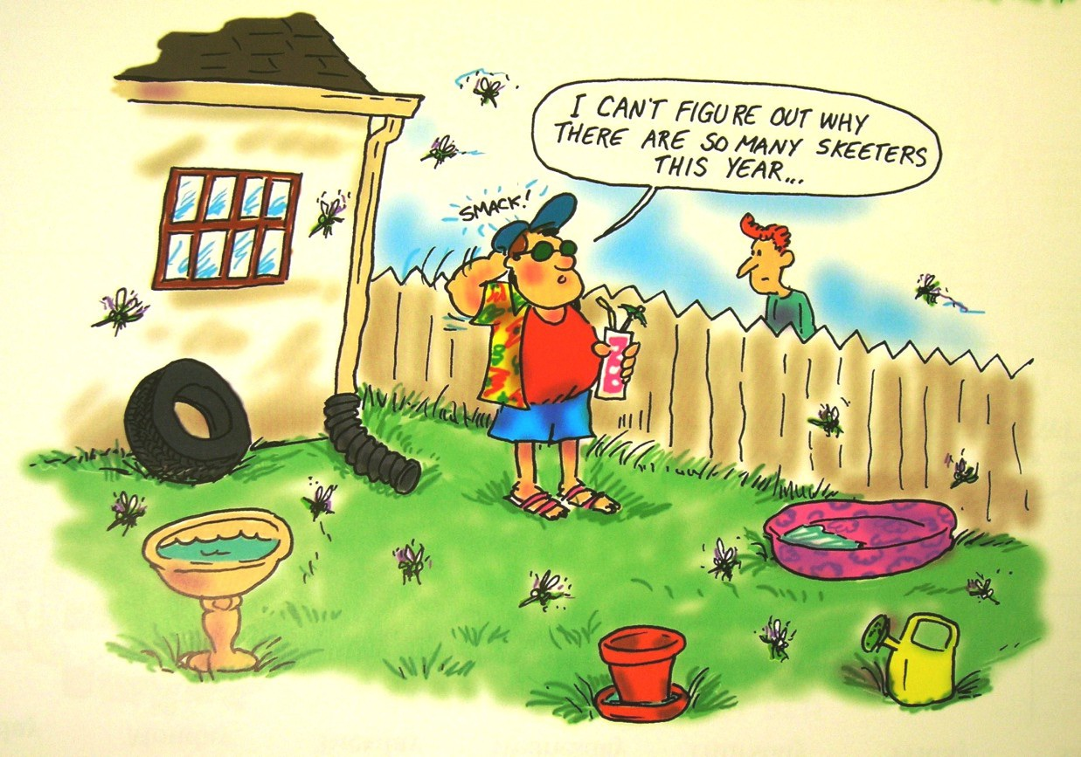

Slide 32
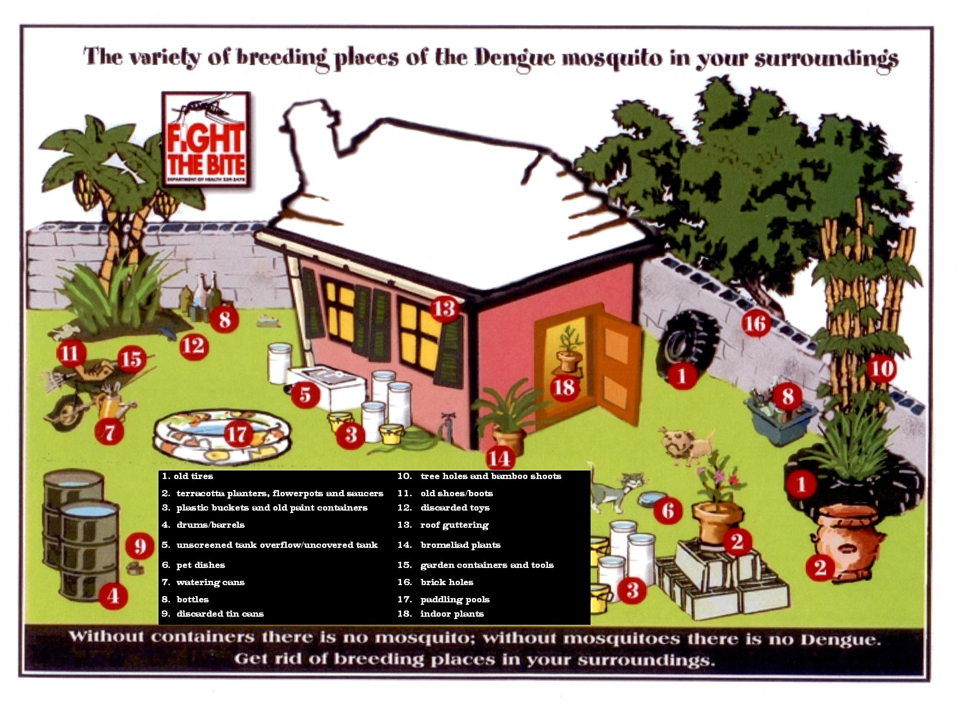

Slide 33
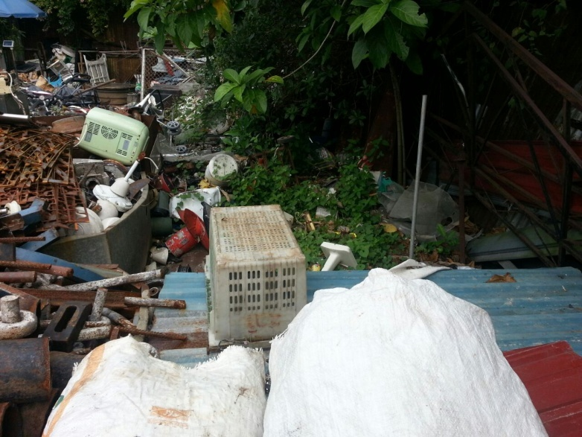
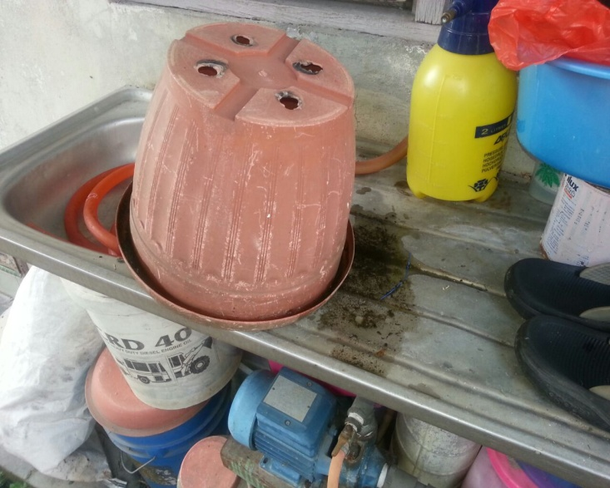
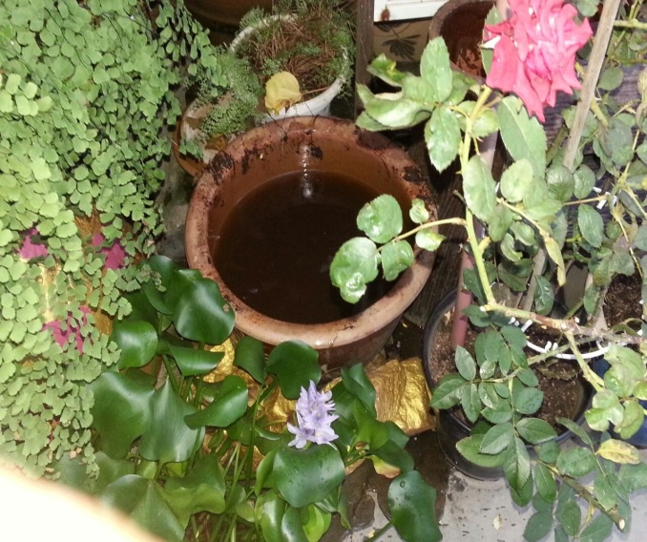
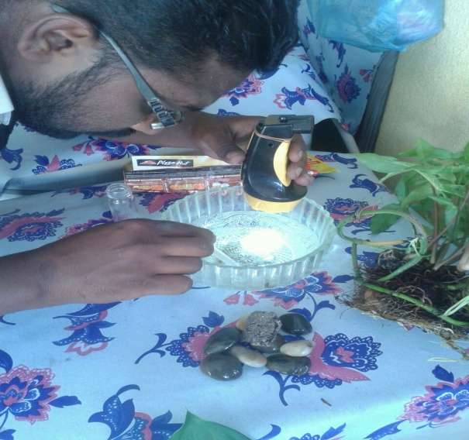
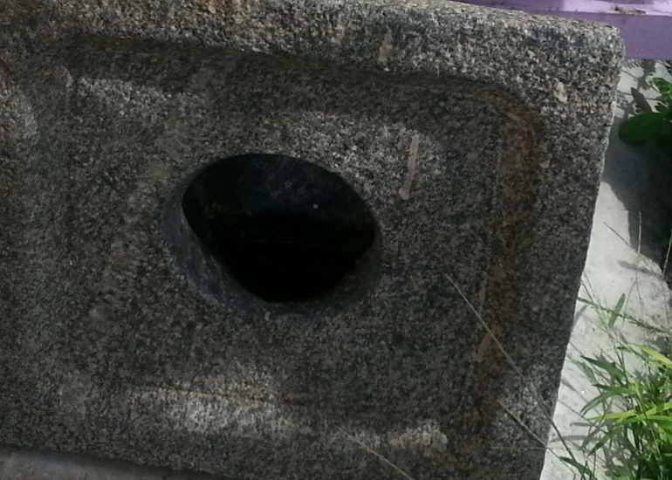
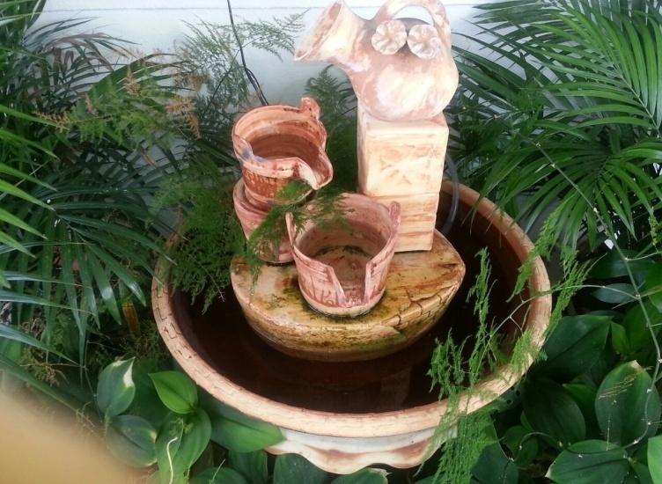
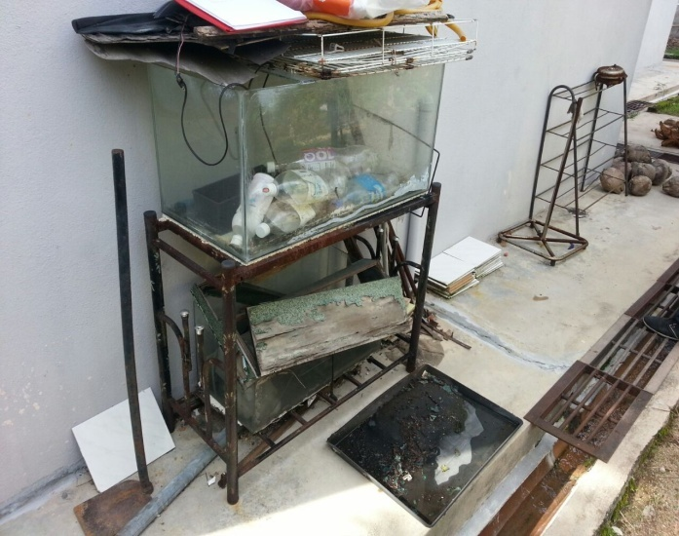

Slide 34
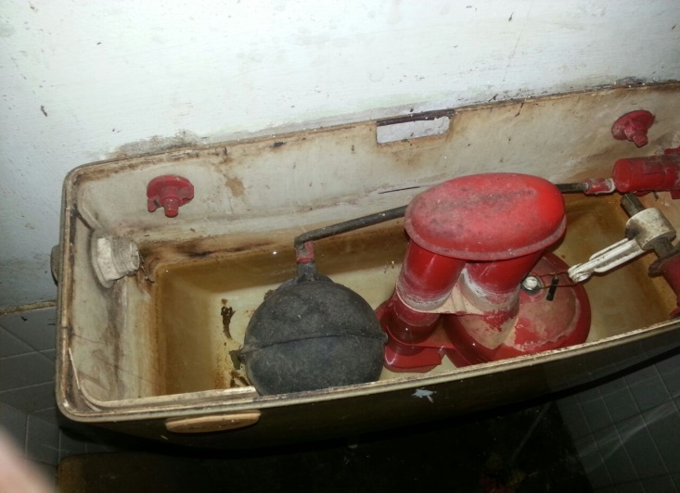
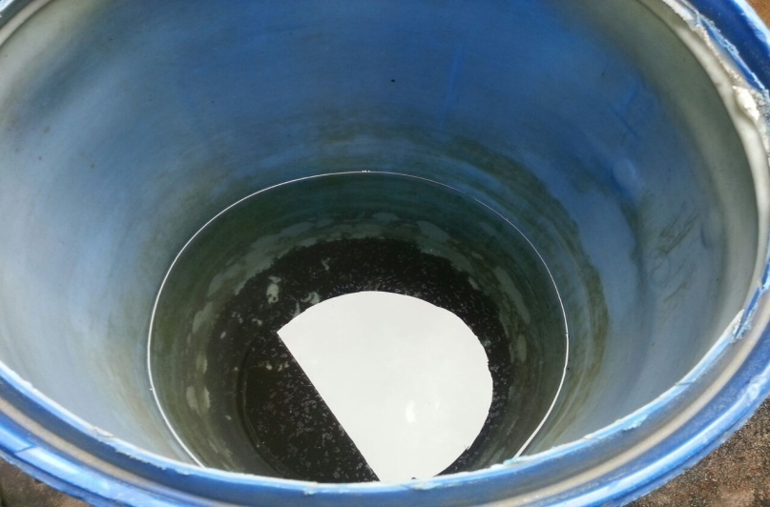
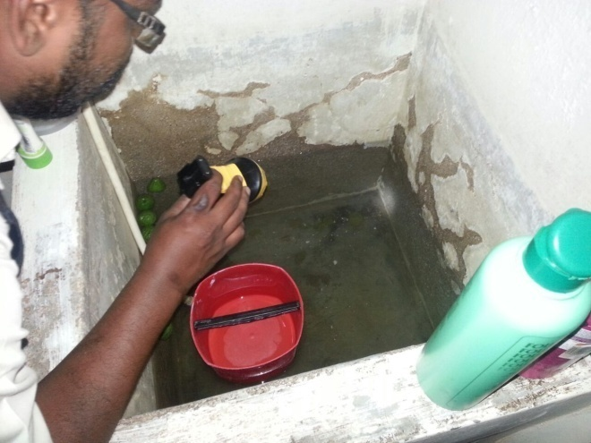
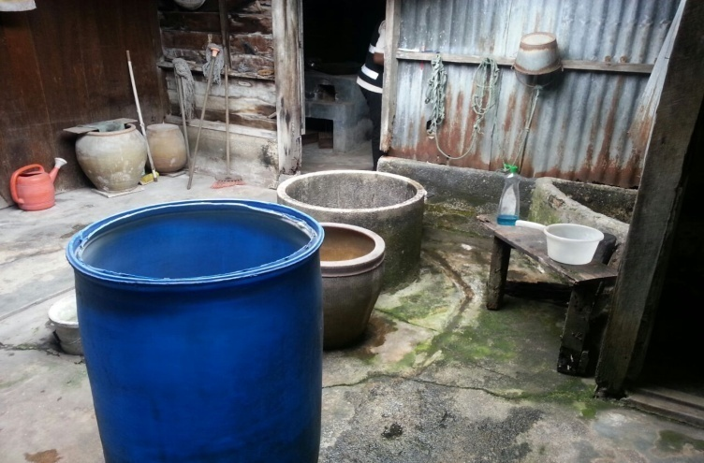
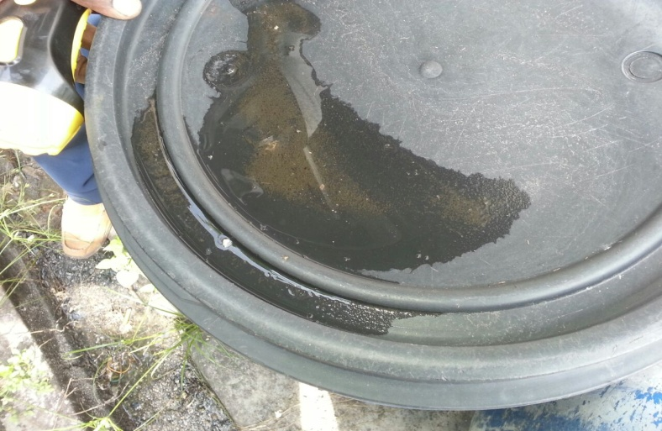
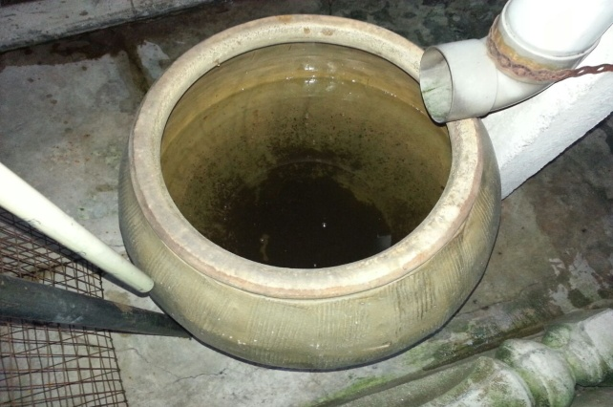
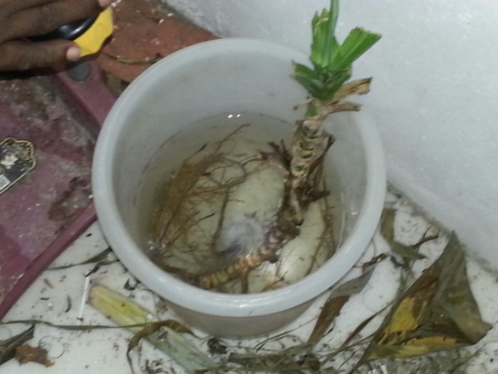
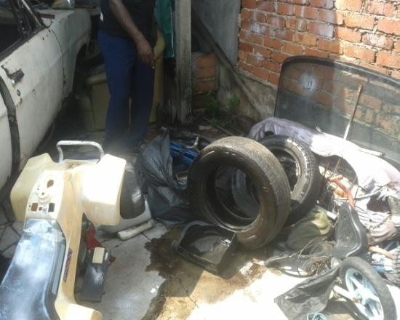
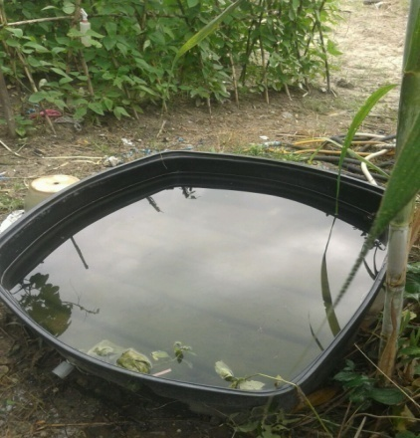

Slide 35
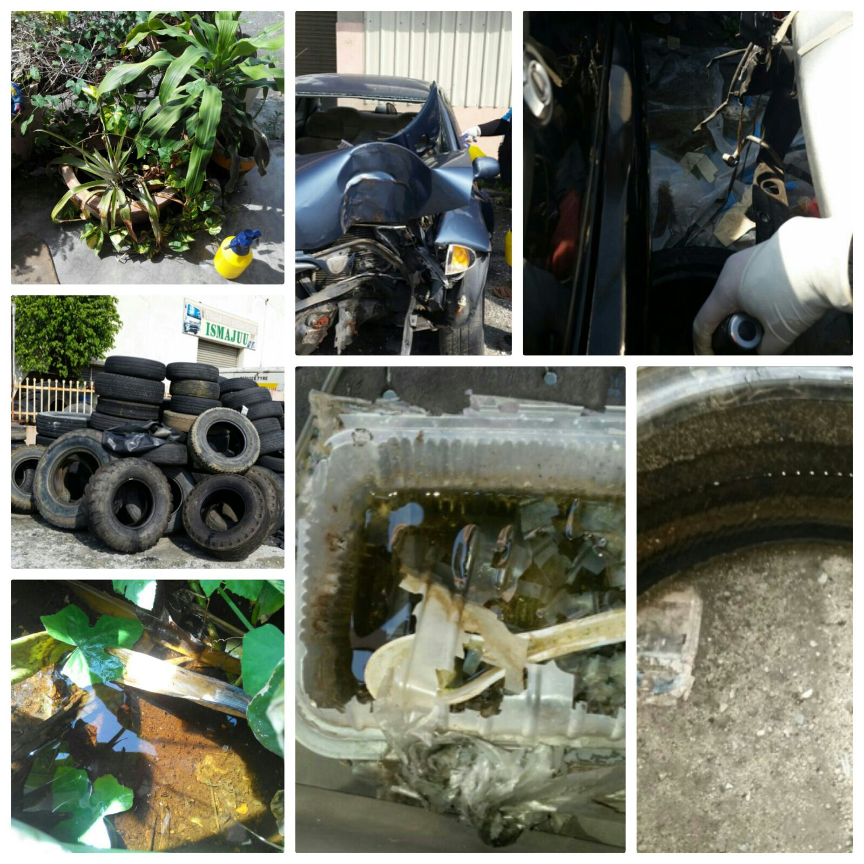

Slide 36
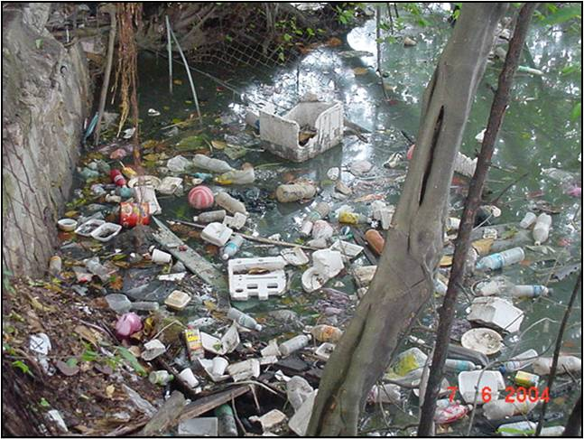

Slide 37
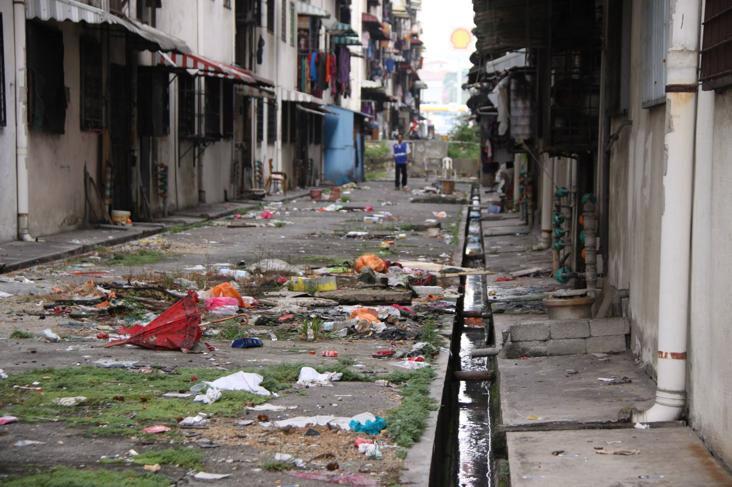

Slide 38
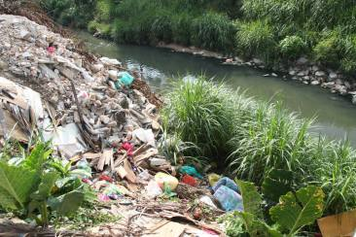
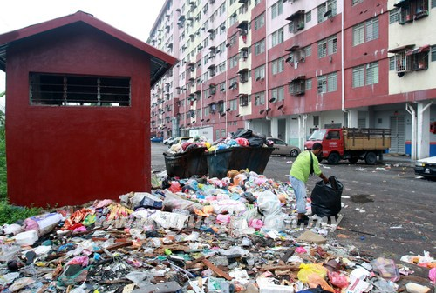
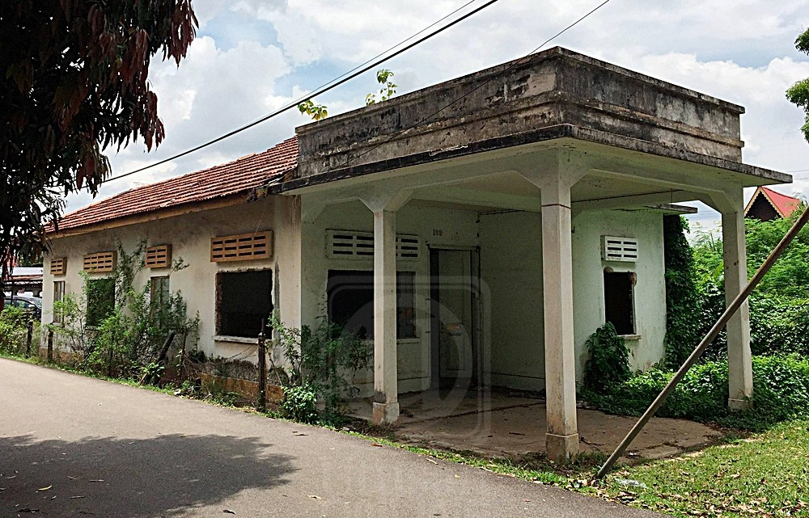

Slide 39
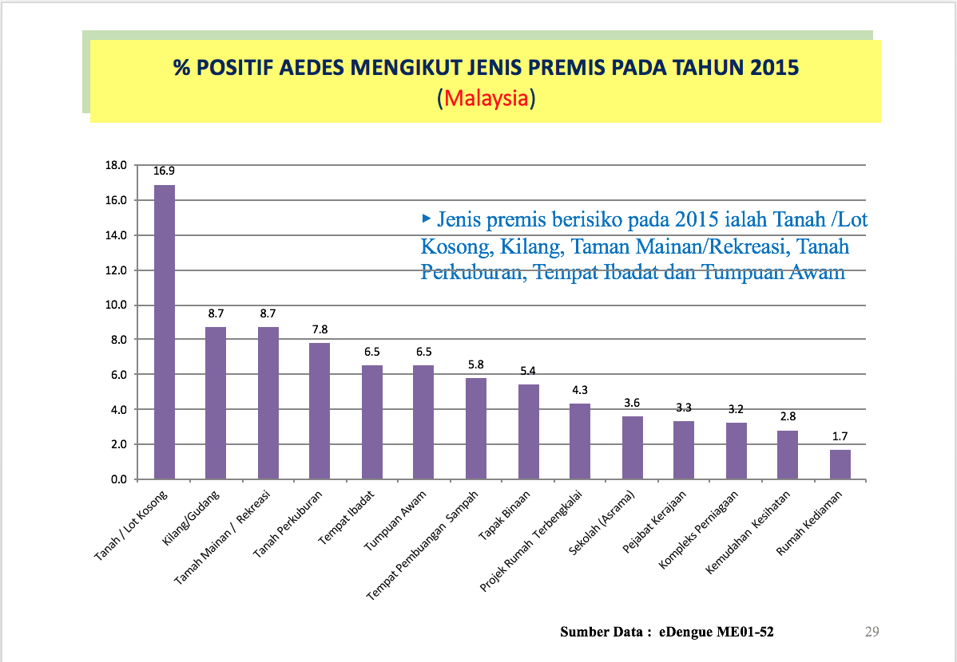
Aedes Index By Premis Inspected In Malaysia During 2015
Source:http://kpkesihatan .com

Slide 40
Aedes Index By Premis Inspected In Perak During 2016
Source : Perak State Health Department

Slide 41
Inefficient & Ineffective Control
Coverage of Aedes Inspection
Coverage of Fogging Activities
Inadequate Resources
Complicated & Ineffective Enforcement
Health education not reaching target groups

Slide 42
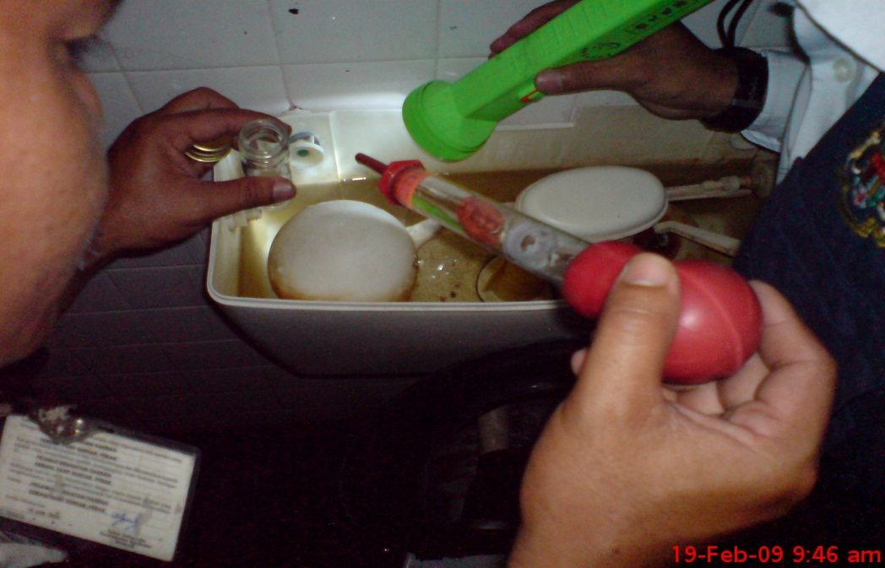
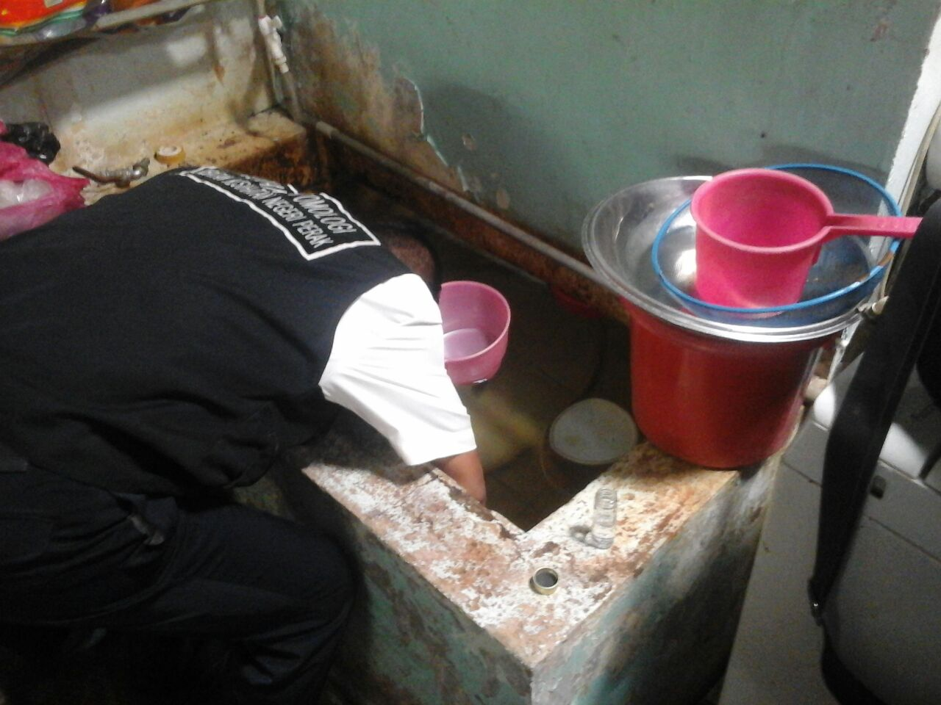
Aedes Premis Inspection

Slide 43
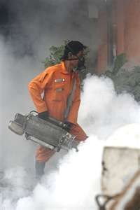
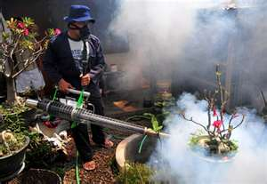
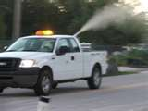
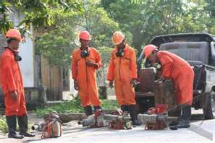
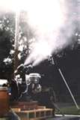
THERMAL FOGGING/ ULV

Slide 44
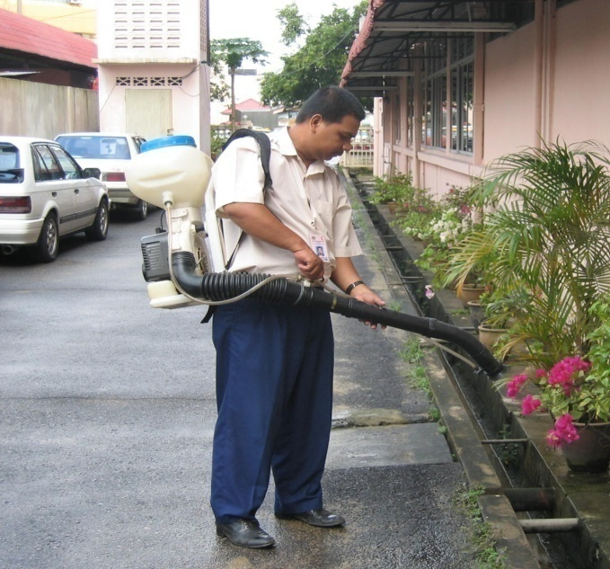
LARVICIDING AND OVITRAPS

Slide 45
Enforcement

Slide 46
Destruction Of Disease Bearing Insects Act 1975
Power To Issue Compound
Subsection 25.
Compound of max RM500 can be offered to any offender.
Failure to settle payment in stipulated time, charges will be filed in court.

Slide 47
Destruction Of Disease Bearing Insects Act 1975
General Penalties
Subsection 23.
1st Offence- Fine up to RM10,000 Or 2 Years Prison or Both
Repeat Offence – Fine up to RM 50,000 or 5 Year Prison or Both

Slide 48
Estimated Economic Burden Of Dengue Treatment, Control & Prevention
Treatment
Government - RM 1,181.64/ case
Private - RM 1,188.76/case
Prevention & Control
RM4,948.01/case
Source: MOH based on multiple data source, Shepard et al 2012, Packiersamy et al 2015

Slide 49
Estimated Economic Burden Of Dengue Treatment, Control & Prevention
2013 - RM308,201,800.24 (Total Case - 43,346)
2014 - RM849,476,905.41 (Total case - 108,698)
2015 - RM1,082,211,513.08 (Total Case - 120,836)
2016 – RM741,772,082.37 (Total Case - 101,357)
* Data represents only registered/reported cases
Source: MOH based on multiple data source, Shepard et al 2012, Packiersamy et al 2015

Slide 50
Human Factor
Mobile Population
Asymptomatic/ mild Dengue cases
Littering /cleanliness habits
Poor Cooperation with health officers during control activities
Poor Community participations in programs

Slide 51
Human Factor
Perceives that Dengue prevention is not their responsibility
Not ensuring their premises free from aedes
Perceives that fogging will solve the issue
Expects incentives to join or conduct community programs.

Slide 52
Why Do People Still Tolerate Aedes?

Slide 53
Future?
Vaccine
Wolbachia
GM Mosquitoes
Antiviral for Dengue
Nuclear-Based Sterile Insect Technique (SIT)

