Slide 1

Putting Dr G on the spot in sexual dysfunction
George Lee
Clinical Associate Professor
Monash University
Consultant Urologist
Gleneagles KL

Slide 2



Why I decided to do Urology?

Slide 3
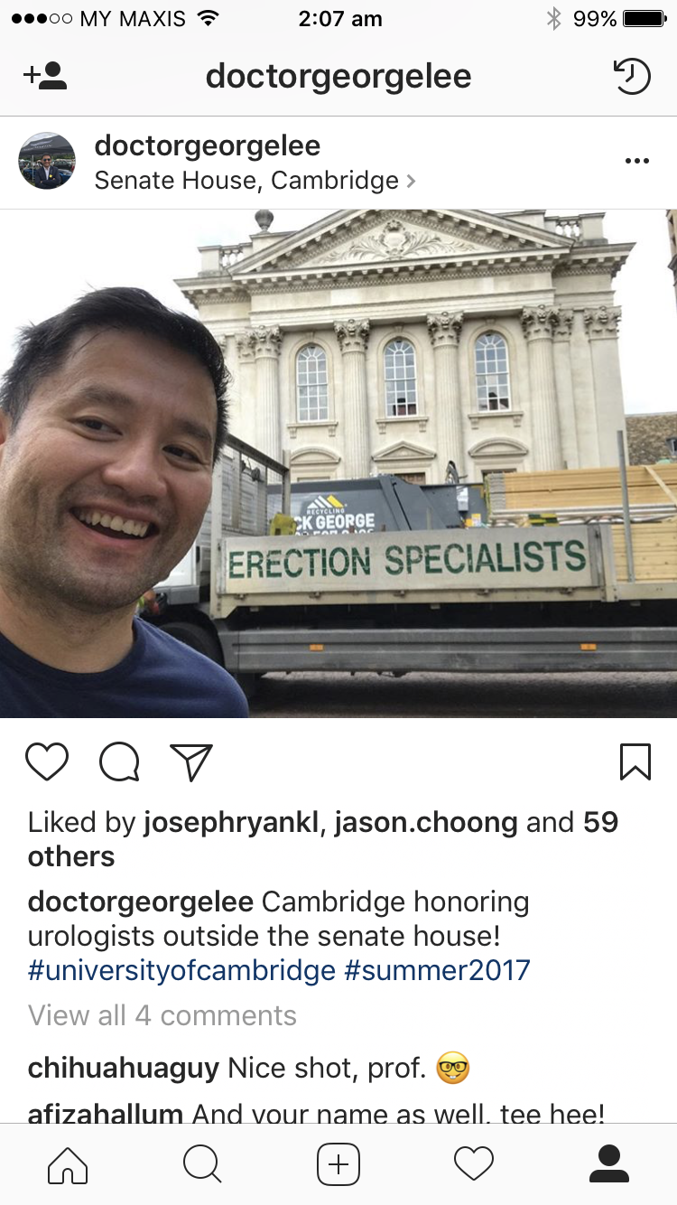

Slide 4

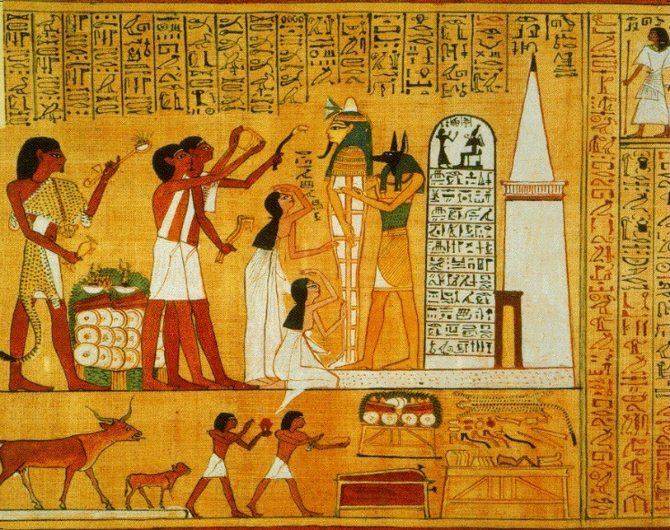
2500 BC – Ancient Chinese Egyptians
Ancient Chinese philosophers believed that a man’s yin and yang
Textbook of traditional Chinese medicine listed a potion of 22 ingredients that was used to help the emperor bed 1,200 women
  Egyptians believed that impotence was the result of a natural disorder or an evil spell
  Grinding up baby crocodile hearts to rub on the penis
  Utilization of white and blue lotus flowers – Apomorphine

Slide 5

1960s
Doctors began using synthetic implants in the 1960s
The first implants were hard and caused pain
In the early 1970s, these were replaced with implants that could be pumped full of air

Slide 6
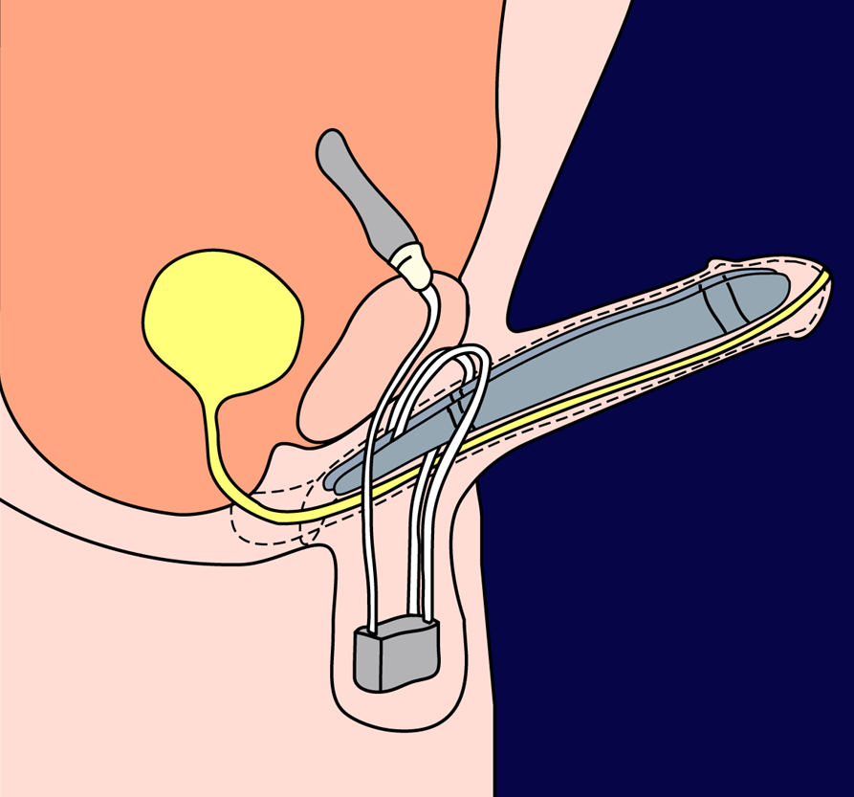
Penile Prosthesis
Reservoir
Multi-part
inflatable
prosthesis
Cylinders
Pump
Notes:
The surgical insertion of a penile prosthesis is reserved for cases where other, less invasive, therapies have failed.
Early versions were rigid devices, but more recently semi-rigid and inflatable prostheses have been developed.

Slide 7
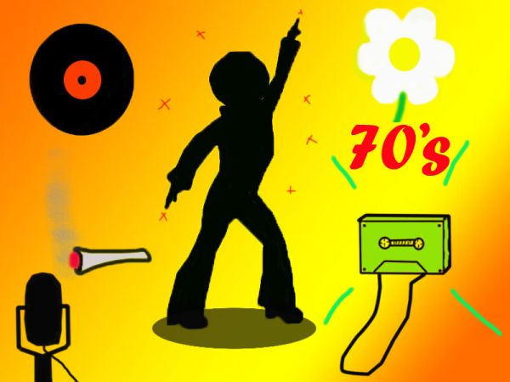
1970s
In the 1970s, a Pentecostal minister with a tyre repair business figured out how to attach a tire pump to a cylinder, creating negative pressure, placing the cylinder over his penis, and pumping up an erection
From such beginnings came the FDA-approved vacuum

Slide 8
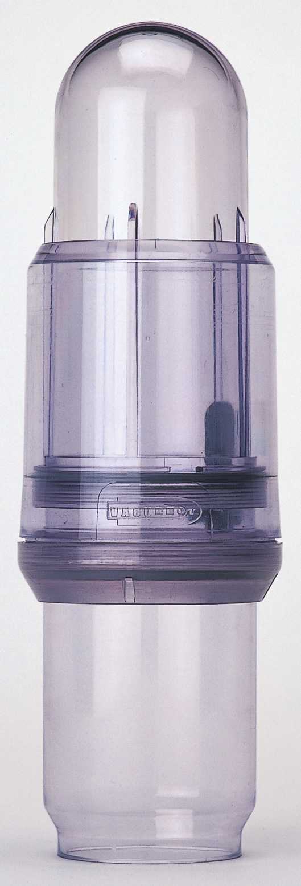
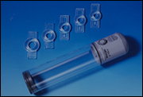
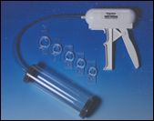
Vacuum Erection Devices
Notes:
Vacuum erection devices (VEDs) have existed in some form since the 1920’s, though they did not gain widespread use until the 1980’s.
The principle is to insert the penis into the tube, the air from which is evacuated. In the presence of low air pressure around it, the penis tumesces and an erection is formed. Blood is kept in the penis by the application of a constrictor ring around the base.
VEDs are effective in producing an erection, regardless of the aetiology of the ED, and with good training and experience in using the device, they are acceptable to many men.
Nonetheless, VEDs remain an option usually reserved for men who fail on oral therapy.
VEDs can be prescribed but like all ED therapies, are subject to the restrictions of Schedule 2.

Slide 9

1980s
A French surgeon unintentionally injected the drug papaverine into someone’s penis, and it caused an instant erection
In 1983, a British researcher actually injected his own penis at a Urodynamic meeting to prove how effective this treatment is

Slide 10
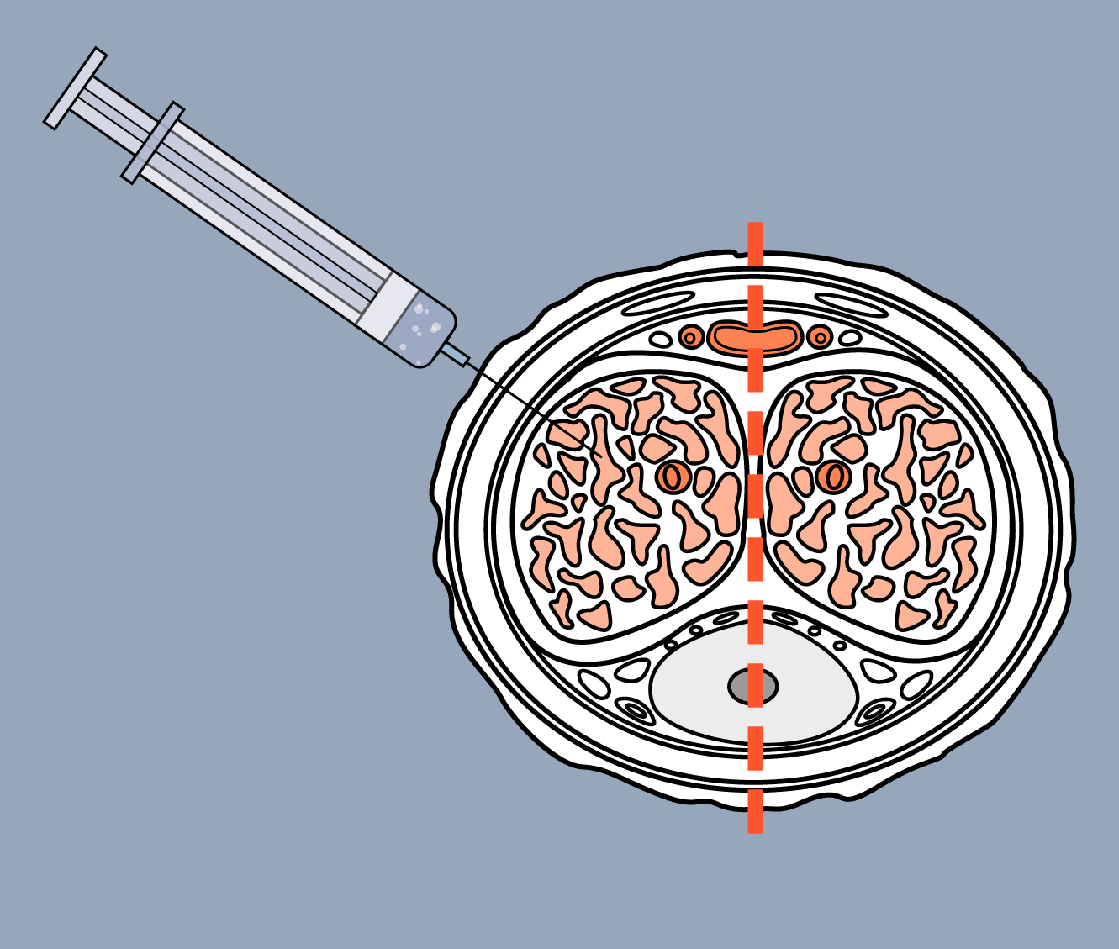
Intracavernosal Injection
Cross-section of the shaft of the penis
e.g. alprostadil
Midline
Drug
injected directly
into the corpus
away from midline
Corpus cavernosum
Notes:
Before the introduction of oral therapy in the late 1990’s, intracavernosal injections were one of the few effective treatments available for ED.
Perhaps for obvious reasons, oral therapies are preferred over injections both by patients and clinicians. Nonetheless, Caverject is highly efficacious and is a helpful therapy for men who fail on oral therapy. Sexual stimulation is not required in order to achieve an erection.
Although a number of pharmacological agents have been given by intracavernosal injection, alprostadil (PGE1) is the most widely used.

Slide 11

1990s
Sildenafil (compound UK-92,480) was synthesized by a group of pharmaceutical chemists working at Pfizer
On March 27, 1998, it became the first oral treatment approved to treat erectile dysfunction (ED) in the United States
1998: The House voted to impeach Bill Clinton over the Lewinsky Scandal

Slide 12
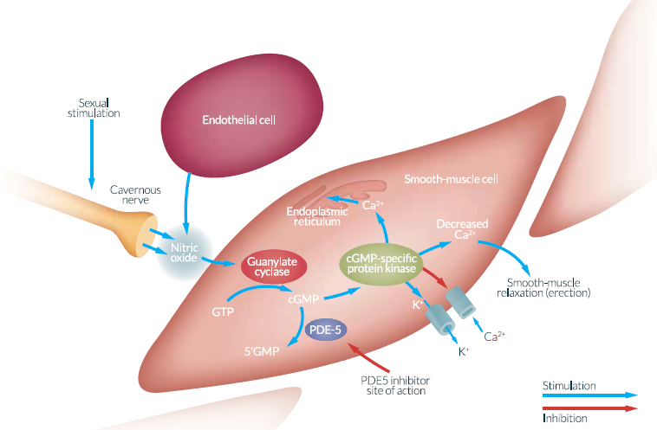
Phosphodiesterase 5 (PDE5) inhibitors: Mechanism of action

Slide 13
Diagnosis and Treatment of ED
First-line treatment: Oral treatment – PDE5 inhibitors
  PDE5 inhibitors are recommended as the preferred pharmacotherapy for ED
  PDE5i is a class of vasodilators that work on the nitric oxide-cGMP mechanism to help restore natural erectile function in the presence of sexual stimulation
  Efficacy is defined by rigidity sufficient for vaginal penetration
  Sildenafil citrate was the first licensed oral medication for ED, receiving marketing authorization in 1998
  Vardenafil and tadalafil received marketing authorization in 2003
Wespes E, Amar E, Hatzichristou D, et al. Eur Urol. 2006;49:806-815; Wright PJ. Int J Clin Pract. 2006;60:967–975; Mulhall J, Althof SE, Brock GB, et al. J Sex Med. 2007;4:448-464; Rosen RC, Kostis JB. Am J Cardiol. 2003;92(suppl):9M-18M; Wespes E, Amar E, Eardley I, et al. Guidelines on Male Sexual Dysfunction. 2010.
Notes:
Phosphodiesterase type 5 (PDE5) is an enzyme that hydrolyzes cyclic guanosine monophosphate in the penile cavernosum tissue. Inhibition of PDE5 results in increased arterial blood flow leading to smooth muscle relaxation, vasodilatation and erection. (Wespes/p810/col2/para5/lines 1-6)
PDE5 inhibitors are recommended as first-line oral treatment for ED. (Wright/p968/col1/para6/lines1-2)
Efficacy is defined by rigidity sufficient for vaginal penetration. (Mulhall/p459/col2/para3/lines1-2)
Sildenafil citrate was the first licensed oral medication for ED, receiving marketing authorization in 1998. (Wespes/p810/col2/para5/lines 1-4)
Vardenafil and tadalafil received marketing authorization in 2003. [cannot confirm ref source]
Wespes E et al. EAU guidelines on erectile dysfunction: An update. Eur Urol. 2006;49:806-815. Wright PJ. Comparison of phosphodiesterase type 5 (PDE5) inhibitors. Int J Clin Pract. 2006;60:967-975. Mulhall J et al. Erectile dysfunction: Monitoring response to treatment in clinical practice – Recommendations of an international study panel. J Sex Med. 2007;4:448-464.

Slide 14
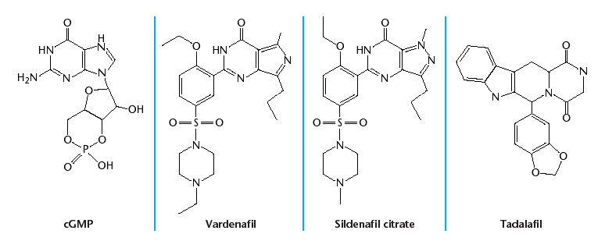
Pharmacology of PDE5 Inhibitors
PDE5 inhibitors
  PDE5 inhibitors resemble cGMP: cyclic guanosine monophosphate and bind to the active site of PDE5, preventing the PDE5 enzyme from binding to and breaking down cGMP
  Even subtle structural differences may have an effect on potency, selectivity, and pharmacokinetic parameters such as C_{max}, T_{max}, t_{1/2}, and bioavailability
Corbin JD, Francis SH. Cyclic GMP phosphodiesterase-5: target of sildenafil. J Biol Chem. 1999;274:13729–13732; Corbin JD, Francis SH. Pharmacology of phosphodiesterase-5 inhibitors. Int J Clin Pract. 2002;56:453-459; Wallis RM, Corbin JD, Francis SH, et al. Tissue distribution of phosphodiesterase families and the effects of sildenafil on tissue cyclic nucleotides, platelet function, and the contractile responses of trabeculae cCarneae and aortic rings in vitro. Am J Cardiol. 1999;83:3C–12C; Stacey P, Mount N. Male erectile dysfunction. The Biochemist. 2002;24(2):16-18; LEVITRA [package insert]. West Haven, CT: Bayer HealthCare Pharmaceuticals; 2011; CIALIS [package insert]. Indianapolis, IN: Eli Lilly and Company; 2011; VIAGRA [package insert]. New York, NY: Pfizer Inc; 2011.
Notes:
Structurally, the PDE5 inhibitor group bears some resemblance to the cyclic guanosine monophosphate (cGMP) molecules that these inhibitors competitively displace from the PDE5 site.
PDE5 inhibitors enhance erectile function during sexual stimulation by maintaining sufficient cellular levels of cGMP in both the corpus cavernosum and the vessels supplying it, resulting in increased blood flow, which allows an erection to occur.
Corbin JD et al. Pharmacology of phosphodiesterase-5 inhibitors. Int J Clin Pract. 2002;56:453-459.
Corbin et al. J Biol Chem. 1999;274:13729–13732 - Pg(13731B)
Stacey P e al. Male erectile dysfunction: The biochemistry of ViagraTM The Biochemist. 2002;24(2):16-18.

Slide 15
Sildenafil Product Profile
Sildenafil efficacy
  Numerous clinical trials have shown that sildenafil is an effective and well-tolerated treatment for ED
  Efficacy is dose-related:
    63% of patients who received the 25 mg dose reported improvements in their erections, whereas the 50 mg and 100 mg doses were associated with improvements in 74% and 82% of men, respectively
  Efficacy is demonstrated across different aetiologies and co-morbidities:
    Men with ED from different causes
    Those with a range of concomitant diseases
  Efficacy is maintained during prolonged use
Buvat J, Hatzichristou D, Maggi M, et al. British Journal of Urology International. 2008; 102:1645–1650; VIAGRA Summary of Product Characteristics. 2008; VIAGRA [package insert]. New York, NY: Pfizer Inc; 2011.
Notes:
Numerous clinical trials have shown that sildenafil is effective and well tolerated in the treatment of ED. (Buvat/p1649/col1/A; col2/B; Viagra US PI/p9/Fig 4)
Efficacy is dose-related:
63% of patients who received the 25 mg dose reported improvements in their erections, whereas the 50 mg and 100 mg doses were associated with improvements in 74% and 82% of men, respectively. (Viagra US PI/p9/fig 1)
Efficacy is demonstrated across different aetiologies and co-morbidities, and efficacy was maintained during prolonged use. (Viagra SmPC/p9/para7-8)
Buvat J. Efficacy, tolerability and satisfaction with sildenafil citrate 100-mg titration compared with continued 50-mg dose treatment in men with erectile dysfunction. Brit J Urol Int. 2008; 102:1645–1650. VIAGRA Summary of Product Characteristics. 2008. VIAGRA [package insert]. New York, NY: Pfizer Inc; 2011.

Slide 16
Sildenafil Efficacy
24-week dose-response study: Ability to achieve erection
  Percent increase from baseline in response to IIEF Q3: “When you attempted sexual intercourse, how often were you able to penetrate your partner?”
P<.001
100% = End point: 4.00, baseline: 2.00
84% = End point: 3.50, baseline: 1.90
60% = End point: 3.20, baseline: 2.00
5% = End point: 2.20, baseline: 2.10
n=199
25 mg
n=96
50 mg
n=105
100 mg
n=101
The results were derived from a 24-week, dose-response, placebo-controlled study with 501 patients completing evaluation.
Goldstein I, Lue TF, Padma-Nathan H, et al. N Engl J Med. 1998; 338: 1397-1404.
Notes:
Results from the 24-week double-blind, fixed-dose study are reported here.
Patient responses to IIEF Question 3 (“When you attempted sexual intercourse, how often were you able to penetrate your partner?”) show that the percent improvement in ability to achieve an erection was significantly higher in patients taking the sildenafil compared to placebo. (Goldstein/p1400/ Table 2)
Patients were also asked to respond to IIEF Question 4 (“During sexual intercourse, how often were you able to maintain your erection after you had penetrated your partner?”). Results reported on the next slide.
Goldstein I et al. Oral sildenafil in the treatment of erectile dysfunction. N Engl J Med. 1998; 338: 1397-1404.

Slide 17
Sildenafil Efficacy
Results from 11 pooled double-blind studies: Patient responses to IIEF Q3
  Overall baseline mean score and least squares mean (+) SE scores at end of treatment for IIEF question 3 (ability to achieve erections)
*P<.001
*
*
*
*
*
*
*
*
617 303 314
312 146 166
1130 547 583
1268 630 638
837 393 444
876 442 434
737 370 367
n= 1521 754 765
ED etiology
ED severity
ED duration
Adapted from Carson CC, Burnett AL, Levine LA, et al. Urology. 2002; 60(suppl 2B):12-27.
Notes:
Sildenafil treatment was associated with significantly higher mean scores based on patient responses to IIEF question 3 (assessing the ability to achieve erections). (Carson/p15/Fig1B)
Similar results were seen in response to IIEF question 4 as noted on the next slide.
Study conclusions are shown on the next slide.
Carson CC et al. The efficacy of sildenafil citrate (Viagra®) in clinical populations: An update. Urology. 2002; 60(suppl 2B):12-27.

Slide 18
Sildenafil in Men with ED and Co-morbid Conditions
Efficacy of sildenafil in patients with ED and co-morbid conditions
*P <.0001 vs placebo. †P <.001 vs placebo.
n= 920 452 468 291 132 159 77 35 42 107 52 57 811 406 405 257 127 130 894 444 450 105 55 50
Data presented here are pooled from 11 double-blind, placebo-controlled, flexible-dose studies to assess the efficacy of sildenafil in 2,667 men with ED. Scores are for subgroups characterized by concomitant medical conditions/medications.
Carson CC, Burnett AL, Levine LA, et al. Urology. 2002; 60(suppl 2B):12-27.
Notes:
Pooled results from 11 double-blind, placebo-controlled, flexible-dose studies to assess the efficacy of sildenafil in 2667 men with ED and co-morbidities are presented here. (Carson/p13/col2/Table 1)
The studies included a 4-week baseline period and a 12-week double-blind treatment period. Patients were randomized to sildenafil (initial dose, 50 mg) or placebo. Dose could be increased to 100 mg or decreased to 25 mg based on efficacy or tolerability. (Carson/p13/col1/para2/lines1-5)
These data indicate that treatment with sildenafil results in improvement in erectile function scores for ED patients with a wide range of concomitant conditions and medications. (Carson/p17/Fig 3)
Carson CC et al. The efficacy of sildenafil citrate (Viagra®) in clinical populations: An update. Urology. 2002;60(suppl 2B):12-27.

Slide 19


Slide 20
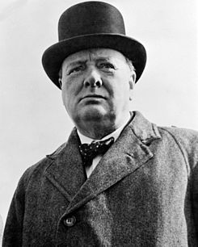
Winston Churchill (1874–1975)
One of the greatest war time leaders in the 20th Century
“There is no time for ease and comfort. It is time to dare and endure.”

Slide 21
Sildenafil Orodispersible Tablet (ODT) Formulation
Rationale
  In the treatment of patients with erectile dysfunction, it is helpful for physicians to have a choice of dosage forms to meet the specific needs of their individual patients
  Utilizing ODT technology, sildenafil orodispersible tablets were developed to offer physicians a dosage option for patients who:
  without the need for water
  OR
  – have difficulty swallowing conventional solid dosage forms
Notes:
In the treatment of patients with erectile dysfunction, it is helpful for physicians to have more than one dosage form to meet the needs of their individual patients.¹ [Damle/p2/A]
With this in mind, the sildenafil orodispersible tablet formulation was developed.¹ [Damle/p2/A]
Physicians who prescribe sildenafil can offer their patients a choice between sildenafil film-coated tablets for those who prefer the conventional solid dosage form or sildenafil ODT for those who want a convenient and discreet way of taking their medication without the need for water or who may have difficulty swallowing.¹ [Damle/p2/A;p8/A]
And because sildenafil ODT is bioequivalent to sildenafil film-coated tablets, physicians and patients can expect the same efficacy and tolerability profile.² [SmPC/p46/B;p47/A]
1. Damle B, Duczynski G, Jeffers BW, et al. Pharmacokinetics of a novel orodispersible tablet of sildenafil in healthy subjects. Clin Ther. 2014; pii: S0149-2918(13)01125-9. doi: 10.10.16/h.clinthera.2013.12.010.
2. VIAGRA Summary of Product Characteristics. 2013.

Slide 22
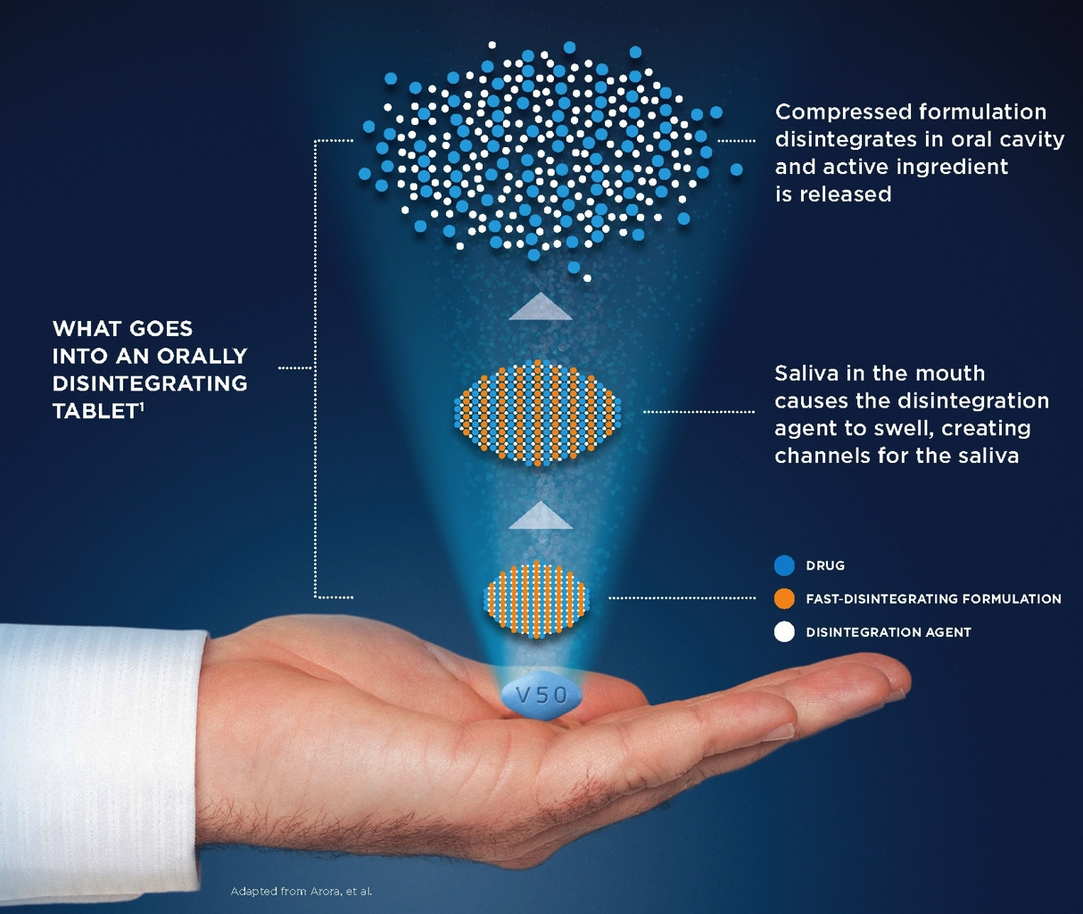
Sildenafil Orodispersible Tablet (ODT) Formulation
ODT Technology
Adapted from Arora P, Sethi VA. Orodispersible tablets: A comprehensive review. Int J Res Dev Pharm L Sci. 2013;2:270-284.
Notes:
Sildenafil orodispersible tablets is the product of ODT technology.
ODT technology maximizes the porous structure of the tablet and incorporates disintegrating agents to assure that the tablet rapidly dissolves in the mouth¹ [Arora/p271/A]
Orodispersible tablets (ODT) are solid unit dosage forms like conventional tablets, but are composed of super disintegrants, which help them to dissolve the tablets within seconds on the tongue in the presence of saliva without any difficulty of swallowing.^{1,2} [Arora/p270/A] [SmPC/p91/A] Thereafter, the drug may get absorbed from the pharynx and esophagus or from other sections of GI tract as the saliva travels down.¹ [Arora/p270/A]
Arora P, Sethi VA. Orodispersible tablets: A comprehensive review. Int J Res Dev Pharm L Sci. 2013;2:270-284.
VIAGRA Summary of Product Characteristics. 2013.

Slide 23
Once-Daily Option of PDE5-I
Dosing paradigms that eliminate coordinating dosing with sexual activity are desirable to accommodate individual patterns and spontaneity of sexual intimacy¹⁻³
Tadalafil is suited for use as a once-daily ED therapy, owing to its long half-life (17.5 hours)⁴
Oral PDE5 inhibitors successfully treat ED¹; however,
  Ameliorating the full psychological impact of ED remains a challenge²
ED=erectile dysfunction; PDE5=phosphodiesterase 5
1. Carson C et al. BJU Int 2004;93:1276-81.
2. Rajfer J et al. Int J Impot Res 2007;19:95-103.
3. Dunn M et al. Int J Impot Res 2007;19:119-23.
4. Forgue S et al. Br J Clin Pharmacol 2006;61:280-8.
Notes:
KEY POINTS
Taking an oral PDE5 inhibitor with a shorter half-life (eg, sildenafil or vardenafil) might result in the ED patient feeling pressure to perform within a limited timeframe and impact sexual activity. Having to plan sexual activity can cause anxiety for both a man and his sexual partner.¹ (p120/col 1/para 4)
For some men, such as those who are not in long-term relationships, the next sexual encounter may be entirely unpredictable, exacerbating attempts to accurately time taking an oral PDE5 inhibitor before a sexual attempt.¹ (p120/col 1/para 4)
The pressure and anxiety to engage in sexual activity after a man takes a PDE5 inhibitor is felt equally by the female partner who may feel pressure to be sexually available, even though she may not feel this way.¹ (p121/col 1/para 1)
A dosing paradigm that could eliminate the need to coordinate dosing with sexual intimacy would provide a useful treatment option for certain men with ED and their partners.
The 17.5-hour half-life of tadalafil, ²(p124/col 2/para 3); ³(p311 col 1/para 2) which is approximately 4 times longer than that of sildenafil or vardenafil, ⁴(p95/col1/para 1) makes it well suited for potential use as a once-daily ED therapy.
Furthermore, given the known modest accumulation (< 2-fold) at steady state (reached after 5 days of once-daily dosing), a lower daily dose (than the 10- or 20-mg on-demand dosing of tadalafil) was predicted to be appropriate for further evaluation as an ED therapy and could be taken without regard to timing of sexual activity.³ (p280/results section of abstract).
BACKGROUND
Phosphodiesterase type 5 (PDE5) inhibitors, sildenafil, tadalafil and vardenafil, are a class of medications that are safe and effective in treating erectile dysfunction (ED). (p119/first line of abstract) In this class, sildenafil, tadalafil and vardenafil all act by inhibiting PDE5, but each have different selectivity, pharmacokinetic properties and tolerability profiles. (p119/col 2/last para)
The primary pharmacokinetic differences between the PDE5 inhibitors relate to half-life and duration of therapeutic action. (p119/col 2/last para)
REFERENCES
Dunn M, Althof S, Perelman M. Phosphodiesterase type 5 inhibitors' extended duration of response as a variable in the treatment of erectile dysfunction. Int J Impot Res. 2007;19(2):119-23.
Porst H, Padma-Nathan H, Giuliano F, et al. Efficacy of tadalafil for the treatment of erectile dysfunction at 24 and 36 hours after dosing: a randomized controlled trial. Urology. 2003;62(1):121-5.
Young J, Feldman R, Auerbach S, et al. Tadalafil improved erectile function at twenty-four and thirty-six hours after dosing in men with erectile dysfunction: US trial. J Androl. 2005;26(3):310-8.
Forgue S, Patterson B, Bedding A, et al. Tadalafil pharmacokinetics in healthy subjects. Br J Clin Pharmacol. 2006;61(3):280-8.

Slide 24
Predicted Tadalafil
Concentration-Versus-Time Profiles
400
Tadalafil Plasma Concentrations Over 1 Week
350
Tadalafil 5 mg OAD
300
Tadalafil 20 mg single dose
250
200
Tadalafil Plasma Concentration (ng/mL)
150
100
50
0
0
24
48
72
96
120
144
168
Time (hours)
OAD=Once-a-Day or Once-Daily
Wrishko R et al. J Sex Med 2009;6:2039-48.
Notes:
KEY POINTS
Compared to plasma concentrations after single-dose administration of tadalafil 20 mg, pharmacokinetic simulations indicated that daily-dosing of tadalafil 5 mg resulted in concentrations that would be less than half that of 20 mg as-needed during the first day, approximately equivalent during the second day, but greater during the remainder of the week after daily administration of tadalafil 5 mg. (p2042/col 2/para 2)
The simulated cumulative weekly exposure after once-daily dosing of tadalafil 5 mg was approximately 69% higher than in that after a single dose of tadalafil 20 mg each week. (p2042/col 2/para 2)
In summary, for a man anticipating 1 dose of tadalafil 20 mg a week as part of his regular sexual activity, a once-daily dose of tadalafil 5 mg would represent a greater weekly exposure to tadalafil. (p2042/col 1/only paragraph)
BACKGROUND
A recent study generated pharmacokinetic predictions of tadalafil plasma concentrations using empirical data gathered from 20-mg, single-dose tadalafil administration paired with tadalafil usage patterns from on-demand clinical trials. (p2039/methods section of abstract)
Predictions were based upon a calculated accumulation ratio from the half-life of tadalafil, and assumed linear pharmacokinetics. Pharmacokinetic characterization (of tadalafil in men with ED) was further provided by population pharmacokinetic analysis of tadalafil concentrations from a subset of 66 patients receiving tadalafil 2.5 or 5 mg once daily in a multicenter, randomized, double-blind, placebo-controlled, parallel-design, efficacy and safety clinical study. (p2040/col 2/para 1)
To test pharmacokinetic simulations and pharmacodynamic predictions, clinical trials were subsequently conducted to demonstrate efficacy and safety of once-daily, low-dose tadalafil 2.5 mg and 5 mg. (p2040/col 2/para 1)
REFERENCE
Wrishko R, Sorsaburu S, Wong D, et al. Safety, efficacy, and pharmacokinetic overview of low-dose daily administration of tadalafil. J Sex Med. 2009;6(7):2039-48.

Slide 25
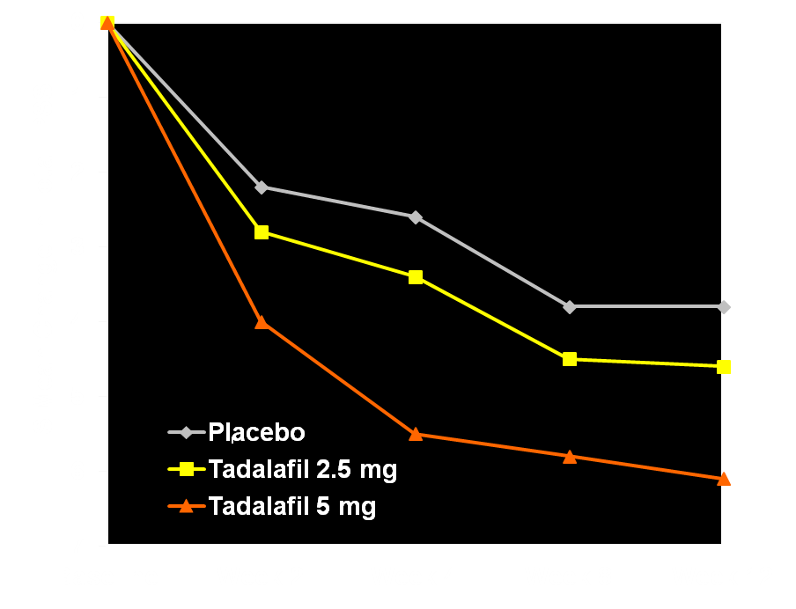
Total IPSS: Mean Change from Baseline
Treatment | Baseline Mean (SD) | 12-week Endpoint LS Mean Change (ANCOVA, LOCF)
Placebo | 18.2 (5.3) | -3.8
Tadalafil
2.5 mg | 18.2 (5.6) | -4.6
5 mg | 18.5 (5.8) | -6.1***
***
***
***
***
ª
***p<.001
ªValues for Week 2 are based on mIPSS
Notes:
[Source: Egerdie RB et al. J Sex Med 2011;doi: 10.1111/j.1743-6109.2011.02504.x. Table 2 (Pg 6); Figure 2B (Pg 7); LVHR CSR Tables LVHR.14.11 (Pg 236), LVHR.14.12 (Pg 237), LVHR.14.13 (Pg 238), LVHR.11.12 (Pg 97)]
Abbreviations: IPSS: International Prostate Symptom Score, SD: standard deviation, LS: least squares, ANCOVA: analysis of covariance, LOCF: last observation carried forward, mIPSS: modified IPSS
Key Points:
The table on the left shows the mean change from baseline to endpoint. The graph on the right shows mean change from baseline over time.
Time course of change in total IPSS from baseline to 2 (mIPSS), 4, 8, and 12 weeks were analyzed using ANCOVA.
Coprimary outcome: Total IPSS change from baseline to end point, LS mean change (SE): Table 2 (Pg 6)]
Placebo, -3.8 (0.5)
Tadalafil 2.5 mg, -4.6 (0.4); Change vs. placebo, -0.8 (0.6); p = .18
Tadalafil 5 mg, -6.1 (0.4); Change vs. placebo, -2.3 (0.6); p<.001
(Statistical significance based on Dunnett-Bonferroni gatekeeping procedure, alpha = .0271)
Tadalafil 5 mg once daily resulted in improvement of primary efficacy (IPSS) endpoint (mean difference -2.3, p<.001). [Pg 4, Col 2, Para 3]
Tadalafil 5 mg significantly improved the BPH-LUTS (lower urinary tract symptoms secondary to benign prostatic hyperplasia) measures of total IPSS at 2, 4, and 8 weeks compared to placebo. [Pg 5, Col 1, Para 3].
Changes in total IPSS were not significant with tadalafil 2.5 mg compared to placebo. [Pg 5, Col 1, Para 2]
Reference:
Egerdie RB, Auerbach S, Roehrborn CG, Costa P, Garza MS, Esler AL, Wong DG, Secrest RJ. Tadalafil 2.5 or 5 mg administered once daily for 12 weeks in men with both erectile dysfunction and signs and symptoms of benign prostatic hyperplasia: results of a randomized, placebo-controlled, double-blind study. J Sex Med 2011;doi: 10.1111/j.1743-6109.2011.02504.x.

Slide 26



…taken as needed approximately 15 to 30 minutes before sexual activity…
Avanafil SmPC Mar 2016

Slide 27
Commonly used oral PDE5 inhibitors:
Pharmacological and pharmacokinetic properties
Characteristic | PDE5 inhibitor
 | Avanafil | Sildenafil | Vardenafil | Tadalafil
T_{max} (range) | 30–45 min | 30–120 min | 30–120 min | Not reported
T_{max} (median) | 0.5-0.75 h | 1 h | 1 h | 2 h
Effect of food on T_{max} | Delayed by 1.25 h | Delayed by 1 h | Delayed by 1 h | None
Plasma protein binding | 99% | 96% | 95 % | 94%
Half-life | 6–17 h | 3–5 h | 4–5 h | 17.5 h (mean)
Accumulation in plasma | None | Not reported | None | Not reported
Effect on exposure/clearance, of:
Age | None | Reduced clearance | Reduced clearance | Reduced clearance
Mild renal impairment | None | None | None | Increased exposure
Moderate renal impairment | None | None | None | Increased exposure
Severe renal impairment | No data | Increased exposure | Increased exposure | Increased exposure
Mild hepatic impairment | None | Increased exposure | Increased exposure | None
Moderate hepatic impairment | Reduced exposure | Increased exposure | Increased exposure | None
Severe hepatic impairment | Not studied | Not studied | Not studied | Limited data

Slide 28
Timing of administration
PDE5 inhibitor | Onset of action (minutes after dosing) | Duration (hours)
Sildenafil | 60 | 4
Tadalafil | At least 30 | 36
Vardenafil FCT | 25-60 | 4
Vardenafil ODT | 25-60 | 4
Udenafil | 60 | 24
Avanafil | Approximately 15 to 30 | >6 hours*

Slide 29

21st Century-
PE- The new Frontier in sexual health?

Slide 30
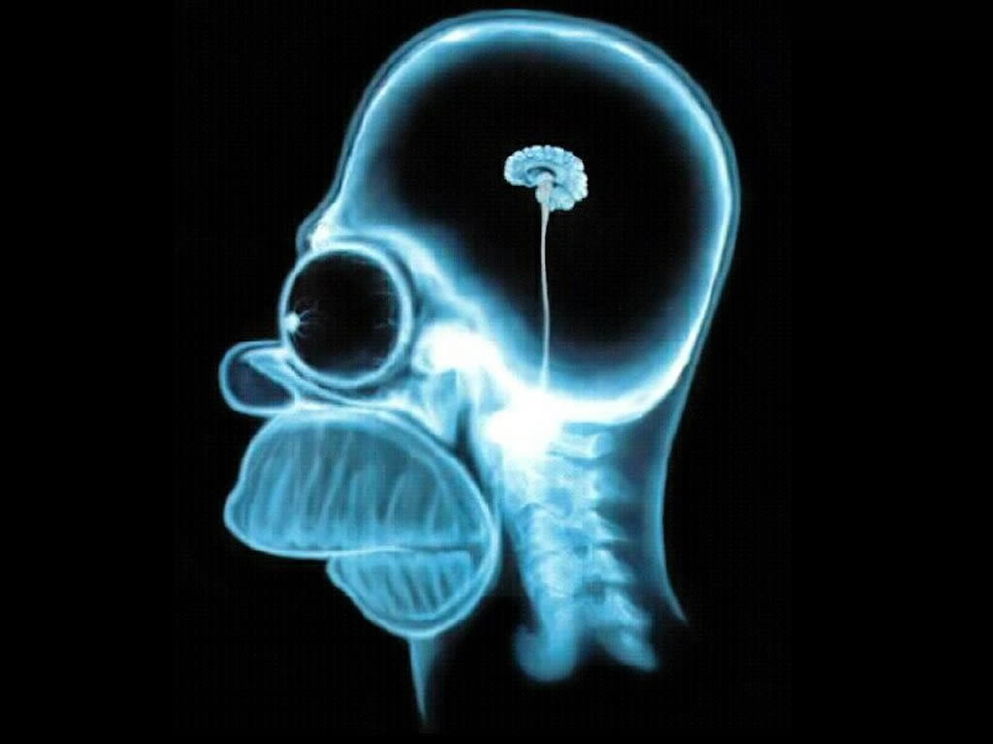
Urology not Neurology

Slide 31
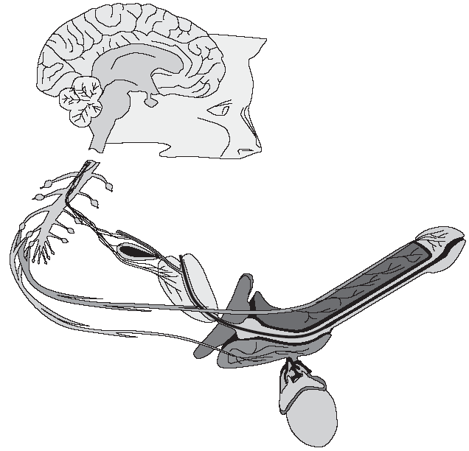
Neurophysiology of Ejaculation
Higher brain Centres
Pons:
nPGi: Nucleus paragigantocellularis
Supraspinal Centres
Sensory inputs from genital areas
Sympathetic supply to:
Epididymis, Vas deferens
Seminal Vesicles
Prostate
Excitatory & inhibitory control
Spinothalamic
cells L3-L4:
Coordination of spinal nuclei
Hypogastric Plexus
~ T12-L1:
Emission
afferent
Spinal Reflex
S1-S3:
Expulsion
efferent
Dorsal nerve of penis
Pudendal nerve
Motor supply to bulbospongiosus muscle
Giuliano & Clement (2005) Ann Rev Sex Res 16:190–216
Notes:
31
CNS control of ejaculation is mediated via spinal ejaculation centres including lumbar spinothalamic (LSt) cells. These cells integrate peripheral signals from the genital areas with excitatory and inhibitory control from supraspinal centres such as the nucleus paragigantocellularis (nPGi).
The spinal ejaculation generators send co-ordinated outputs to the anatomic structures that allow ejaculation to occur.
The ejaculation reflex consists of:
Emission – the generation of semen by structures including the seminal vesicles and the prostate gland
Expulsion – rhythmic muscular contractions involving the bulbocavernosus muscle controlled by the pudendal nerves
The lumbar spinothalamic cells constitute the spinal ejaculation generator, which integrates the sensory inputs and outputs necessary to trigger ejaculation. The spinal ejaculation generator is discussed in more detail on the following two slides (which may be too technical for some audiences).

Slide 32

Neural Control of Ejaculation
Key Supraspinal Centres
Emission and ejection are centrally integrated and coordinated processes involving several key brain areas …
Cortex
Thalamus
Hypothalamus:
PVN: Paraventricular nucleus
MPOA: Medial preoptic area
Midbrain:
PAG: Periaqueductal Grey
Sensory inputs from genital areas
Pons:
nPGi: nucleus paragigantocellularis
Excitatory & inhibitory control
Giuliano & Clement (2006) Eur Urol 50(3):454–466
Notes:
32
32
Emission and ejaculation are centrally integrated and highly co-ordinated processes.
Brain structures involved in the control of ejaculation include:
The thalamus
Structures in the hypothalamus such as the medial preoptic area (MPOA) and the paraventricular thalamic nucleus (PVN)
Structures in the midbrain such as the periaqueductal grey nucleus (PAG)
Structures in the pons such as the paragigantocellular nucleus (nPGi)
These structures integrate sensory ejaculation-related inputs from the genital areas with higher excitatory and inhibitory controls.

Slide 33
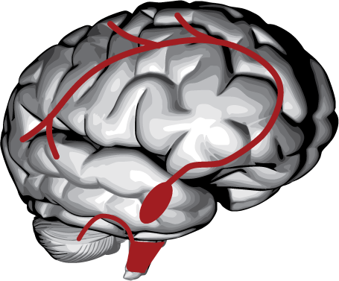
Neurotransmitters Involved in Control of Ejaculation
Neurotransmitters are
involved in the processing of emission and ejaculation:
  Serotonin (5-HT)
  Dopamine (DA)
  Gamma-aminobutyric acid (GABA)
  Noradrenaline
McMahon et al, Disorders of orgasm and ejaculation in men. In Sexual Medicine: Sexual dysfunctions in men and women. 2nd International Consultation on Sexual Dysfunctions, Paris, 2004
Notes:
33
Central control of ejaculation involved many neurotransmitter systems including serotonin (5-HT), dopamine (DA), gamma-amino butyric acid (GABA) and norepinephrine (NE). Of these, 5-HT is a major player.
Serotonin cell bodies are located in distinct clusters in the brainstem and send extensive projections throughout the brain and spinal cord.
The actions of serotonin are mediated via one of the most extensive receptor systems known. Seven 5-HT receptor classes, encompassing some 14 different receptors, are currently recognized. These receptors and the serotonin transporter are widely distributed with particularly high density in the hypothalamus, brainstem and spinal cord.

Slide 34
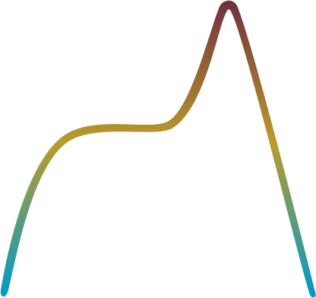
Normal Male Sexual Response
Sexual interest/ stimulation
Orgasm
Ejaculation accompanied by orgasm
Penile tumescence
Penetration
Penile detumescence
High arousal / penile erection
Plateau
Resolution
Excitement
Time
Adapted from Donatucci (2006) J Sex Med 3(suppl 4):303–308
Notes:
34
The normal male sexual response is a sequential process, starting with sexual stimulation, penile tumescence and erection, and culminating in ejaculation—normally associated with orgasm—followed by detumescence. This can be expressed graphically as a cycle of four phases: excitement, plateau, orgasm (and associated ejaculation), and resolution.

Slide 35
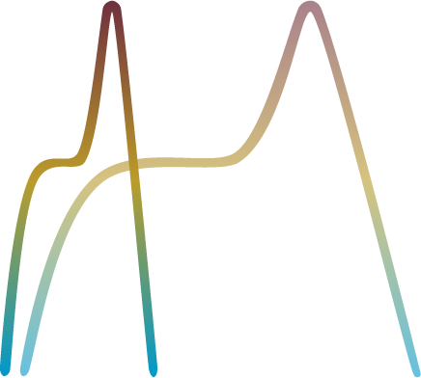

Premature Ejaculation
Rapid ejaculation and associated orgasm with normal erection
Short plateau phase
Steep excitement
phase with normal erection
PE
Normal response
Time
Adapted from Donatucci (2006) J Sex Med 3(suppl 4):303–308
Notes:
35
In men with PE, the entire ejaculatory sequence is curtailed compared with the normal sequence. A very steep excitement phase with a normal erection, is followed by a shorter plateau and a rapid ejaculation and associated orgasm. Although these features are well established, the exact etiology of PE is unknown.

Slide 36
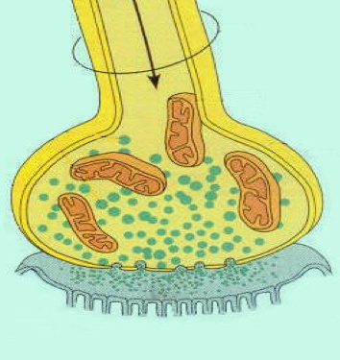
5HT: Inhibitory NTM in Hypothalamus, Brainstem, Spinal cord
Synaptic cleft 5‑HT is regulated by a transporter re‑uptake system (5-HTT)
As serotonin is released,
the transporter system is activated, removing serotonin preventing inhibition of ejaculation
SSRIs inhibit the serotonin transporter system, increasing levels of serotonin
Axon
Axonal
Terminal
5-HTT
5-HTT
5-HTT
5-HTT
5-HT
5-HT
5-HT
Synaptic
Cleft
Post-Synaptic Neuron
Notes:
36
The observation that chronic treatment with selective serotonin reuptake inhibitors (SSRIs) is associated with sexual dysfunction, including delay of ejaculation, suggests that serotonergic pathways are involved in central control of ejaculation.
The actions of serotonin are mediated via one of the most extensive receptor systems known. Seven 5-HT receptor classes, encompassing some 14 different receptors, are currently recognized. These receptors and the serotonin transporter are widely distributed with particularly high density in the hypothalamus, brainstem and spinal cord.
SSRIs inhibit the action of the serotonin transporter system, leading to greater stimulation of postsynaptic receptors.

Slide 37
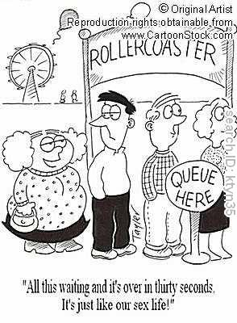
So, What is normal?

Slide 38
Normative IELT Data
Unselected “normal” population of 500 heterosexual couple
Netherlands, United Kingdom, Turkey and Spain
Stopwatch timing of the intravaginal ejaculatory latency time (IELT)
Median stopwatch IELT of 5.4 minutes (range, 0.55 - 44.1 min.)
IELT is distributed in a positively skewed pattern
Using an epidemiological approach to assess PE risk, men with an IELT < 1 min. have "definite" PE, while men with IELTs 1-1.5 min have "probable" PE.
100
90
80
70
60
Percentage of subjects
50
40
30
20
10
0
0
200
400
600
800
1,000
1,200
1,400
1,600
1,800
2,000
2,200
2,400
2,600
2,800
Mean IELT (s)
Waldinger et al. (2005) J Sex Med 2:492–497
Notes:
38
This slide shows part of the evidence base for the ISSM definition of premature ejaculation as ‘about a minute’.
This survey aimed to assess the distribution of IELT in the general male population. A total of 500 couples were
recruited from the Netherlands, United Kingdom, United States, Spain, and Turkey. IELT was measured by the partner using a stopwatch.

Slide 39
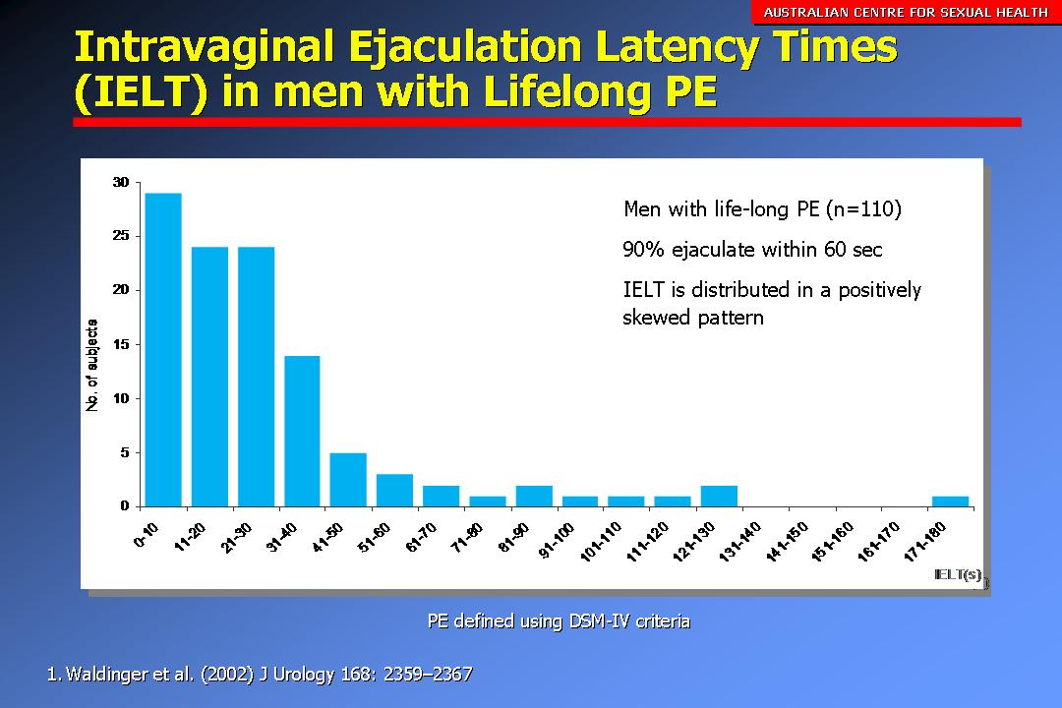
Lifelong PE
Syndrome characterized by early ejaculation at nearly every intercourse within 30-60 seconds in 80-90% of cases
Or between 1-2 minute in the remaining 10-20%, with every
Or nearly every sexual partner and from the first sexual encounters onwards [1]
McMahon, CG, Althof, SE, Waldinger, MD et al. J Sex Med 2008; 5(7):1590-1606

Slide 40
ISSM Definition of Lifelong PE
A male sexual dysfunction characterized by … [1]
  ejaculation which always or nearly always occurs prior to or within about one minute of vaginal penetration, and
  the inability to delay ejaculation on all or nearly all vaginal penetrations, and
  negative personal consequences, such as distress, bother, frustration and/or the avoidance of sexual intimacy
McMahon, CG, Althof, SE, Waldinger, MD et al. J Sex Med 2008; 5(7):1590-1606

Slide 41

Premature Ejaculation Perceptions and Attitudes (PEPA) Study
Largest international study to date designed to investigate PE
Internet survey
Apr-Aug 2004
Random sample (controlled for census)
  12,133 men
  18–70 yrs
  Questioned on general and sexual health
USA
Germany
Italy
PEPA: Premature ejaculation perceptions and attitudes. Porst et al. (2007) Eur Urol 51:816–824
Notes:
41
The PEPA study is the largest international survey conducted to date specifically to investigate PE.
The study had two parts:
Part 1 of the study comprised 65 qualitative 1-on-1 interviews in the US, Germany and Italy, intended to design the survey questions. The interviewees were 44 men self-reporting PE, and 21 women whose partners suffer from PE.
Part 2 was an internet survey of men in the USA, Germany and Italy. There were 11,543 study participants, ranging from 18 to 70 years of age.
The survey comprised some 82 questions. Questions 1-54 assessed general and sexual health, attitudes towards medical treatment, and demographics. Questions 55-82 identified PE-related attitudes and behaviours. The questions were administered to all men who met the criteria for PE, as well as ~20% of men who did not meet the criteria, but were interested in prolonging ejaculatory latency time.

Slide 42
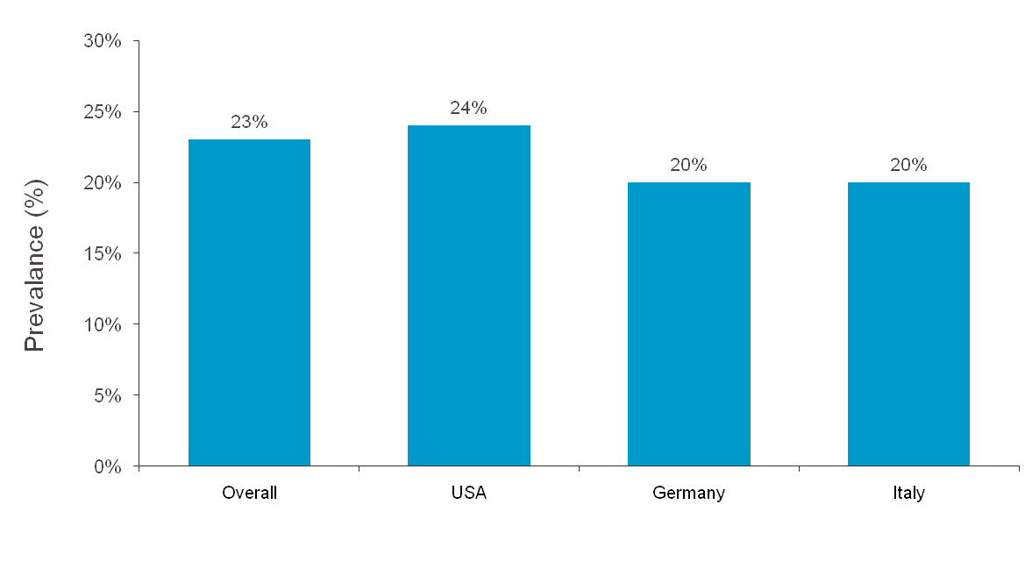
Prevalence of PE is Similar Across Countries
PEPA: Premature ejaculation perceptions and attitudes. Porst et al. (2007) Eur Urol 51:816–824
Notes:
42
The PEPA study was also able to compare PE prevalence in the USA, Germany and Italy. The lowest incidence of PE was found in Germany with the highest in Italy. Nevertheless, these differences were not significant.

Slide 43
Prevalence of PE is higher than ED and consistent across age groups <60 & 60 years
National Health and Social Life Survey analysis
PE defined as ‘climaxing too early’ ED defined as ‘trouble achieving or maintaining erection’
Laumann et al. (1999) JAMA 281:537-544
Notes:
43
The PEPA study finding of constant PE prevalence across the age span matches well with the findings of the Laumann study from 1999 using data from the National Health and Social Life Survey (NHSLS). In the NHSLS, PE was identified by questioning participants whether they had experienced climaxing or ejaculating too rapidly.
Although a smaller study than PEPA (only 1410 men) and spanning a narrower and older age range (18 to 59 years), the results are qualitatively similar and show a constant prevalence of PE across ages.
The Laumann study also highlights another important issue – that PE has a higher prevalence than ED, itself a common condition. Moreover, the prevalence of ED increases with age.

Slide 44
Variation Between Countries in the Asia-Pacific Region in the Prevalence of Premature Ejaculation
G. Lee,¹ C. G. McMahon,² J. K. Park,³ P. G. Adaikan⁴
¹University of Malaya Medical School, Kuala Lumpur, Malaysia
²Australian Centre for Sexual Health, Sydney, Australia
³Department of Urology, Institute for Medical Sciences, Chonbuk National University Medical School, Chonju, Korea
⁴Section of Sexual Medicine, Obstetrics & Gynaecology, National University Hospital, National University of Singapore, Singapore
This study was funded by Johnson & Johnson
Pharmaceutical Research & Development, L.L.C., Raritan, NJ.

Slide 45
Methods
A 48-question survey was completed by a random sample of heterosexual men ages 18-65 years
Recruitment and survey methodology varied by country (computer-assisted interviewing, online or in person)
  - The survey included 5 questions from the PE Diagnostic Tool (PEDT),¹
1. Symonds T. et al. Euro Urol. 2007; 52:565-573

Slide 46
Premature Ejaculation Diagnostic Tool (PEDT)¹
All respondents were asked 5 questions
  How difficult is it for you to delay ejaculation?
  Do you ejaculate before you want to?
  Do you ejaculate with very little stimulation?
  Do you feel frustrated because of ejaculating before you want to?
  How concerned are you that your time to ejaculation leaves your partner sexually unfulfilled?
Score each question from 0 = not at all / never or almost never to 4 = extremely / always or almost always
A PEDT score is obtained by adding the numbers for the 5 questions for each respondent
  PEDT score ≥11: With PE
  PEDT score = 9 or 10: Probable PE
  PEDT score ≤8: No PE
1. Symonds T. et al. Euro Urol. 2007; 52:565-573

Slide 47
Prevalence of PE
PE
No PE
16% of the 4,997 respondents were diagnosed to have PE while another 15% were diagnosed with probable PE by PEDT
The remaining 69% of respondents were not diagnosed to have this condition
When the respondents were asked if they perceive themselves to have PE, 13% self-assess themselves to be PE sufferers

Slide 48
PEDT-diagnosed Versus Self-reported PE
China
(n = 600)
Taiwan
(n = 1000)
Aust/Nz
(n = 1019)
Thailand
(n = 200)
Korea
(n = 1167)
Hong Kong
(n = 204)
Malaysia
(n = 200)
Indonesia
(n = 207)
Philippines
(n = 200)
Total
(n = 4997)
The prevalence of PE assessed by the validated PEDT was higher that of self-reported PE in Australia/New Zealand and Korea

Slide 49
Prevalence of PE and ED by Location
PEDT-diagnosed PE
Self-reported ED
Percentage of respondents
With the exception of China, rates of PE among respondents were higher than ED
Notes:
PEDT diagnosed PE

Slide 50

Impacts on Partners

Slide 51


Too Fast too furious
Men too fast
Women too furious

Slide 52
The Premature Ejaculation Profile (PEP)
Measure | Question | 5 possible responses
Control over ejaculation | Over the past month, was your control over ejaculation during sexual intercourse… | 0 = very poor ↓ 4 = very good
Personal distress related to ejaculation | Over the past month, how distressed were you by how fast you ejaculated during sexual intercourse? | 0 = extremely ↓ 4 = not at all
Satisfaction with sexual intercourse | Over the past month, was your satisfaction with sexual intercourse… | 0 = very poor ↓ 4 = very good
Interpersonal difficulty related to ejaculation | Over the past month, to what extent did how fast you ejaculated during sexual intercourse cause difficulty in your sexual relationship with your partner? | 0 = extremely ↓ 4 = not at all
Patrick et al. (2005) J Sex Med 2:358-367
Giuliano, F., et al (2007) Eur Urol, 2007.
Notes:
52
The Premature Ejaculation Profile (PEP) assesses a number of outcomes for the patient and their partner using a 5-point scale.

Slide 53
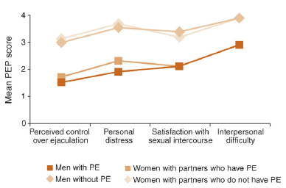
European PE Observational Study-PROs
Men with PE and their partners reported significantly worse control, personal distress, interpersonal difficulty and satisfaction than men without PE and their partners
Giuliano, F., et al (2007) Eur Urol, 2007.

Slide 54
Premature Ejaculation
Common male sexual dysfunction
In the literature, self-reported complaints of PE as high as 30% are reported
Poor rates of treatment seeking
Epidemiology not firmly established
Neglected area of male sexual health
and an unmet therapeutic need
Rosen (2000) Curr Psychiatr Rep 2:189-195; Laumann et al (1999) JAMA 281: 537-544
Spector & Carey (1990) Arch Sex Behav 19: 389-408; Porst et al. (2007) Eur Urology 51:816-824
Notes:
54
PE may be the most common male sexual dysfunction, with as many as 30% of adult males self-reporting complaints of the condition. Reported prevalence is influenced by the definition used – most studies to date (e.g. Rosen, 2000) are based on the DSM-IV criteria.
However, rates of treatment seeking are very low. There are various barriers to treatment seeking are discussed later: stigma and embarrassment are among the most important barriers.
Despite the high self-reported prevalence, factors contributing to PE remain unconfirmed: Several psychological and biological theories exist.
The high prevalence rates of PE, coupled with the absence of approved treatments, make PE a major unmet therapeutic need.

Slide 55


Slide 56
PE Medical Treatment Strategies
Psychotherapy/Behavioural Therapy
Pharmacotherapy
  Daily Dosing
    Off-label anti-depressant SSRI drugs and clomipramine
    Off-label alpha-adrenoreceptor antagonists
    Off-label Tramadol and PDE5-I
  On-demand Dosing
    Dapoxetine (ESSTI)
    Off-label anti-depressant SSRI drugs and clomipramine
    Off-label Tramadol
    Topical anesthetic sprays or gels
    Off-label PDE-5 inhibitors

Slide 57
Psycho-Behavioural Treatment of PE
Based on assumption that PE is due to a failure to pay sufficient attention to pre-orgasmic levels of sexual tension
  Stop-start manoeuvre [1]
  Squeeze technique [2]
Treatment success relatively good in the short term as most men with PE are aware of their anxiety
Convincing long-term treatment outcome data are lacking
Semans JH. Premature ejaculation: a new approach. South Med J 1956; 49(4):353-8.
Masters WH, Johnson VE. Human Sexual Inadequacy. 1970; Boston: Little Brown.p 92-115

Slide 58
Early Observations Of The Effect Of SSRIs
Antidepressant Selective Serotonin Reuptake Inhibitor (SSRI) associated with delayed ejaculation [1]
  Daily administration of paroxetine associated with greater clinical improvement than placebo [2]
  Daily administration of fluoxetine increased Intravaginal Ejaculatory Latency Time (IELT) compared with placebo [3]
  Daily administration of paroxetine, fluoxetine, and sertraline increased IELT in men with baseline IELT ≤ 1 min compared with placebo [4]
1. McMahon (2005) Nat Clin Prac Urol 2(9): 426-433; 2. Waldinger et al. (1994) Am J Psychiatry 151(9):1377-1379; 3. Kara et al. (1996) J Urol. 156(5):1631-2; 4. Waldinger et al. (1998) J Clin Psychopharmacol. 18(4):274-281
Notes:
58
Early observation of the delayed ejaculation as a side effect of antidepressant treatment led to studies of the efficacy of antidepressants, mostly SSRIs, as treatments for PE.
Note that a selection of studies are shown on the slide – not a comprehensive overview.

Slide 59
“On-Demand” Topical Anesthetics
Lidocaine, lidocaine/prilocaine (EMLA)
Few controlled studies: Moderately effective in delaying ejaculation [1-3]
Resulting in vaginal numbness and resultant female anorgasmia
Level 1B evidence to support the efficacy and safety of on-demand topical anaesthetics in the treatment of PE
Berkovitch M, Keresteci AG, Koren G. Efficacy of prilocaine-lidocaine cream in the treatment of premature ejaculation. J Urol 1995; 154(4):1360-1.
Xin ZC, Choi YD, Lee SH, Choi HK. Efficacy of a topical agent SS-cream in the treatment of premature ejaculation: preliminary clinical studies. Yonsei Med J 1997; 38(2):91-5.
Busato W, Galindo CC. Topical anaesthetic use for treating premature ejaculation: a double-blind, randomized, placebo-controlled study. BJU Int 2004; 93(7):1018-21.

Slide 60
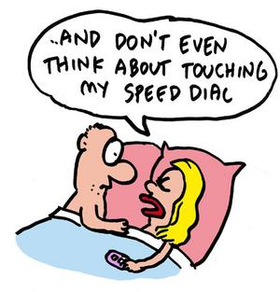
Dapoxetine

Slide 61
Dapoxetine is absorbed and eliminated faster than antidepressant SSRIs
Dapoxetine plasma concentrations at 24 hours <5% of peak
Andersson et al. BJU Int 2006;97(2):311-315.
Notes:
61
This slide compares the pharmacokinetic profile of Dapoxetine with that of SSRIs indicated for the treatment of depression.
The data show that Dapoxetine is absorbed more rapidly, with the time taken to reach the peak plasma concentrations (T_{max}) approximately 3-fold less than the antidepressant SSRIs.
Plasma concentrations of Dapoxetine also decrease more rapidly following achievement of peak levels. While plasma Dapoxetine concentrations fall to less than 5% of peak 24 hours post-dosing, the concentration of the antidepressant SSRIs remains above 40%. Therefore, while repeated daily dosing of Dapoxetine is likely to lead to only minimal accumulation, considerable accumulation is likely with repeated dosing of antidepressant SSRIs.

Slide 62
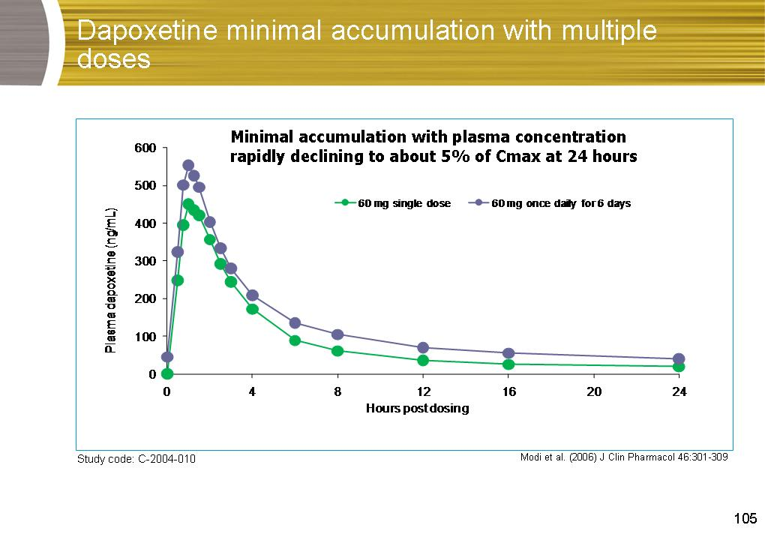
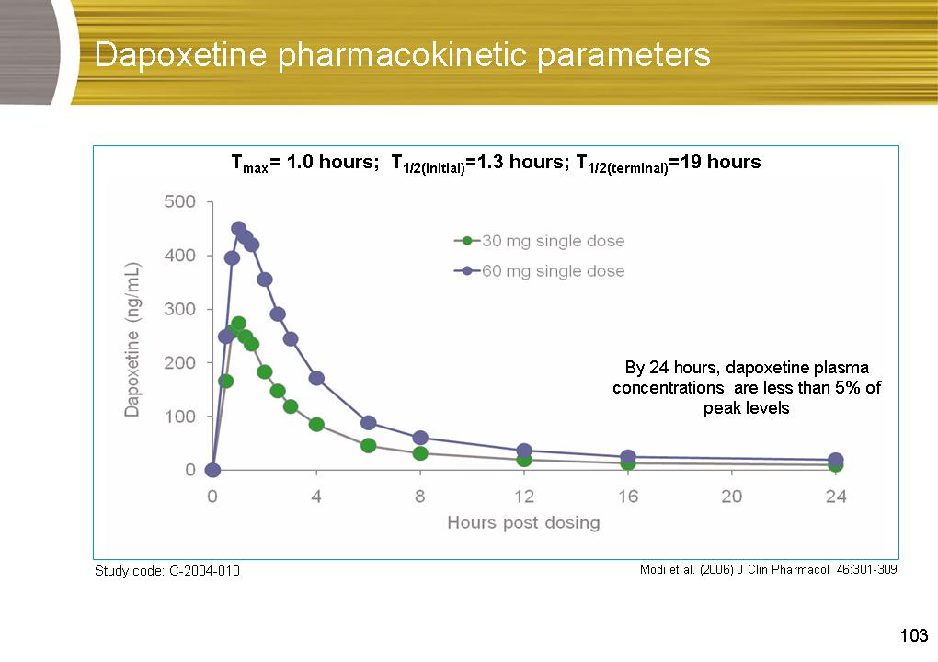
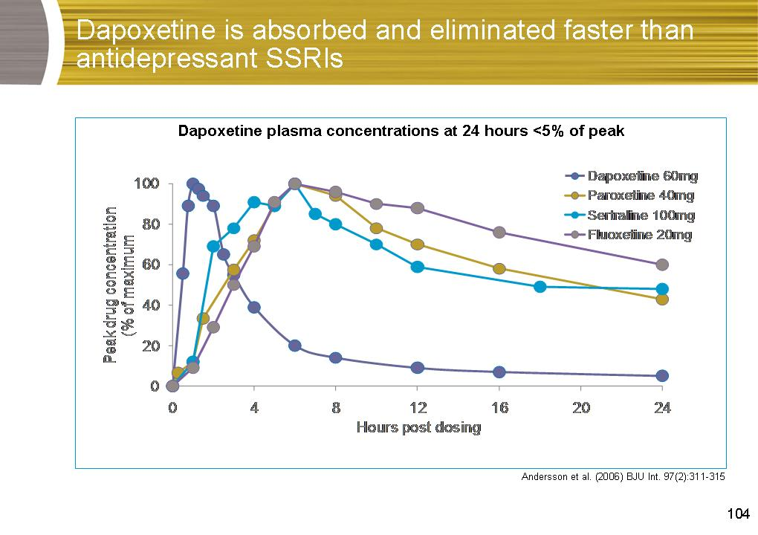
Dapoxetine Pharmacokinetics
Dapoxetine undergoes rapid absorption (Tmax of 1.0 hours), mean half-life after a single dose is 1.3 hours
Minimal accumulation with plasma concentration rapidly declining to about 5% of Cmax at 24 hours.
Dose-dependent pharmacokinetics with plasma concentrations unaffected by multiple dosing

Slide 63
Tadalafil and sildenafil do not affect the plasma concentrations of Dapoxetine
It appears that co-administered sildenafil or tadalafil does not result in clinically significant drug-drug interactions with Dapoxetine
Plasma Dapoxetine concentrations decreased to 5%
of C_{max} by 24 hours
500
400
Dapoxetine
Dapoxetine + tadalafil
300
Dapoxetine + sildenafil
Plasma Dapoxetine (ng/mL)
200
100
0
0
20
40
60
80
Time (hours)
Dresser et al. Int J Impot Res 2006;18(1):104-110.
Notes:
63
The pharmacokinetic profile of Dapoxetine is unaffected by co-administration of the PDE-5 inhibitors tadalafil and sildenafil.
Plasma concentrations of Dapoxetine after administration of a single 60 mg dose were comparable when co-administered with single doses of tadalafil (20 mg) or sildenafil (100 mg).
Profiles for desmethylDapoxetine and Dapoxetine-N-oxide are similarly unaffected.

Slide 64
Rapid absorption of Dapoxetine may enhance clinical utility
  Antidepressant SSRIs generally take 1-2 weeks of daily dosing before they are effective against the symptoms of PE
  The rapid absorption of Dapoxetine might lead to an abrupt increase in serotonin levels that overwhelms the compensatory capacity of the 5-HT_{1A} autoreceptors
  This may explain the ability of Dapoxetine to improve PE symptoms with on-demand dosing.
Giuliano & Clement. Eur Urol 2006;50(3):454-66.
Giuliano. Trends Neurosci 2007;30(2):79-84.
Notes:
64
The ideas in this slide are summarized by Giuliano. TINS 2006;30(2):79-84.
The function of serotonin in the central nervous system is controlled by many factors including the 5-HT transporter and the 5-HT_{1A} autoreceptors. When bound by serotonin, the 5-HT_{1A} autoreceptors reduce the firing rate of serotonergic neurons, so also inhibiting the activity of serotoergic pathways.
Administration of a single dose of a long-acting, antidepressant SSRI causes an increase in synaptic serotonin levels due to 5-HT transporter blockade. However, the increase in synaptic serotonin levels, in turn, causes activation of 5-HT_{1A} autoreceptors, which reduce synaptic serotonin levels again, negating the effect of 5-HT transporter blockade. To be effective, antidepressant SSRIs must be administered daily for several weeks until 5-HT_{1A} autoreceptors are downregulated and the SSRI-induced increase in synaptic serotonin is achieved.
The short-acting SSRI Dapoxetine is effective on-demand from the first dose. It has been speculated that rapid absorption of Dapoxetine overwhelms the 5-HT_{1A} autoreceptors, resulting in an increase in synaptic serotonin levels. Alternatively, the particular properties of Dapoxetine may not result in 5-HT_{1A} autoreceptors activation.

Slide 65
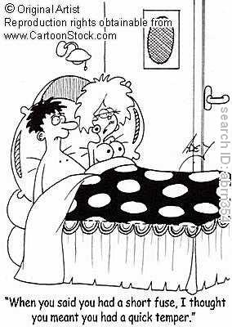
Dapoxetine - Integrated Phase III Data

Slide 66
Dapoxetine - Integrated Phase III Data
Pooled data from 5 randomized, double blind placebo controlled, multicentre 12-24 week phase III studies
n= 6,081, DSM-IV-TR diagnosis & IELT <2 min
Screening Phase
Double Blind 12-24 week Rx Phase
4 weeks
Dapoxetine 60mg
Collect
Baseline
Data
Randomize
Dapoxetine 30mg
No Drug
Placebo
VISITS
4/52 8/52 12/52 16/52 20/52
Week 12/24
1º Efficacy Endpoint

Slide 67
Dapoxetine First Dose Effect on IELT
Pooled data (baseline – Week 12†) and 3001 data (Week 24†)
*p<0.001 vs placebo ANCOVA
*
*
†Week 12 (012, 013, 3001, 3003) or Week 24 (3001) or last observation carried forward
McMahon et al. (2008) Presented at ESSM/ISSM; Data on file;
Buvat et al. (2009) Eur Urology DOI: 10.1016/j.eururo.2009.01.025
Notes:
67
Dapoxetine significantly increased IELT from first administration to drug naïve individuals. Mean IELT at 12 weeks was approximately three-times baseline values.
The effect of dapoxetine showed no signs of diminution after the first month of on-demand treatment and significant increases in IELT were maintained for up to 24 weeks.

Slide 68
Dapoxetine IELT
Pooled IELT values at endpoint†
†Week 12 (012, 013, 3001, 3003) or last observation carried forward
* Fold-increase=geometric endpoint/geometric baseline, not model based. Values are unadjusted.
McMahon et al. (2008) Presented at ESSM/ISSM
Notes:
68
Marked increases in IELT values with dapoxetine were apparent irrespective of the method of reporting data.
It has been argued that IELT values are not normally distributed but rather positively skewed and thus should be reported as medians or geometric means rather than arithmetic means (Waldinger, Lancet 2006; 368:1869).
These data also show the magnitude of the effect of dapoxetine on IELT, providing a 2.5- and 3-fold increase compared with placebo (30 mg and 60 mg, respectively).

Slide 69
Perceived Control Over Ejaculation
“Over the past month, was your control over ejaculation during
sexual intercourse: very poor, poor, fair, good, very good
*
32.4%
*
26.2%
12.4%
0.3%
0.6%
0.4%
(n = 1,853)
(n = 1,614)
(n = 2,101)
(n = 1,682)
(n = 1,489)
(n = 1,893)
*P <0.001 vs placebo.
Baseline
Endpoint
McMahon et al. (2008) Presented at ESSM/ISSM

Slide 70
Ejaculation-related Personal Distress
“Over the past month, how distressed were you by how fast you ejaculated during sexual intercourse?” (extremely, quite a bit, moderately, a little bit, not at all)
71.1%
71.3%
68.9%
39.7%
*
28.1%
*
21.1%
(n = 987)
(n =742)
(n = 1,235)
(n = 909)
(n = 689)
(n =1,123)
*P <0.001 vs placebo.
Baseline
Endpoint
McMahon et al. (2008) Presented at ESSM/ISSM
70

Slide 71
Association with Suicidal Ideation & Withdrawal Syndrome
Evidence of increased risk of suicidal ideation and self harm in subjects receiving antidepressant SSRIs:
  Compared to placebo [1,2]
  Compared to other antidepressants (in the elderly) [3]
Abrupt interruption of antidepressant SSRI therapy for 5–8 days may be associated with the emergence of a withdrawal syndrome [4], including …
  Dizziness; Insomnia; Nervousness; Nausea; Agitation
Gunnell et al. (2005) BMJ 330:385
Fergusson et al. (2005) BMJ 330:396l
Juurlink et al. (2006) Am J Psychiatry 163:813–21
Rosenbaum et al. (1998) Biol Psychiatry 44:77-87
Notes:
71
The abrupt cessation of administration of marketed SSRIs has been reported to result in an SSRI discontinuation syndrome. The 3002 study, a safety study in the US and Canada, was designed specifically to evaluate the potential for withdrawal syndrome, incorporated the Discontinuation Emergent Signs and Symptoms (DESS) checklist to evaluate the potential for such a withdrawal syndrome.

Slide 72


Slide 73
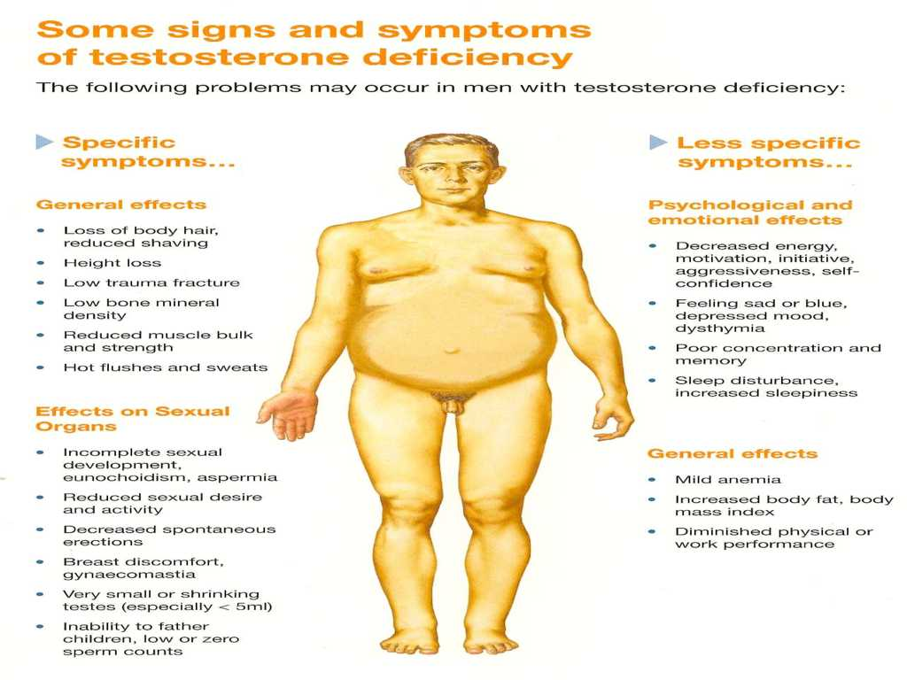

Slide 74


Androgen Deficiency
Androgen deficiency is a condition in which tissues do not have enough exposure to androgens for normal function
One in 200 men under 60 years of age suffer from androgen deficiency
Testosterone levels fall with age
At age 65 years, 10% of men have androgen deficiency and this increases to 20% by 70 years

Slide 75
Aspects of LOH remain controversial
Diagnosis is not straightforward
  Symptoms are vague and non specific (depression, hypothyroidism, anaemia, ageing)
  No validated screening instrument
Disagreement over ‘normal’ and ‘low’ T levels
  no single level of T separates hypogonadism from eugonadism
  selection of ‘lower limit’ of T is arbitrary
    Australia <8 nmol/L
    US <10.4 nmol/L
    Europe <12 nmol/L
  thresholds for clinically low T are arbitrarily chosen
Notes:
In a study
by Wang and colleagues, values as low as 160 ng/dL and as high
as 508 ng/dL were reported for the same sample, depending on
which assay was used.32
Wang C, Catlin DH, Demers LM, Starcevic B, Swerdloff RS.
Measurement of total serum testosterone in adult men:
comparison of current laboratory methods versus liquid
chromatography-tandem mass spectrometry. J Clin Endocrinol
Metab. 2004;89(2):534-543.
Mass spectroscopy gold standard
160,000 women aged 50 to 79

Slide 76
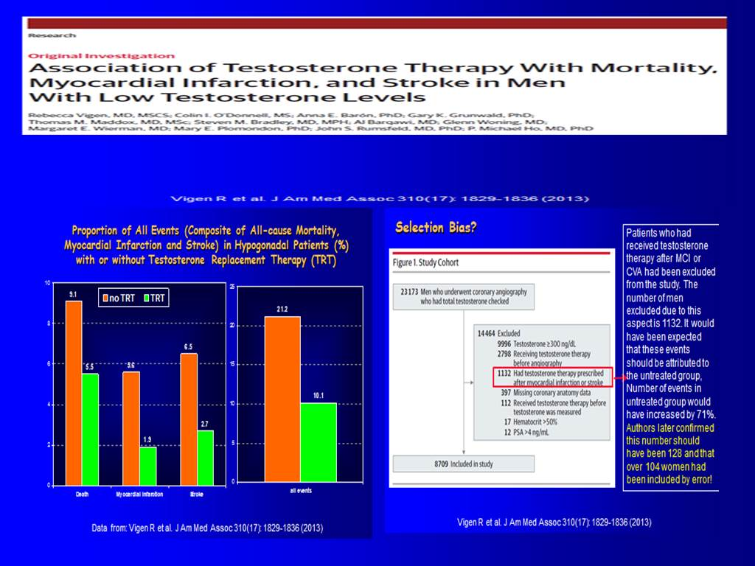
Notes:
JAMA. 2013 Nov 6;310(17):1829-36. doi: 10.1001/jama.2013.280386.
Association of testosterone therapy with mortality, myocardial infarction, and stroke in men with low testosterone levels.
Vigen R, O'Donnell CI, Barón AE, Grunwald GK, Maddox TM, Bradley SM, Barqawi A, Woning G, Wierman ME, Plomondon ME, Rumsfeld JS, Ho PM.
http://www.ncbi.nlm.nih.gov/pubmed/24193080
Full-text: http://jama.jamanetwork.com/article.aspx?articleid=1764051
IMPORTANCE:
Rates of testosterone therapy are increasing and the effects of testosterone therapy on cardiovascular outcomes and mortality are unknown. A recent randomized clinical trial of testosterone therapy in men with a high prevalence of cardiovascular diseases was stopped prematurely due to adverse cardiovascular events raising concerns about testosterone therapy safety.
OBJECTIVES:
To assess the association between testosterone therapy and all-cause mortality, myocardial infarction (MI), or stroke among male veterans and to determine whether this association is modified by underlying coronary artery disease.
DESIGN, SETTING, AND PATIENTS:
A retrospective national cohort study of men with low testosterone levels (<300 ng/dL) who underwent coronary angiography in the Veterans Affairs (VA) system between 2005 and 2011.
MAIN OUTCOMES AND MEASURES:
Primary outcome was a composite of all-cause mortality, MI, and ischemic stroke.
RESULTS:
Of the 8709 men with a total testosterone level lower than 300 ng/dL, 1223 patients started testosterone therapy after a median of 531 days following coronary angiography. Of the 1710 outcome events, 748 men died, 443 had MIs, and 519 had strokes. Of 7486 patients not receiving testosterone therapy, 681 died, 420 had MIs, and 486 had strokes. Among 1223 patients receiving testosterone therapy, 67 died, 23 had MIs, and 33 had strokes. At 3 years after coronary angiography, the Kaplan-Meier estimated cumulative percentages with events were 19.9%in the no testosterone therapy group vs 25.7%in the testosterone therapy group,with an absolute risk difference of 5.8%(95%CI, -1.4%to 13.1%) [corrected].The Kaplan-Meier estimated cumulative percentages with events among the no testosterone therapy group vs testosterone therapy group at 1 year after coronary angiography were 10.1% vs 11.3%; at 2 years, 15.4% vs 18.5%; and at 3 years, 19.9% vs 25.7 [corrected].There was no significant difference in the effect size of testosterone therapy among those with and without coronary artery disease (test for interaction, P = .41).
CONCLUSIONS AND RELEVANCE:
Among a cohort of men in the VA health care system who underwent coronary angiography and had a low serum testosterone level, the use of testosterone therapy was associated with increased risk of adverse outcomes. These findings may inform the discussion about the potential risks of testosterone therapy.

Slide 77
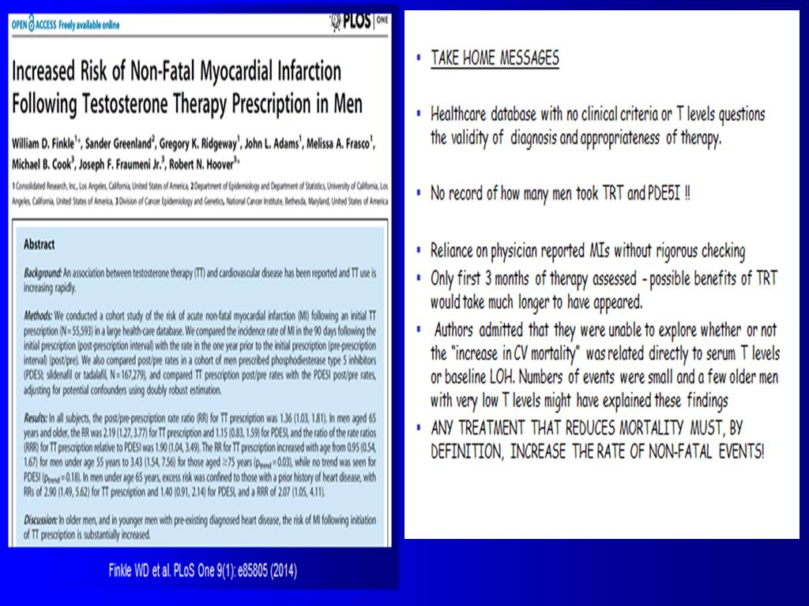
Notes:
PLoS One. 2014 Jan 29;9(1):e85805. doi: 10.1371/journal.pone.0085805. eCollection 2014.
Increased risk of non-fatal myocardial infarction following testosterone therapy prescription in men.
Finkle WD, Greenland S, Ridgeway GK, Adams JL, Frasco MA, Cook MB, Fraumeni JF Jr, Hoover RN.
http://www.ncbi.nlm.nih.gov/pubmed/24489673
Full-text: http://journals.plos.org/plosone/article?id=10.1371/journal.pone.0085805
BACKGROUND:
An association between testosterone therapy (TT) and cardiovascular disease has been reported and TT use is increasing rapidly.
METHODS:
We conducted a cohort study of the risk of acute non-fatal myocardial infarction (MI) following an initial TT prescription (N = 55,593) in a large health-care database. We compared the incidence rate of MI in the 90 days following the initial prescription (post-prescription interval) with the rate in the one year prior to the initial prescription (pre-prescription interval) (post/pre). We also compared post/pre rates in a cohort of men prescribed phosphodiesterase type 5 inhibitors (PDE5I; sildenafil or tadalafil, N = 167,279), and compared TT prescription post/pre rates with the PDE5I post/pre rates, adjusting for potential confounders using doubly robust estimation.
RESULTS:
In all subjects, the post/pre-prescription rate ratio (RR) for TT prescription was 1.36 (1.03, 1.81). In men aged 65 years and older, the RR was 2.19 (1.27, 3.77) for TT prescription and 1.15 (0.83, 1.59) for PDE5I, and the ratio of the rate ratios (RRR) for TT prescription relative to PDE5I was 1.90 (1.04, 3.49). The RR for TT prescription increased with age from 0.95 (0.54, 1.67) for men under age 55 years to 3.43 (1.54, 7.56) for those aged ≥ 75 years (p trend = 0.03), while no trend was seen for PDE5I (p trend = 0.18). In men under age 65 years, excess risk was confined to those with a prior history of heart disease, with RRs of 2.90 (1.49, 5.62) for TT prescription and 1.40 (0.91, 2.14) for PDE5I, and a RRR of 2.07 (1.05, 4.11).
DISCUSSION:
In older men, and in younger men with pre-existing diagnosed heart disease, the risk of MI following initiation of TT prescription is substantially increased.

Slide 78
Studies following publication of Vigen and Finkle
Author | Year | Journal / Congress | Study type | # of patients on TRT | Results
TESTOSTERONE REPLACEMENT THRAPY (TRT)
Baillargeon et al. | 2014 | Ann Pharmacother | Retrospective Medicare database review | 6,355 | No increased risk of MI, moderately protective effect of TRT in high risk patients.
Anderson JL et al. | 2014 | Circulation/AHA | Retrospective medical records review | 4,713 | Reduced incidence of MACE.
Eisenberg ML et al. | 2015 | Int J Impot Res | Retrospective medical records review | 284 | No increased mortality risk.
Janmohamed S et al. | 2015 | Endocrin Rev /Endo | Retrospective | 217 | Reduced incidence of MACE.
Li H et al. | 2015 | Endocrin Rev /Endo | Truven database review | 102,650 | No increased risk of VTE.
Saad F et al. | 2015 | Endocrin Rev /Endo | Prospective registry | 68 | No MACE in patient with CVD history.
MACE; Major Adverse Cardiovascular Event, VTE; Venous Thromboembolism
Notes:
1)
Ann Pharmacother. 2014 Jul 2;48(9):1138-1144. [Epub ahead of print]
Risk of Myocardial Infarction in Older Men Receiving Testosterone Therapy.
Baillargeon J, Urban RJ, Kuo YF, Ottenbacher KJ, Raji MA, Du F, Lin YL, Goodwin JS.
http://www.ncbi.nlm.nih.gov/pubmed/24989174
Full-text: http://www.ncbi.nlm.nih.gov/pmc/articles/PMC4282628/pdf/nihms628700.pdf
2)
http://circ.ahajournals.org/content/130/Suppl_2/A13220.abstract
Final study publication:
Am J Cardiol. 2016 Mar 1;117(5):794-9
Impact of Testosterone Replacement Therapy on Myocardial Infarction, Stroke, and Death in Men With Low Testosterone Concentrations in an Integrated Health Care System.
Anderson JL, May HT, Lappé DL, Bair T, Le V, Carlquist JF, Muhlestein JB.
http://www.ncbi.nlm.nih.gov/pubmed/26772440
The aim of this study was to assess the effect of testosterone replacement therapy (TRT) on cardiovascular outcomes. Men (January 1, 1996, to December 31, 2011) with a low initial total testosterone concentration, a subsequent testosterone level, and >3 years of follow-up were studied. Levels were correlated with testosterone supplement use. The primary outcome was major adverse cardiovascular events (MACE), defined as a composite of death, nonfatal myocardial infarction, and stroke at 3 years. Multivariate adjusted hazard ratios (HRs) comparing groups of persistent low (<212 ng/dl, n = 801), normal (212 to 742 ng/dl, n = 2,241), and high (>742 ng/dl, n = 1,694) achieved testosterone were calculated by Cox hazard regression. A total of 4,736 men were studied. Three-year rates of MACE and death were 6.6% and 4.3%, respectively. Subjects supplemented to normal testosterone had reduced 3-year MACE (HR 0.74; 95% confidence interval [CI] 0.56 to 0.98, p = 0.04) compared to persistently low testosterone, driven primarily by death (HR 0.65, 95% CI 0.47 to 0.90). HRs for MI and stroke were 0.73 (95% CI 0.40 to 1.34), p = 0.32, and 1.11 (95% CI 0.54 to 2.28), p = 0.78, respectively. MACE was noninferior but not superior for high achieved testosterone with no benefit on MI and a trend to greater stroke risk. In conclusion, in a large general health care population, TRT to normal levels was associated with reduced MACE and death over 3 years but a stroke signal with high achieved levels suggests a conservative approach to TRT.
3)
Int J Impot Res. 2015 Mar-Apr;27(2):46-8. doi: 10.1038/ijir.2014.29. Epub 2014 Jul 31.
Testosterone therapy and mortality risk.
Eisenberg ML, Li S, Herder D, Lamb DJ, Lipshultz LI.
http://www.ncbi.nlm.nih.gov/pubmed/25078049
Full-text: http://www.ncbi.nlm.nih.gov/pmc/articles/PMC4312542/pdf/nihms600869.pdf
Recent data suggest an increased risk of cardiovascular events and mortality in men on testosterone therapy (TT). To date, there are no long-term, prospective studies to determine safety. In such cases, retrospective observational studies can be helpful. We examined our patient database to determine whether TT altered the risk of all-cause mortality in men. We queried our hormone database for all men with a serum testosterone level and then examined charts to determine testosterone status. In all, 509 men had charts available for review. We linked our patient records to the National Death Index to determine mortality. Of the 509 men who met inclusion criteria, 284 were on TT and 225 did not use testosterone. Age (mean 54 years) and follow-up time (mean 10 years) were similar for both groups. In all, 19 men died--10 (4.4%) men not on TT and 9 (3.2%) men on TT. After adjusting for age and year of evaluation, there was no significant difference in the risk of death based on TT (hazard ratio 0.92, 95% confidence interval 0.36-2.35, P=1.0). There appears to be no change in mortality risk overall for men utilizing long-term testosterone therapy.
4)
Janmohamed S et al.
Abstract: http://press.endocrine.org/doi/abs/10.1210/endo-meetings.2015.RE.15.OR34-4
5)
Li H et al.
http://press.endocrine.org/doi/10.1210/endo-meetings.2015.RE.15.OR34-2
Abstract:
Background: To date, no studies have assessed whether an association exists between testosterone replacement therapy (TRT) and venous thrombotic events (VTE).
Purpose: Investigate whether an association exists between TRT use and VTE in hypogonadal men via retrospective cohort and nested-case-control analyses.
Methods: Truven Databases were reviewed to obtain data from men with a hypogonadal condition (either treated with an approved TRT product or untreated but with a hypogonadal diagnosis meeting prespecified International Classification of Diseases [ICD-9] criteria) who were ≥18 years old, continuously enrolled (≥12 months) in a healthcare plan, and did not have a VTE diagnosis during baseline. Propensity-score (PS) 1:1 matching was used in the cohort analysis to ensure comparability between TRT-treated and untreated patients (pts) at baseline. In nested-case-control analyses, TRT-treated pts were matched to untreated pts in a 1:4 ratio based on age and calendar year. Among TRT-treated pts, index date was defined as the first TRT prescription date; among untreated pts, index date was assigned at random according to the distribution observed for treated pts. The outcome was defined as incident VTE, primarily Idiopathic VTE; exposure was assessed as primarily any TRT use and by different TRT administration routes. Cox regression and conditional logistic regression models were used in cohort and nested-case-control analyses, respectively, to assess hazard ratios (HRs) and odds ratios (ORs) for TRT/VTE associations. Sensitivity analyses were also performed using different TRT exposure and VTE parameters.
Results: 533,223 hypogonadal men met study inclusion criteria. After PS 1:1 matching, 102,650 TRT-treated pts and 102,650 untreated pts with Idiopathic VTE were included in the analysis.
Retrospective cohort analysis revealed an HR for Idiopathic VTE that was 1.08 for all TRT-treated pts (95% CI: 0.91, 1.27; p=0.378), 1.07 for topical/gel TRT-treated pts (95% CI: 0.88, 1.29; p=0.496), and 1.32 for injectable TRT-treated pts (95% CI: 0.89, 1.96; p=0.164). Stratification of pts by age (≤65 vs >65 years old) revealed similar, statistically non-significant results.
Nested-case-control analyses of 2,785 TRT-treated cases and 11,119 untreated controls revealed similar, non-significant findings. The OR for current TRT was 1.02 (95% CI: 0.92, 1.13; p=0.702), while the OR for past TRT was 0.92 (95% CI: 0.82, 1.03; p=0.145). Similar, non-significant findings were observed with age and TRT administration-route stratification.
Results from most sensitivity analyses supported those observed from the cohort and nested-case-control analyses.
Conclusion: The results from this study do not support an association between exogenous testosterone replacement therapy in hypogonadal men and an increased risk of venous thrombotic events.
6)
Saad F et al.
http://press.endocrine.org/doi/10.1210/endo-meetings.2015.RE.11.SAT-135
Abstract:
Introduction and Objectives:
Hypogonadism is associated with cardiometabolic risk. Studies suggest that hypogonadism increases the risk of all-cause and cardiovascular mortality. While some short-term studies have been performed in men with CVD, there are no data on long-term effects of testosterone (T) therapy in men with CVD.
Methods:
In a prospective, cumulative, observational registry study from a single urologist’s office, 340 men with T ≤12.1 nmol/L received TU injections for up to 87 months. In this subgroup analysis, 68 men with a previous diagnosis of coronary artery disease (CAD; n=40) and/or a history of myocardial infarction (MI; n=40) and/or stroke (n=6) were analyzed. These patients are considered high-risk patients by any definition.
Results:
Mean age was 60.76±4.94 years. The mean observation time was 72 months. All men except four were obese. 68 men were included for 3 years, 59 for 4 years, 54 for 5 years, 44 for 6 years, and 28 for 7 years. Declining numbers reflect the nature of the registry but not drop-out rates.
Weight (kg) decreased from 115.07±13.71 to 90.79±8.92. Waist circumference (cm) decreased from 112.07±7.97 to 99.14±6.53. BMI decreased from 37.27±4.45 to 29.58±3 (p<0.0001 for all). Mean weight loss was 18.75±0.71%.
Fasting glucose decreased from 108.74±17.08 to 96.14±2.01 mg/dl, HbA1c from 7.81±1.16 to 5.86±0.49% (p<0.0001 for both).
Total cholesterol decreased from 304.66±34.09 to 187.75±7.6, LDL from 184.28±37.51 to 120.64±29.29, triglycerides from 308.38±56.3 to 187.04±7.65 mg/dl. HDL increased slightly from 63.79±17.79 to 67.14±16.71 (p<0.0001 for all). The total cholesterol:HDL ratio declined from 5.16±1.55 to 2.97±0.77 (p<0.0001).
Liver enzymes: aspartate transaminase (AST) decreased from 42.16±14.13 to 19.71±2.17, alanine transaminase (ALT) from 42.56±15.55 to 19.39±3.25 U/L (p<0.0001 for both).
Systolic BP decreased from 167.82±11.01 to 142.39±9.54, diastolic BP from 102.28±8.23 to 80.07±7.13 mmHg (p<0.0001 for both). Pulse pressure declined from 65.54±5.24 to 62.32±5.15 (p<0.0001).
C-reactive protein (CRP) decreased from 3.97±4.73 to 0.32±0.44 mg/dl.
Haemoglobin increased from 14.45±0.68 to 15.03±0.45 g/dl, haematocrit from 43.51±2.86 to 48.86±1.41%.
In no patient testosterone was discontinued or interrupted. There were no major cardiovascular events during the observation time.
Conclusion:
T treatment in hypogonadal men with CVD was well tolerated and resulted in significant and sustained improvements of cardiometabolic risk factors. Medication adherence was excellent.

Slide 79
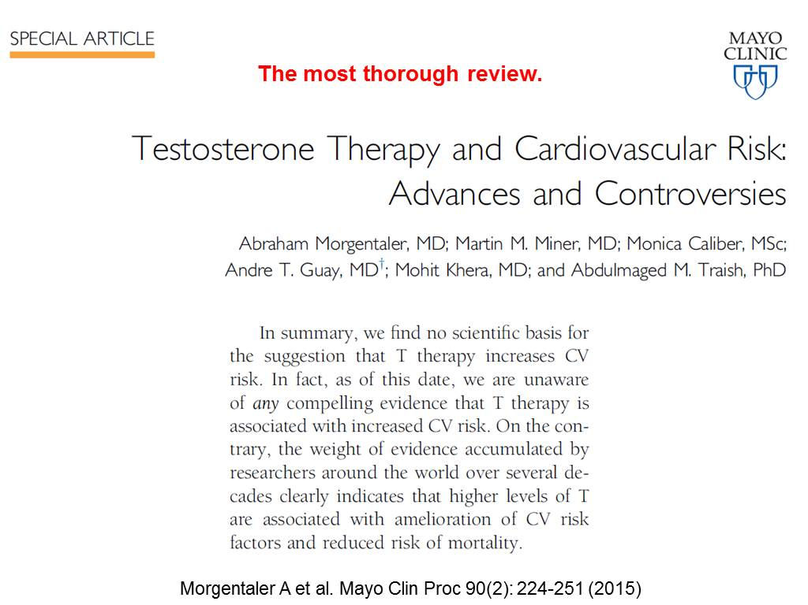
Notes:
Mayo Clin Proc. 2015 Feb;90(2):224-51.
Testosterone therapy and cardiovascular risk: advances and controversies.
Morgentaler A, Miner MM, Caliber M, Guay AT, Khera M, Traish AM.
http://www.ncbi.nlm.nih.gov/pubmed/25636998
Full-text: http://www.mayoclinicproceedings.org/article/S0025-6196(14)00925-2/pdf
Abstract:
Two recent studies raised new concerns regarding cardiovascular (CV) risks with testosterone (T) therapy. This article reviews those studies as well as the extensive literature on T and CV risks. A MEDLINE search was performed for the years 1940 to August 2014 using the following key words: testosterone, androgens, human, male, cardiovascular, stroke, cerebrovascular accident, myocardial infarction, heart attack, death, and mortality. The weight and direction of evidence was evaluated and level of evidence (LOE) assigned. Only 4 articles were identified that suggested increased CV risks with T prescriptions: 2 retrospective analyses with serious methodological limitations, 1 placebo-controlled trial with few major adverse cardiac events, and 1 meta-analysis that included questionable studies and events.
In contrast, several dozen studies have reported a beneficial effect of normal T levels on CV risks and mortality. Mortality and incident coronary artery disease are inversely associated with serum T concentrations (LOE IIa), as is severity of coronary artery disease (LOE IIa). Testosterone therapy is associated with reduced obesity, fat mass, and waist circumference (LOE Ib) and also improves glycemic control (LOE IIa). Mortality was reduced with T therapy in 2 retrospective studies. Several RCTs in men with coronary artery disease or heart failure reported improved function in men who received T compared with placebo.
The largest meta-analysis to date revealed no increase in CV risks in men who received T and reduced CV risk among those with metabolic disease. In summary, there is no convincing evidence of increased CV risks with T therapy. On the contrary, there appears to be a strong beneficial relationship between normal T and CV health that has not yet been widely appreciated.

Slide 80

Finally..

