Slide 1
Medical doctors’ contribution to Primary Care on the basis of patient-, person- and people- centered care
A new medical culture for Family Medicine in Thailand
Yongyuth Pongsupap MD, MPH, PhD
Senior Expert, National Health Security Office, Thailand
10th ASEAN and 7th Perak Health Conference on Primary Health Care
21-23 July 2017
Kinta Riverfront Hotel, Ipoh, Malaysia

Slide 2
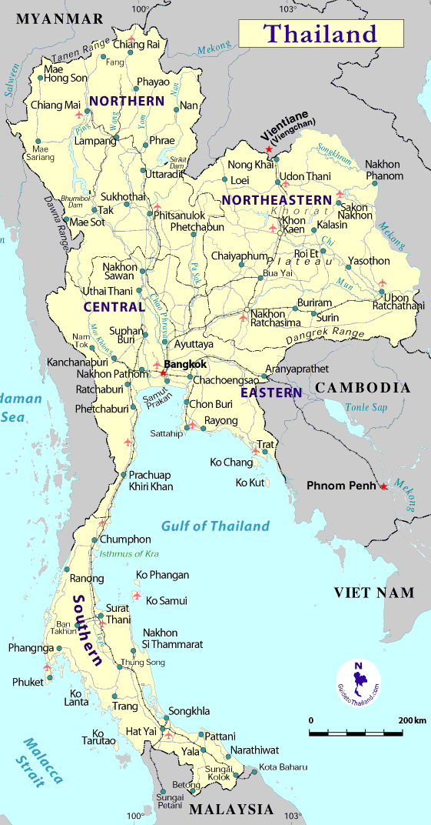
Background: “Thailand” Doctor, by definition, means ‘Hospital Doctor’
Health Care Structure in Thailand
National/University Hospital
Regional Hospital
Provincial or General Hospital
District Hospital
Population ~ 10,000 – 100,000
Doctors
Population: 65 millions
GNI: US$ 5210 per capita
Life expectancy at birth: 74 years
Total Health Expenditure: 4.6% of GDP
Health Centre
(No Doctor)
Population ~ 2,000 -5,000
Current Movements:
Primary Care (PC) in the Context of
District Health System (DHS)
Doctors/Population ~ 4/10,000
(Doctors may also work in
Hospitals as well as Private Clinics)

Slide 3
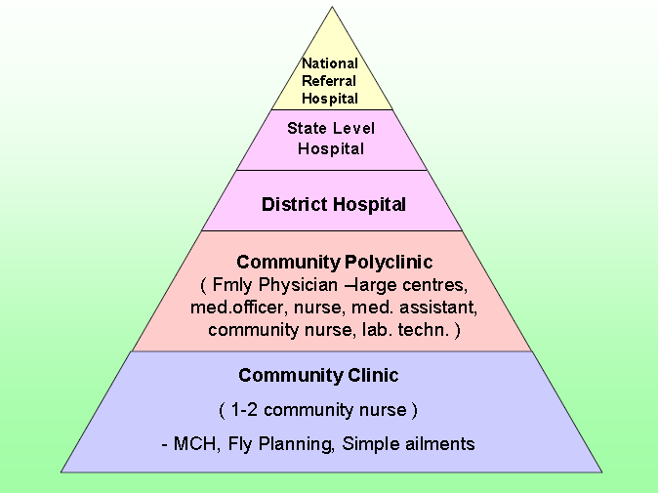
Background: “Thailand” Doctor, by definition, means ‘Hospital Doctor’
Health Care Structure in Malaysia
Health Care Structure in Thailand
National/University Hospital
Regional Hospital
Provincial or General Hospital
District Hospital
Population ~ 10,000 – 100,000
Doctors
Health Centre
(No Doctor)
Population ~ 2,000 -5,000
Current Movements:
Primary Care (PC) in the Context of
District Health System (DHS)
Source: Ministry of Health of Malaysia

Slide 4
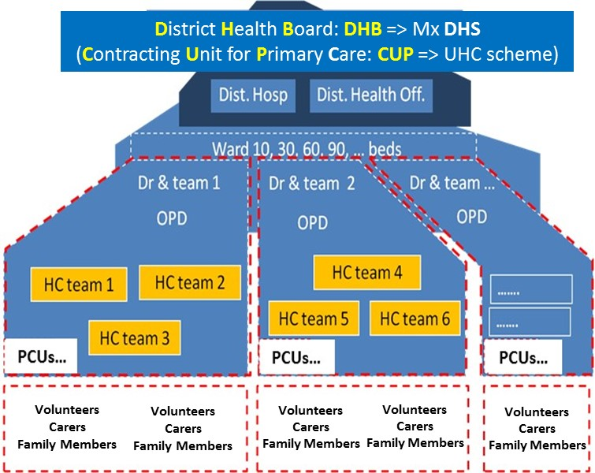
Evolution: Doctor as a member of “Matrix Team” >>> PATIENT-Centred Care
Health Care Structure in Thailand
National/University Hospital
Regional Hospital
Matrix Team
Provincial or General Hospital
District Hospital
Population ~ 10,000 – 100,000
Doctors
Family Doctors
Health Centre
(No Doctor)
Population ~ 2,000 -5,000
Current Movements:
Primary Care (PC) in the Context of
District Health System (DHS)
PCU (2002): Primary Care Unit; FCT (2015): Family Care Team; PCC (2016): Primary Care Cluster
Continuous policy Boosters toward “Matrix Team”

Slide 5
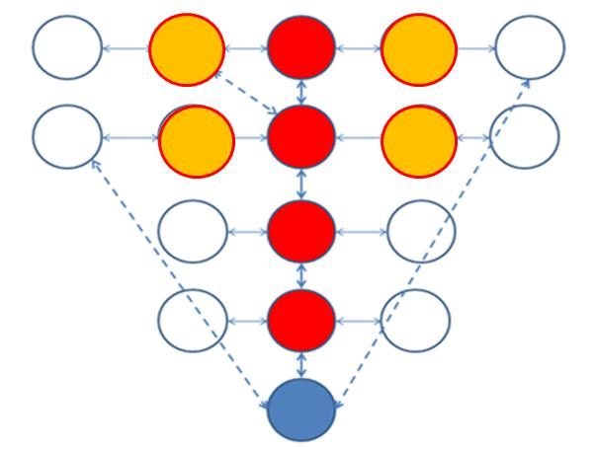
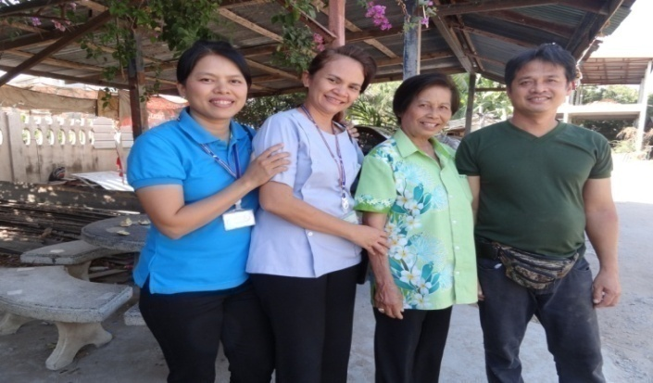
Evolution: Doctor as a member of “Matrix Team” >>> PERSON-Centred Care
A way forward in the New Constitution: “Empanelment”
(Patient-, Person-, and People-Centred Care)
Family Doctor
Hospital
District
Health Centre
Sub-District
Matrix Team
Village
Village Health Volunteers
Family
Relatives
Doctor
Nurse
Volunteer
Patient’s Son
Individual
Systematic Link: The name of Doctor
with the name of the Population
-> a clear Matrix Team
(Horizontal/Vertical Team including Diagonal relationships -> Person-Centred care)
PCU (2002): Primary Care Unit; FCT (2015): Family Care Team; PCC (2016): Primary Care Cluster
Continuous policy Boosters toward “Matrix Team”

Slide 6
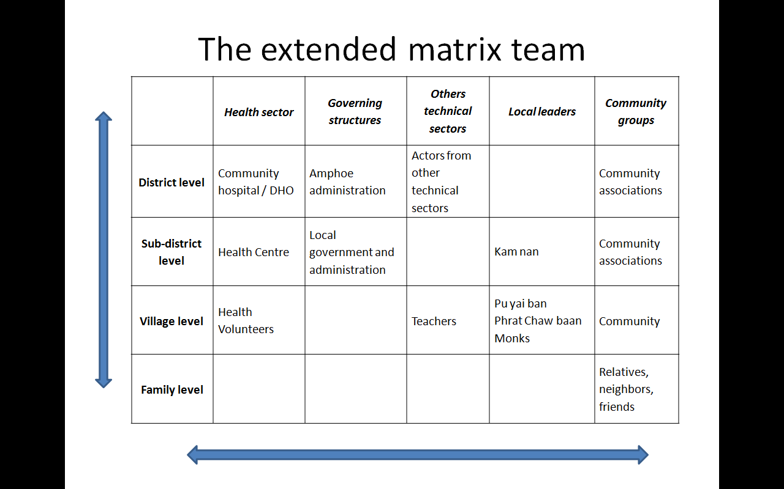
Evolution: DHB facilitates “Matrix Teams/Links/Networks” PEOPLE-Centred Care
A way forward in the New Constitution: “Empanelment”
(Patient-, Person-, and People-Centred Care)
Family Doctor
Hospital
District
Health Centre
Sub-District
Village
Village Health Volunteers
Interactive
Synergies
Family
Relatives
Doctor
Nurse
Volunteer
Patient’s Son
Individual
Systematic Link: The name of Doctor
with the name of the Population
-> a clear Matrix Team
(Horizontal/Vertical Team including Diagonal relationships -> Person-Centred care)
Matrix links in DHS: teams, networks, participation/collaboration
-->> Extended Matrix Teams

Slide 7
Significant Interventions and the Impacts
From… Hospital Based….
Toward… Area Based and People Centred System

Slide 8
1970s - 80s
Hospital: in every district
Health centre: in every sub-district
1980s
Health Volunteers: in every village
Good Care: Hospitals + Technologies
Introduction of new paradigm: Hol., Int. Cont., ...
1
1990s: Family Practice Model (Action Research)
+ Demonstration Diffusion Strategy
1999: Specialization in Family Medicine
Impacts of the UC scheme: Introducing Matrix Teams
2
2002: Contracting Unit for Primary Care (CUP): HR criteria
Primary Care Unit (PCU): intro… new medical culture
Historical Backgrounds
The Hegemony of Hospital Based Specialists
3
Matrix Teams/Links/Networks in the context of DHS
Area based and People-centred System…
Hospital-centred System…
2007: Context Based Learning (CBL): identified Gaps
Changing Paradigm
PCPL (2007), FPL (2012), DHML (2014)
2011: DHS --> UCARE
2015: Family Care Teams (FCT)
2016: Primary Care Cluster (PCC);
District Health Boards (DHB): pilot in 73 districts
>>> early 2017: expanded to 200 districts
4
Legal issues:
2017: Family Doctor (Constitution); DHB (Cabinet resolution)
>>> All (928) districts
Good Care: Patient-, Person-, People-centred Care
2000s: Achieving Universal Health Coverage

Slide 9
1970s - 80s
Hospital: in every district
Health centre: in every sub-district
Extensive Coverage of infra-structure in Public Sector
1980s
Health Volunteers: in every village
Good Care: Hospitals + Technologies
Introduction of new paradigm: Hol., Int. Cont., ...
1
1990s: Family Practice (Action Research)
+ Demonstration Diffusion Strategy
1999: Specialization in Family Medicine
Impacts of the UC scheme: Introducing Matrix Teams
2
2002: Contracting Unit for Primary Care (CUP): HR criteria
Primary Care Unit (PCU): intro… new medical culture
Historical Backgrounds
The Hegemony of Hospital Based Specialists
3
Matrix Teams/Links/Networks in the context of DHS
Area based and People-centred System…
Hospital-centred System…
2007: Context Based Learning (CBL): identified Gaps
Changing Paradigm
PCPL (2007), FPL (2012), DHML (2014)
2011: DHS --> UCARE
2015: Family Care Teams (FCT)
2016: Primary Care Cluster (PCC);
District Health Boards (DHB): pilot in 73 districts
>>> early 2017: expanded to 200 districts
4
Legal issues:
2017: Family Doctor (Constitution); DHB (Cabinet resolution)
>>> All (928) districts
Good Care: Patient-, Person-, People-centred Care
2000s: Achieving Universal Health Coverage

Slide 10
1970s - 80s
Hospital: in every district
Health centre: in every sub-district
1980s
Health Volunteers: in every village
% of Total population
2001: Universal Coverage
Scheme
2009: 99.36%
1992: Social Security
Scheme
1983: Civil Service
Medical Benefit Scheme
1983 -2002: Voluntary Public Health Insurance Schemes
(500 Baht per family)
1975: Scheme for the poor
2000s: Achieving Universal Health Coverage

Slide 11
1970s - 80s
Hospital: in every district
Health centre: in every sub-district
1980s
Health Volunteers: in every village
2001: Universal Coverage
Scheme
75%
1992: Social Security
Scheme
15%
1983: Civil Service
Medical Benefit Scheme
10%
Purchasing powers
All facilities in public sector
Some facilities in private sector
2000s: Achieving Universal Health Coverage

Slide 12
1970s - 80s
Hospital: in every district
Health centre: in every sub-district
1980s
Health Volunteers: in every village
Good Care: Hospitals + Technologies
Introduction of new paradigm: Hol., Int. Cont., ...
1
1990s: Family Practice Model (Action Research)
+ Demonstration Diffusion Strategy
1999: Specialization in Family Medicine
Impacts of the UC scheme: Introducing Matrix Teams
Reform process…
“Primary Care Development
In the context of DHS”
2
2002: Contracting Unit for Primary Care (CUP): HR criteria
Primary Care Unit (PCU): intro… new medical culture
3
Matrix Teams/Links/Networks in the context of DHS
Main Interventions & Current Changes
2007: Context Based Learning (CBL): identified Gaps
Changing Paradigm
PCPL (2007), FPL (2012), DHML (2014)
2011: DHS --> UCARE
2015: Family Care Teams (FCT)
2016: Primary Care Cluster (PCC);
District Health Boards (DHB): pilot in 73 districts
>>> early 2017: expanded to 200 districts
4
Legal issues:
2017: Family Doctor (Constitution); DHB (Cabinet resolution):
>>> All (928) districts
Good Care: Patient-, Person-, People-centred Care
2000s: Achieving Universal Health Coverage

Slide 13
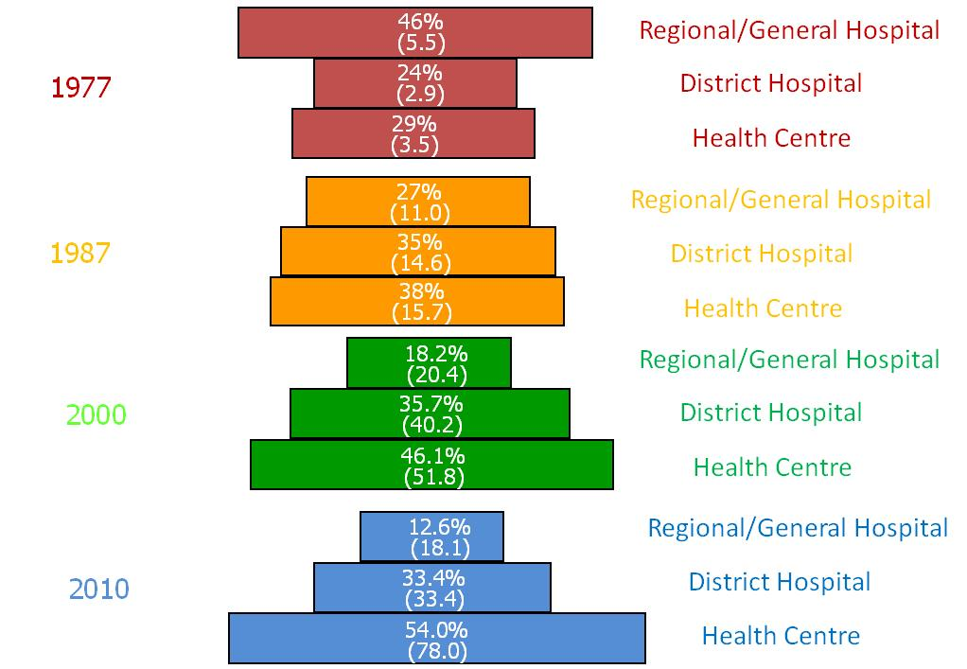
Changing of unitization patterns:
Progressive decentralization of care
Good Care: Hospitals + Technologies
Introduction of new paradigm: Hol., Int. Cont., ...
1
1990s: Family Practice Model (Action Research)
+ Demonstration Diffusion Strategy
1999: Specialization in Family Medicine
Impacts of the UC scheme: Introducing Matrix Teams
2
2002: Contracting Unit for Primary Care (CUP): HR criteria
Primary Care Unit (PCU): intro… new medical culture
3
Matrix Teams/Links/Networks in the context of DHS
Main Interventions & Current Changes
2007: Context Based Learning (CBL): identified Gaps
Changing Paradigm
PCPL (2007), FPL (2012), DHML (2014)
2011: DHS --> UCARE
2015: Family Care Teams (FCT)
2016: Primary Care Cluster (PCC);
District Health Boards (DHB): pilot in 73 districts
>>> early 2017: expanded to 200 districts
4
Legal issues:
2017: Family Doctor (Constitution); DHB (Cabinet resolution)
>>> All (928) districts
Matrix Team: Primary Care Development
In the contest of District Health System
Good Care: Patient-, Person-, People-centred Care
Source: NHSO (2012)

Slide 14
1970s - 80s
Hospital: in every district
Health centre: in every sub-district
1980s
Health Volunteers: in every village
Good Care: Hospitals + Technologies
1
Introduction of new paradigm: Hol., Int. Cont., ...
1
1990s: Family Practice Model (Action Research)
+ Demonstration Diffusion Strategy
1999: Specialization in Family Medicine
Impacts of the UC scheme: Introducing Matrix Teams
2
2002: Contracting Unit for Primary Care (CUP): HR criteria
Primary Care Unit (PCU): intro… new medical culture
Historical Backgrounds
The Hegemony of Hospital Based Specialists
3
Matrix Teams/Links/Networks in the context of DHS
Area based and People-centred System…
Hospital-centred System…
2007: Context Based Learning (CBL): identified Gaps
Changing Paradigm
PCPL (2007), FPL (2012), DHML (2014)
2011: DHS --> UCARE
2015: Family Care Teams (FCT)
2016: Primary Care Cluster (PCC);
District Health Boards (DHB): pilot in 73 districts
>>> early 2017: expanded to 200 districts
4
Legal issues:
2017: Family Doctor (Constitution); DHB (Cabinet resolution)
>>> All (928) districts
Good Care: Patient-, Person-, People-centred Care
2000s: Achieving Universal Health Coverage

Slide 15
1
Introduction of New Paradigm…
1990s: Family Practice Model (Action Research)
1999: Specialization in Family Medicine
+ Demonstration Diffusion (DD) Strategy
1989: Ayutthaya Research Project (ARP): introducing
holistic, integrated, and continuous care
1986: First Department of Family Medicine
Chiang Mai University
1991: Ayutthaya Urban Health Centre
...
1993: Korat
1999: Royal College of Family Physicians
1994: Hadyai
Formal Residency Training (3 years)
1995: Khon Khean
...
or Experiences > 5 years
+ additional criteria: eligible for exam.
1996: Health Care Reform Project
Implementation of the Demonstration Diffusion Strategy
(2002-2004: Fast tracts)
Reference Model: Gate Keeper (… UK)
Reference Model: Residency Training (… USA)

Slide 16
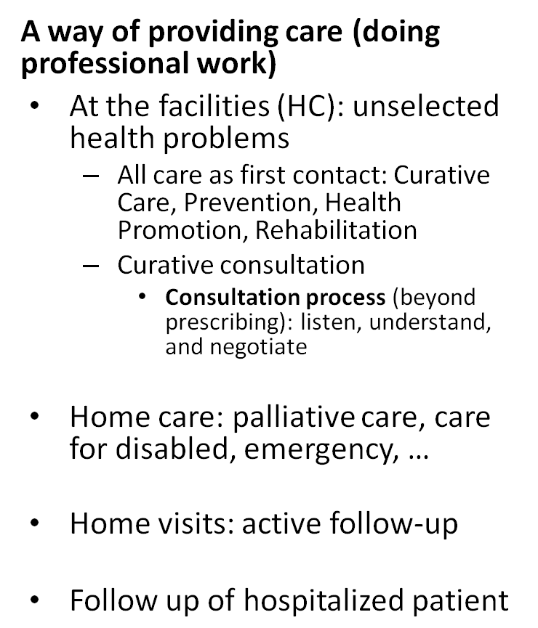
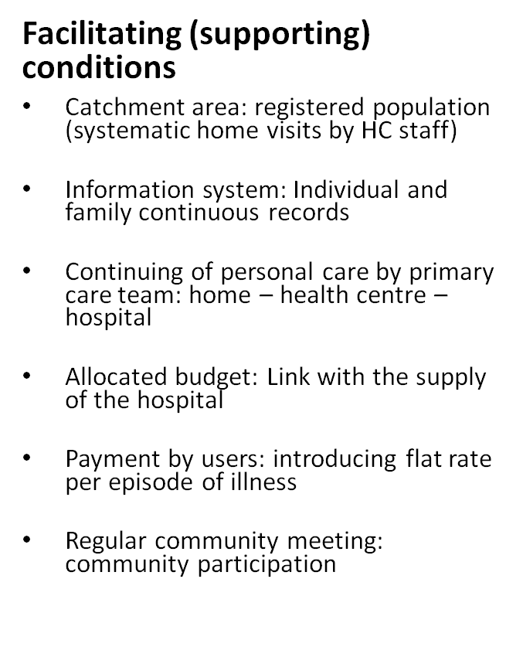
1
Demonstration Diffusion Strategy
1990s: Family Practice Model (Action Research)
Package of Activities and Facilitating Conditions
+ Demonstration Diffusion (DD) Strategy
1989: Ayutthaya Research Project (ARP): introducing
holistic, integrated, and continuous care
1991: Ayutthaya Urban Health Centre
1993: Korat
1994: Hadyai
1995: Khon Khean
...
1996: Health Care Reform Project
Implementation of the Demonstration Diffusion Strategy
Reference Model: Gate Keeper …
Specific Experience of ARP

Slide 17
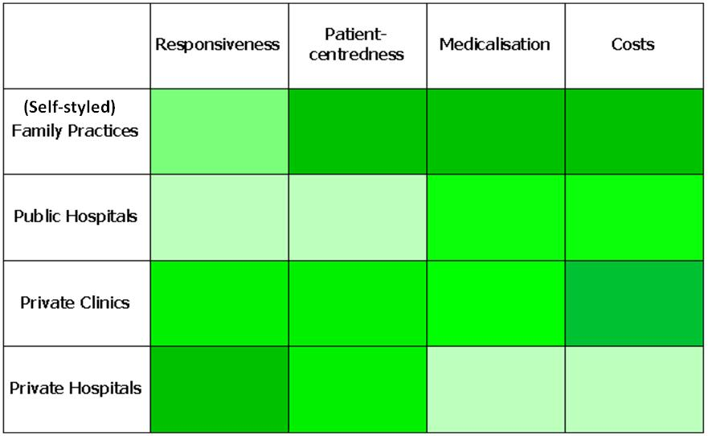
1
Demonstration Diffusion Strategy
Action Research: Ayuthaya Urban Health Centre
Simulated Patient Survey: consultation process
+ the implementation of the DD Strategy
Spontaneous diffusion before achieving UHC
Pongsupap, Y., & Van Lerberghe, W. (2006): Is motivation enough? Responsiveness, patient-centredness, medicalization and cost in family practice and conventional care settings in Thailand. Human Resources for Health, 4, 19. http://doi.org/10.1186/1478-4491-4-19

Slide 18
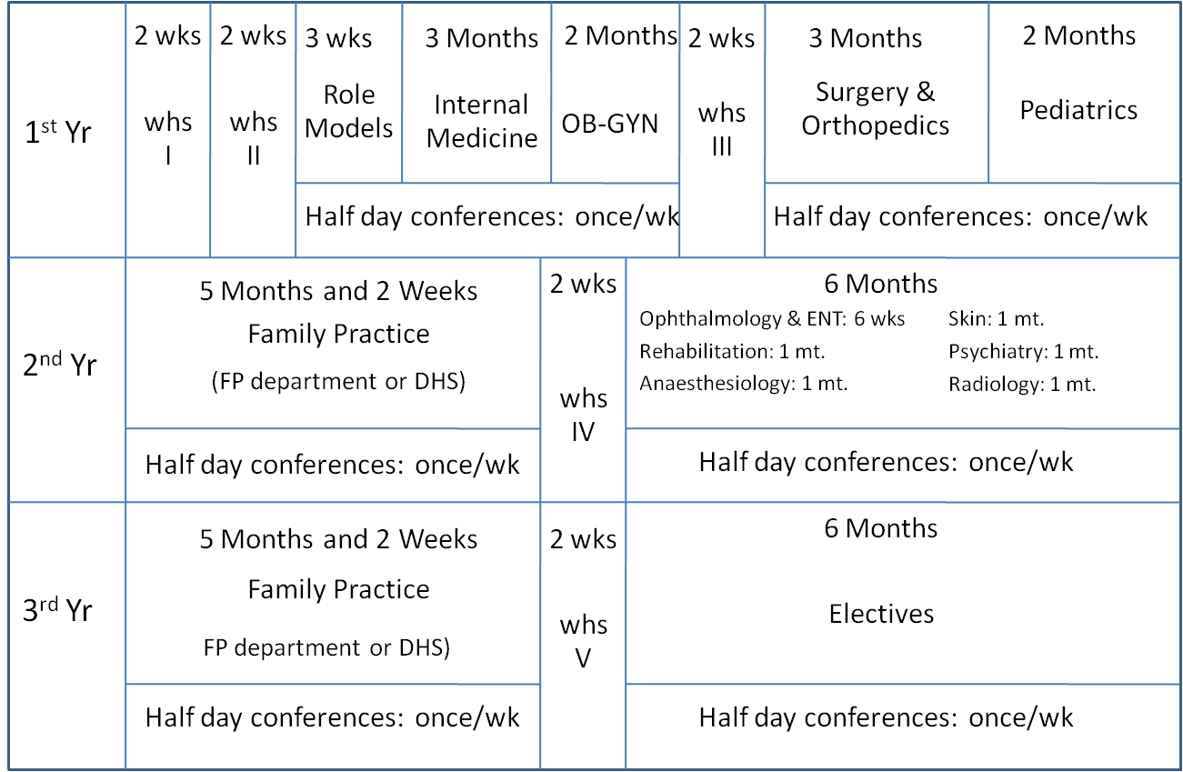
1
Specialization in Family Medicine
Package of Formal Residency Training (3 years)
1999: Specialization in Family Medicine
1986: First Department of Family Medicine
Chiang Mai University
...
1999: Royal College of Family Physicians
Formal Residency Training (3 years)
or Experiences > 5 years
+ additional criteria: eligible for exam.
(2002-2004: Fast tracts)
Reference Model: Residency Training …

Slide 19
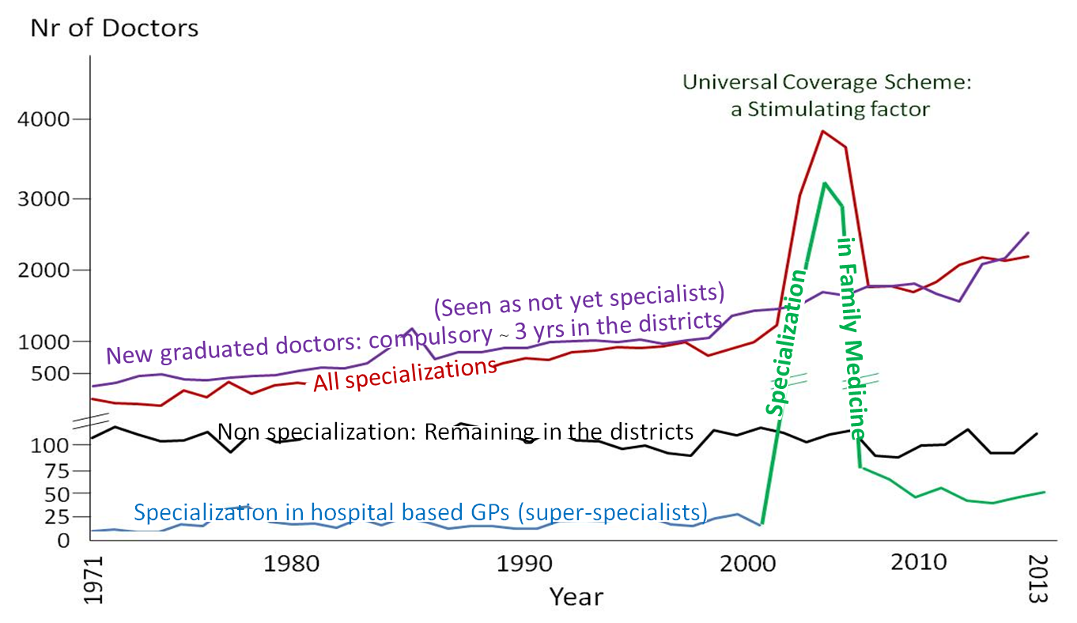
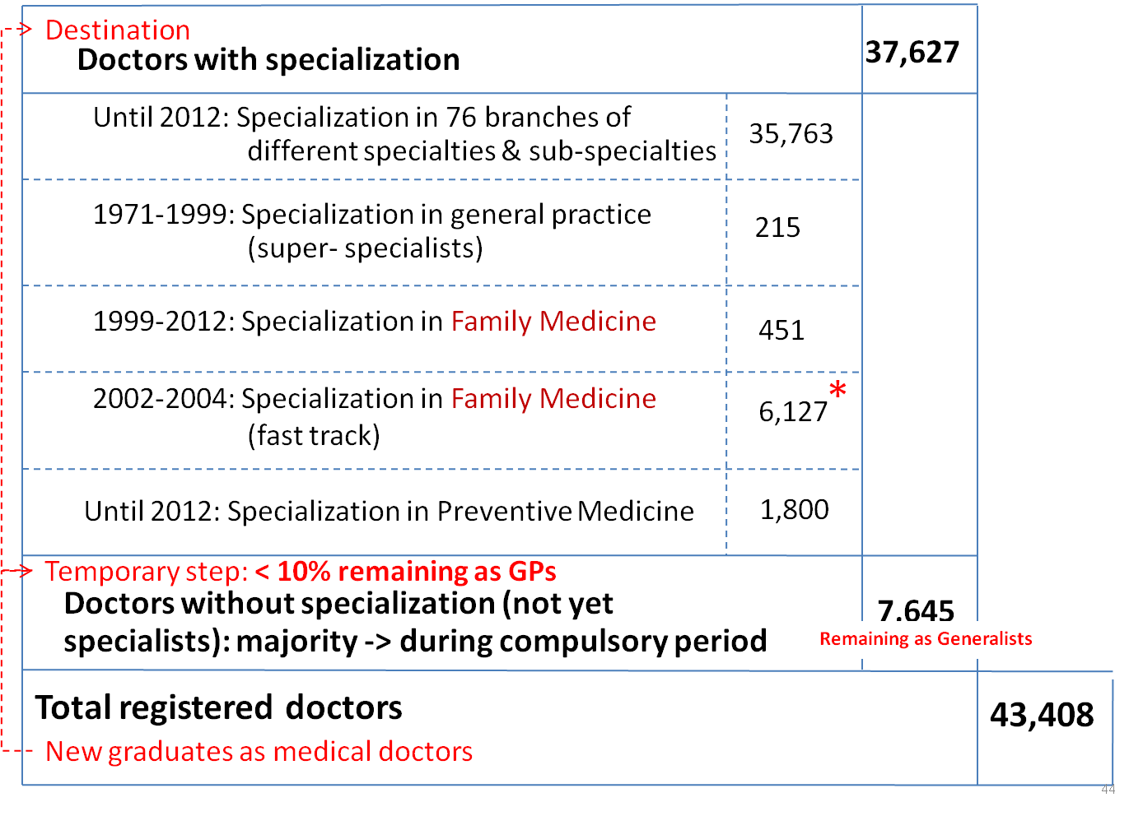
1
Specialization in Family Medicine & GPs (not yet Specialists)
Annual production of Doctors
Accumulated numbers of Doctors: until 2013

Slide 20
Conclusion: implemented strategies
1
Demonstration Diffusion (DD) Strategy: tested model >>> available model for the UC scheme…
Improving curriculums: especially on Family Medicine, Community Medicine in academic institutions
Build and stimulate the development of field models and learn what they mean in realities in different circumstances for policy implication
Consolidate family practice and primary care team specific to the Thai context: status, career, professional identity, production, and quality improvement

Slide 21
1970s - 80s
Hospital: in every sub-district
Health centre: in every sub-district
1980s
Health Volunteers: in every village
Good Care: Hospitals + Technologies
Introduction of new paradigm: Hol., Int. Cont., ...
1
1990s: Family Practice Model (Action Research)
+ Demonstration Diffusion Strategy
1999: Specialization in Family Medicine
2
Impacts of the UC scheme: Introducing Matrix Teams
2
2002: Contracting Unit for Primary Care (CUP): HR criteria
Primary Care Unit (PCU): intro… new medical culture
Historical Backgrounds
The Hegemony of Hospital Based Specialists
3
Matrix Teams/Links/Networks in the context of DHS
Area based and People-centred System…
Hospital-centred System…
2007: Context Based Learning (CBL): identified Gaps
Changing Paradigm
PCPL (2007), FPL (2012), DHML (2014)
2011: DHS --> UCARE
2015: Family Care Teams (FCT)
2016: Primary Care Cluster (PCC);
District Health Boards (DHB): pilot in 73 districts
4
Legal issues:
2017: Family Doctor (Constitution); DHB (Cabinet resolution)
>>> 200 districts >>>
Good Care: Patient-, Person-, People-centred Care
2000s: Achieving Universal Health Coverage

Slide 22
Contracting Unit for Primary Care (CUP): UC scheme
Payment mechanism: capitation basis
2
CUP must have
  At least a physician (1:10,000-20,000 population) for at least one PCU, …
Rural: limited resources
  One CUP => one administrative District (Hosp + HCs)
Urban: higher number of health services
  One administrative area => may be more than one CUP (Hosp + HCs or private clinics)
  One CUP may be a (network of) HC(s) or private clinic (s): if they fulfil the human resources criteria

Slide 23
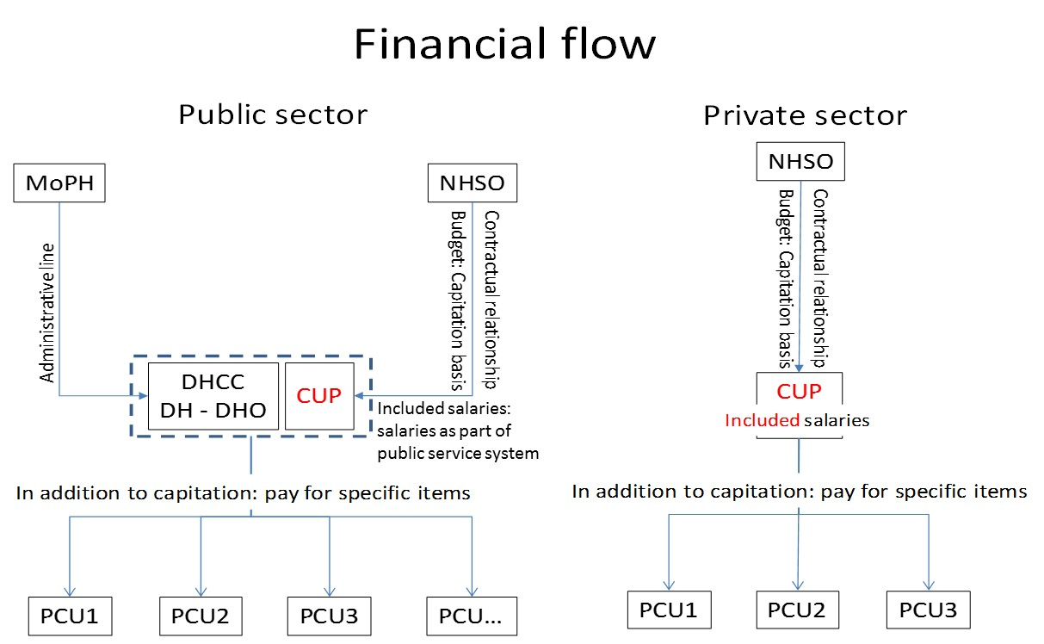
2
UC scheme: warm community clinics

Slide 24
2
Contracting Unit for Primary Care (CUP): human resource criteria
At least one doctor in one PCU under the CUP
Nr of HCs with MD
Majority of the cases
PCUs: application of UHC policy
Demonstration HCs:
Matrix Team
Being motivated as prime movers
of family doctors
UC scheme
2016: under the UC scheme, 10210 registered PCUs, 2387 doctors systemically involved in the PCUs
(169 doctors: specialization in Family Medicine)

Slide 25
2
Patient satisfaction
Exit survey:
Demon HCs – PCUs – Pub Hosp OPDs
Added value? PCUs more responsive than OPD, but less than prime movers
PCUs vs Pub Hosp OPDs: PCUs better than OPDs
PCUs vs Demon HCs: Demon HCs better than PCUs
How well did the doctor examine you?
Trust
How well did the doctor examine you?
How well did health services ensure you could talk
privately to the doctor?
How well did health services ensured you could
talk privately to the doctor?
How well did the doctor listen to you?
How well did the doctor listen to you?
How well did you understand what the doctor told you?
Communication
How well did you understand what the doctor
told you?
How clearly did the doctor explain things to you?
How clearly did the doctor explain things to you?
How comfortable were the premises?
Basic amenities
How comfortable were the premises?
How clean were the premise?
How clean were the premise?
How long did you have to wait at cashier?
How long did you have to wait at cashier?
How long did you have to wait at pharmacy?
How long did you have to wait at pharmacy?
How long did you have to wait at consultation?
Prompt attention
How long did you have to wait at consultation?
How long did you have to wait at reception?
How long did you have to wait at reception?
How this facility was easily accessible?
How this facility was easily accessible?
How were you involved in making decisions about
your health care?
Autonomy
How were you involved in making decisions
about your health care?
How well did you get enough time to speak or
ask questions?
How well did you get enough time to speak or
ask questions?
How politely were you treated by the
staff at the cashier?
How politely were you treated by the staff at the cashier?
How politely were you treated by the staff at
the pharmacist?
Dignity
How politely were you treated by the staff
at the pharmacy?
How politely were you treated by the staff at
the reception?
How politely were you treated by the staff
at the reception?
How politely were you treated by the doctor?
How politely were you treated by the doctor?
-1.4
-1.2
-1
-0.8
-0.6
-0.4
-0.2
0
0.2
0.4
0.6
0.8
1
1.2
1.4
Pub Hosp OPDs better
PCUs better
-1.4
-1.2
-1
-0.8
-0.6
-0.4
-0.2
0
0.2
0.4
0.6
0.8
1
1.2
1.4
Demon HCs better
PCUs better
Source: Pongsupap Y , Boonyapaisarnchareon B and Van Lerberghe W (2005): The Perception of Patients Using Primary Care Units in Comparison
with Conventional Public Hospital Outpatient Departments and Prime Mover Family Practices: An Exit Survey, Journal of Health Science, Vol 14 (3): 475-483

Slide 26
2
Responsiveness
Exit survey
New Methodology
Satisfaction
Expectation
Responsiveness
Domain of Responsiveness | Score of Direct experience (D) | Score of Vignette (V) | Score of Responsiveness (R)
Dignity | D_{d} | V_{d} | R_{d} = D_{d} - V_{d}
Autonomy | D_{a} | V_{a} | R_{a} = D_{a} - V_{a}
Confidentiality | D_{con} | V_{con} | R_{con} = D_{con} - V_{con}
Communication | D_{com} | V_{com} | R_{com} = D_{com} - V_{com}
Choice | D_{ch} | V_{ch} | R_{ch} = D_{ch} - V_{ch}
Prompt attention | D_{p} | V_{p} | R_{p} = D_{p} - V_{p}
Basic amenities | D_{b} | V_{b} | R_{b} = D_{b} - V_{b}
Family and community involvement | D_{f} | V_{f} | R_{f} = D_{f} - V_{f}
Source: WHR (2000)
R = D - V
Note: Higher score of Direct experience (D) means Higher satisfaction (Score: 1-10)
Higher score of Vignette (V) means Lower expectation (Score: 1-10)
Source: Pholpark A, Ponsupap Y, Aekplakorn W, Srithamrongsawat S, Sunsern R (2012): Responsiveness under
different health insurance schemes and hospital types, Journal of Health System Research, Vol 6 (2): 207-218

Slide 27
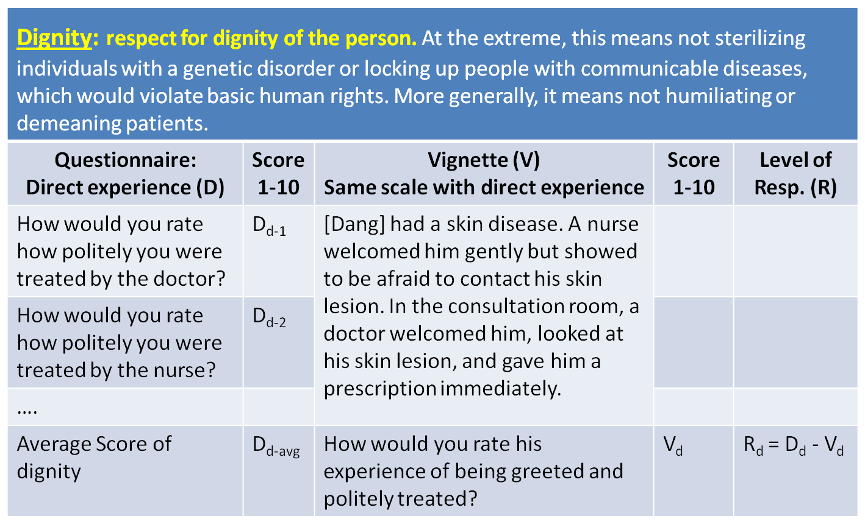
2
Responsiveness
Exit survey
New Methodology
For example
Satisfaction
Expectation
Responsiveness
Source: Pholpark A, Ponsupap Y, Aekplakorn W, Srithamrongsawat S, Sunsern R (2012): Responsiveness under
different health insurance schemes and hospital types, Journal of Health System Research, Vol 6 (2): 207-218

Slide 28
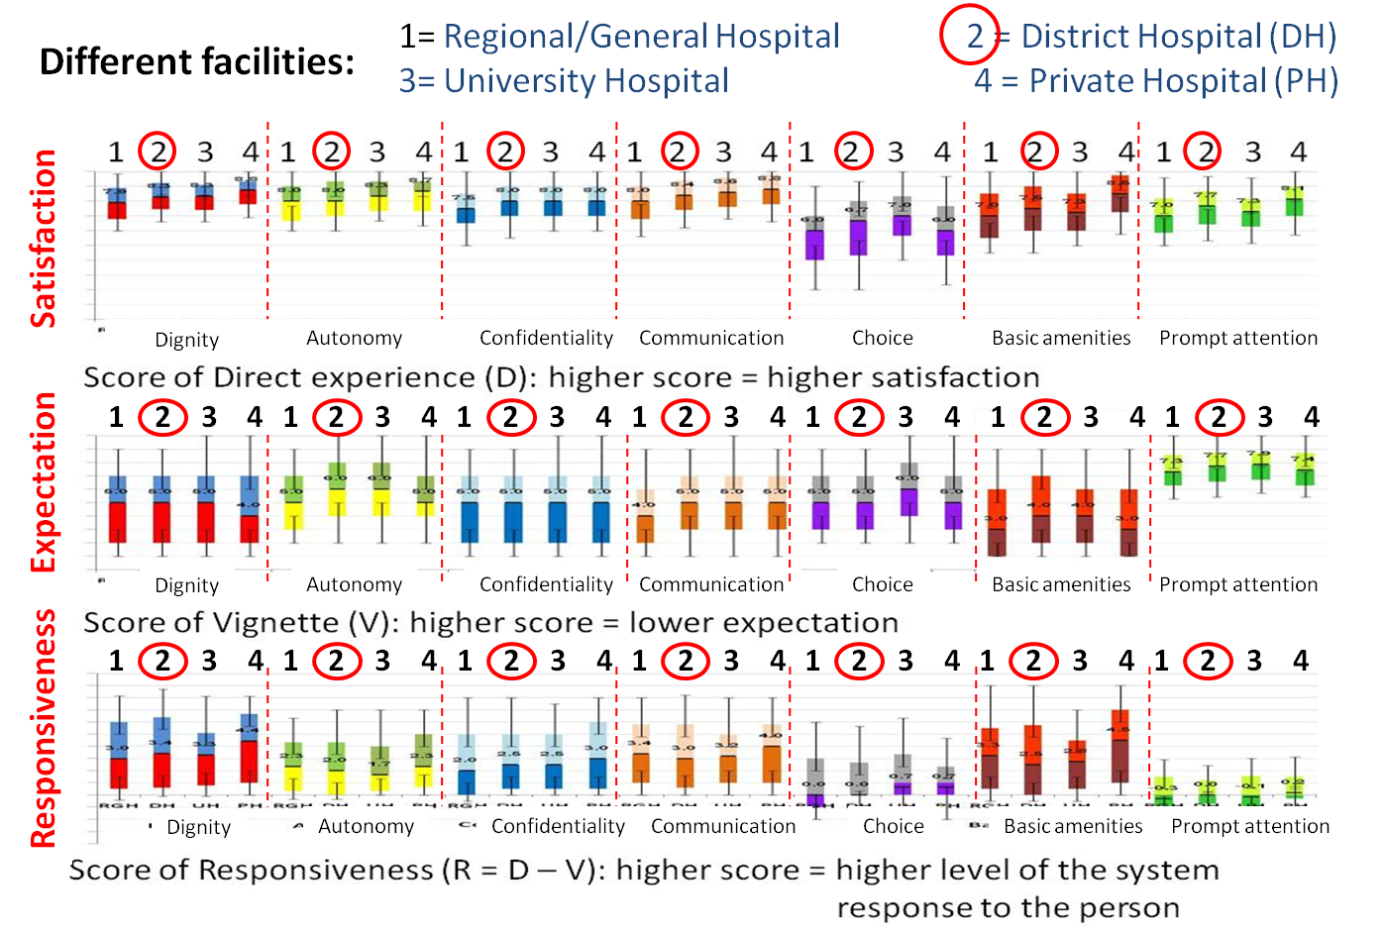
2
Responsiveness
Exit survey
New Methodology
Regional/Geneal Hospital; District Hospital
University Hospital; Private Hospital
District Hospital ~ Better
Not significantly different
Methodology
Adapted and Integrated into Routine National Statistic Survey (Since 2015): monitor every 2 years
Source: Pholpark A, Ponsupap Y, Aekplakorn W, Srithamrongsawat S, Sunsern R (2012): Responsiveness under
different health insurance schemes and hospital types, Journal of Health System Research, Vol 6 (2): 207-218

Slide 29
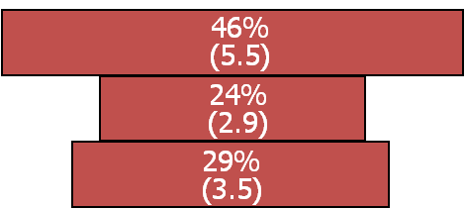
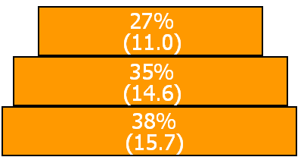
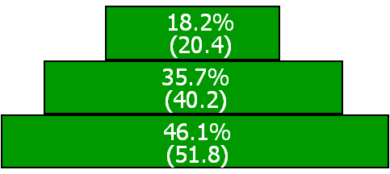
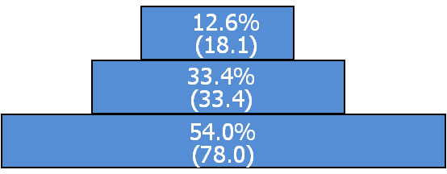
2
Better Responsiveness
Expectation of the implementation of the CUP
… Integrated District Health System …
Progressive decentralization of care
Regional/General Hospital
Regional/Geneal Hospital; District Hospital
University Hospital; Private Hospital
District Hospital ~ Better
District Hospital
Health Centre
1977
1987
2000
2010
Administrative
& Operational Integration

Slide 30
2
Consequences: impacts of the UC scheme
Administrative
Integration
Operational
Integration
Matrix Teams

Slide 31
2
Evolution: … “2 lines of commands” >> Committee >>> … “Board”
“District Hospital” & “District Health Office”
DHDC (1983): District Health Developing Committee
  Chairman: District Officer (Sheriff)
  Deputy Chairman: Director of the district hospital
  Secretary: District Health Officer
DHCC (1986): District Health Coordinating Committee (12 persons)
  Chairman: Director of the district hospital or District Health Officer
  Secretary: Chairman choose (one from District Hospital; and one from District Health Office)
  Deputy Secretary: Chairman choose (one from District Hospital; and one from District Health Office)
CUP (2545): Contracting Unit for Primary Care (UC scheme: include Bangkok and private), Not include CSMBS, SSS
DHCC (2003): District Health Coordinating Committee (10-20 persons): more involvement of stake holders from different sectors
DHS movement (2011): UCARE (informal DHB in some districts: District Officer is the chairman)
DHB (2016): 73 districts under MOU (MoI, MoPH, NHSO, THPF); DHB (2017): 200 districts,
DHB (2017) >>> a formal legal framework
Administrative
Integration
UC scheme
Cabinet resolution

Slide 32
2
Evolution: From… extended OPDs in HCs >>> To… Matrix Teams
Extended OPDs
  Doctor and hospital team: go to only remote health centres
PCUs (2002): Human resource criteria of CUP
  Doctor and hospital team: go (rotate) to almost every health centre in the district under the condition as PCUs
  Community Medical Centres CMUs in some urban areas e.g. Ayutthaya, Korat., Hadyai, …
Movement of DHS (2011): Matrix Links/Networks
FCT (2015): Family Care Team
PCC (2016): Primary Care Cluster
(2017): Family Doctors -> appropriate proportion with the population
>>> Matrix Team: Horizontal, Vertical, and Diagonal Relationships
Operational
Integration
Cultural Confrontations: hospital culture & family medicine concepts
UC scheme
Matrix Team
New constitution
Individual

Slide 33
1970s - 80s
Hospital: in every district
Health centre: in every sub-district
1980s
Health Volunteers: in every village
Good Care: Hospitals + Technologies
Introduction of new paradigm: Hol., Int. Cont., ...
1
1990s: Family Practice Model (Action Research)
+ Demonstration Diffusion Strategy
1999: Specialization in Family Medicine
Impacts of the UC scheme: Introducing Matrix Teams
2
2002: Contracting Unit for Primary Care (CUP): HR criteria
Primary Care Unit (PCU): intro… new medical culture
Historical Backgrounds
The Hegemony of Hospital Based Specialists
3
Matrix Teams/Links/Networks in the context of DHS
3
Area based and People-centred System…
Hospital-centred System…
2007: Context Based Learning (CBL): identified Gaps
Changing Paradigm
PCPL (2007), FPL (2012), DHML (2014)
2011: DHS --> UCARE
2015: Family Care Teams (FCT)
2016: Primary Care Cluster (PCC);
District Health Boards (DHB): pilot in 73 districts
>>> early 2017: expanded to 200 districts
4
Legal issues:
2017: Family Doctor (Constitution); DHB (Cabinet resolution)
>>> All (928) districts
Good Care: Patient-, Person-, People-centred Care
2000s: Achieving Universal Health Coverage

Slide 34

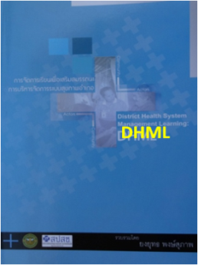


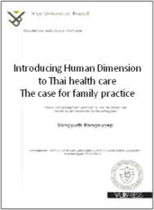
Context Based Learning (CBL): formal Introduction & Evolution
3
Proposed “CBL”
in PhD thesis
Family Practice
Learning
District Health
Management
Learning
Primary Care
Practice Learning
Decision trees
+
Implemented the DD strategy
PCPL:
Scale up for DHS dev.
Explanation of common diseases
For Basic Curative Services
PCPL
FPL
DHML
Learning in the Context
Introduced: 1980s
1990s
2007
2011
2012
2104
Mainly for
“HC staff (No MD)”
Curative (not clearly prepared)
+ Prevention
+ Health Promotion
Introduced
“HC staff with MD”
New Paradigm:
Holistic + Integrated + Continuous Care
CBL
CBL
CBL
CBL
Technical Competencies
Shadow Competencies (5)
“Polyvalent Team”
“Ayutthaya Research Project”
Identified for Carers
+
+
Identified for Managers
Social Competencies
Core Competencies (5)
Significant Inputs:
before formally formulated to be CBL
Individual-Team-System

Slide 35

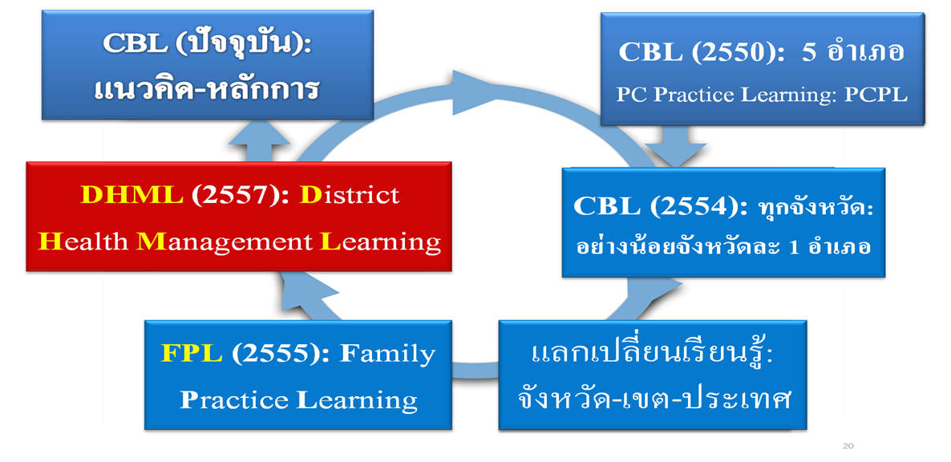
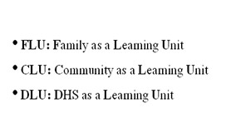
3
Spiraling up through action and reflection
Synthesis principles & different experiences of PCPL
Interactions with Current Policies:
FCT (2015) >>> PCC (2016); DHB (2016 & 17)
CBL: Context Based Learning
[Tested Methods]
PCPL (2007): Primary Care Practice Learning (Carers)
Started identifying different learning needs: Mangers & Carers under the principle of CBL
DHML (2014): District Health Management Learning (Managers)
PCPL (2011): scale up for DHS development
Guideline for DHML
FPL (2012): Family Practice Learning (Carers)
*** Exchanges: Provincial, Regional and National Levels
Gaps: Expected VS Existing Competencies
>>> Identified learning activities:
mainly learning in the context of DHS
Guideline for FPL
Including demonstration visits for
different actors and policy makers

Slide 36
3
Spiraling up through action and reflection
Participatory Interactive Learning through Actions: PILA
DHB
CUP & PCU (since 2002)
DHS
FCT
PCC
Introducing Matrix Teams…
(UCARE)
Matrix Teams/Links/Networks…

Slide 37
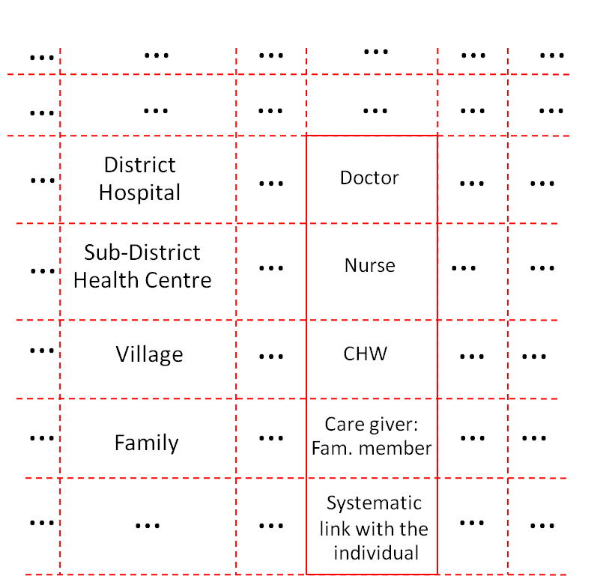
3
Management organization to support Matrix Teams/Links/Networks
Four levels of care are considered in the district health care system: family, village, sub-district health centre, the district hospital.
Vertical Links: At each level for each individual/family, one person is given the responsibility of care (family care team as focal point of matrix team): family member as a care giver, volunteer, nurse, medical doctor. They interact.
Horizontal Links: At each level, these responsible persons are connected with others (matrix team), both within the health care system and outside.
A District Health Board is expected to lead and support the matrix team: systemic management.
Characteristics of “Matrix Team”
Doctor
Nurse
CHW
Patient’s Son
CHW: Community Health Workers (Health Volunteers)
Notes:
When talking about policy of Family Care Team. In terms of vertical links: each family knows who are their-CHW their-Nurse and their-Doctor of the family. When family member is identified as a care giver. He or She is also consider as member of the team. Apart from working together as a team, information technology has been a very good facilitating condition to strengthen their working and caring in teams. In terms horizontal links, collaboration with local authorities and local governments have very clear impacts especially on Social Care.
Both Vertical and Horizontal links are expected to be better supported in terms of systemic management by district Health board, which is being planned to start piloting this year.

Slide 38
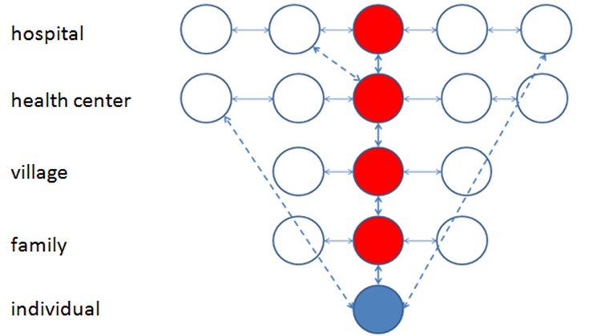
3
Vertical Team: new culture being introduced toward Matrix Team
Name of Doctor
Name of Population
Functional diagonal links within the matrix team (integration)

Slide 39
3
Matrix links in DHS: teams, networks, participation/collaboration

Slide 40
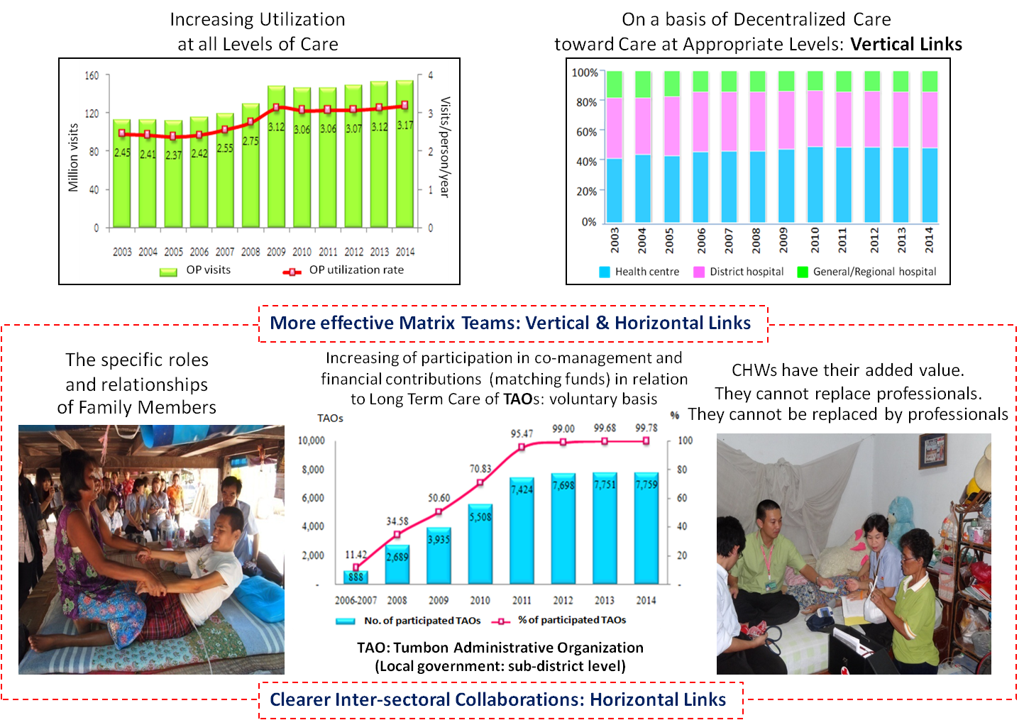
3
Visible Impacts
Notes:
Visible impacts:
First, we can see that utilization has been increasing at all levels of care, however, it has been increasing on a basis of decentralized care toward Care at appropriate levels. That we can say, vertical links have been improving.
On the other hand, in terms of horizontal links, there have been increasing of participation in co-management and financial contributions, in a form of matching funds between the funds form National Health Security Office and the funds from Tumbon Administrative Organizations (Local government at the sub-district level) on voluntary basis in relation to Long Term Care.
And Matrix Team become more and more clearer and more and more effective. For examples in the pictures: the specific roles and relationships of family members become very crucial in Family Care Team. When looking at Community Health Workers, they can support, they can replace, and they can do refreshing of family members. They have their added value, they cannot replace professionals and they also cannot be replaced by professionals as well.

Slide 41
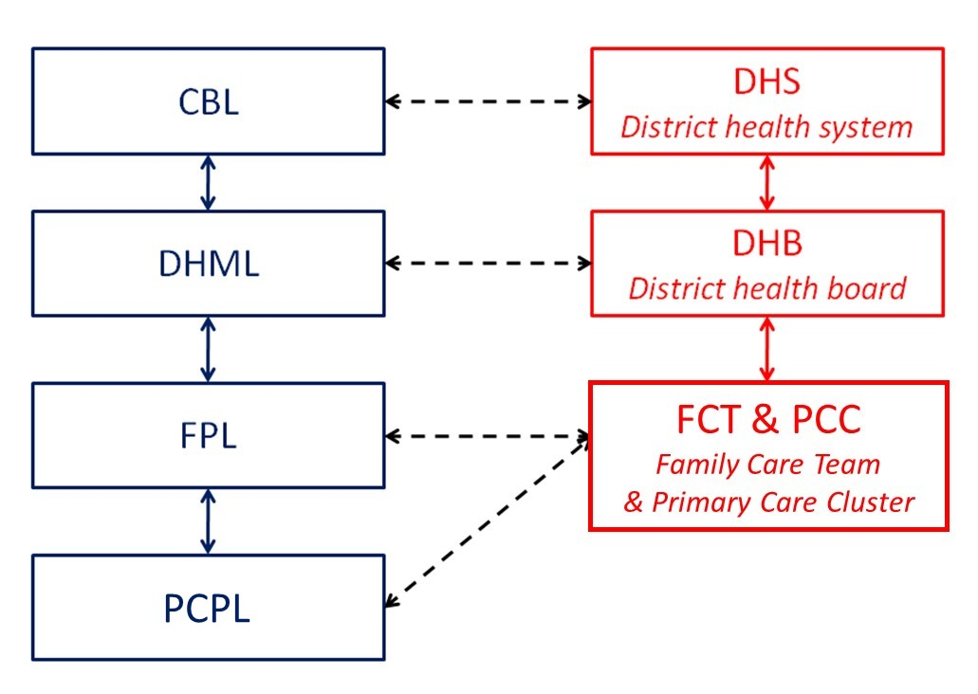
3
Capacity building and health policy

Slide 42
Hospital: in every sub-district
1970s - 80s
Hospital: in every sub-district
Health centre: in every sub-district
Health centre: in every sub-district
1980s
Health Volunteers: in every village
Good Care: Hospitals + Technologies
Introduction of new paradigm: Hol., Int. Cont., ...
1
1990s: Family Practice Model (Action Research)
+ Demonstration Diffusion Strategy
1999: Specialization in Family Medicine
Impacts of the UC scheme: Introducing Matrix Teams
2
2002: Contracting Unit for Primary Care (CUP): HR criteria
Primary Care Unit (PCU): intro… new medical culture
Historical Backgrounds
The Hegemony of Hospital Based Specialists
3
Matrix Teams/Links/Networks in the context of DHS
Area based and People-centred System…
Hospital-centred System…
2007: Context Based Learning (CBL): identified Gaps
Changing Paradigm
PCPL (2007), FPL (2012), DHML (2014)
2011: DHS --> UCARE
2015: Family Care Teams (FCT)
2016: Primary Care Cluster (PCC);
District Health Boards (DHB): pilot in 73 districts
>>> early 2017: expanded to 200 districts
4
Legal issues:
4
2017: Family Doctor (Constitution); DHB (Cabinet resolution)
>>> All (928) districts
Good Care: Patient-, Person-, People-centred Care
2000s: Achieving Universal Health Coverage

Slide 43


A way forward in the New Constitution: “Empanelment”
The name of doctor with the name of the population
4
National Data Center
Standard sets of inf.
Local Data Center
Local Networks
Analysis of Local
Health System: M&E
Analysis
Measurement of
selected indicators
Interoperability & Data availability:
Information come back to Family Doctor by default
Cohort study of selected
population groups
Few simple indicators
(participatory decision)
for comprehensive analysis
  Accessibility
  Quality
  Help seeking behavior
  Etc.
Individual Global Medical Record (GMR)
The Doctor who has the name with the name of the Population
“Privacy & Confidentiality: Protected by Law”
GMR: to support quality of care and to promote “Mutual Trust”

Slide 44

4
Government sector
Private sector
for deciding on,
steering,
supporting ...
...health interventions involving several partners in the district
>>> Integration of health and social care
People sector
District Health Board (DHB ~ 21 members)
Doctor
Individual
And managing for appropriate proportion
between family doctors and populations
in the district (according to the constitution)

Slide 45
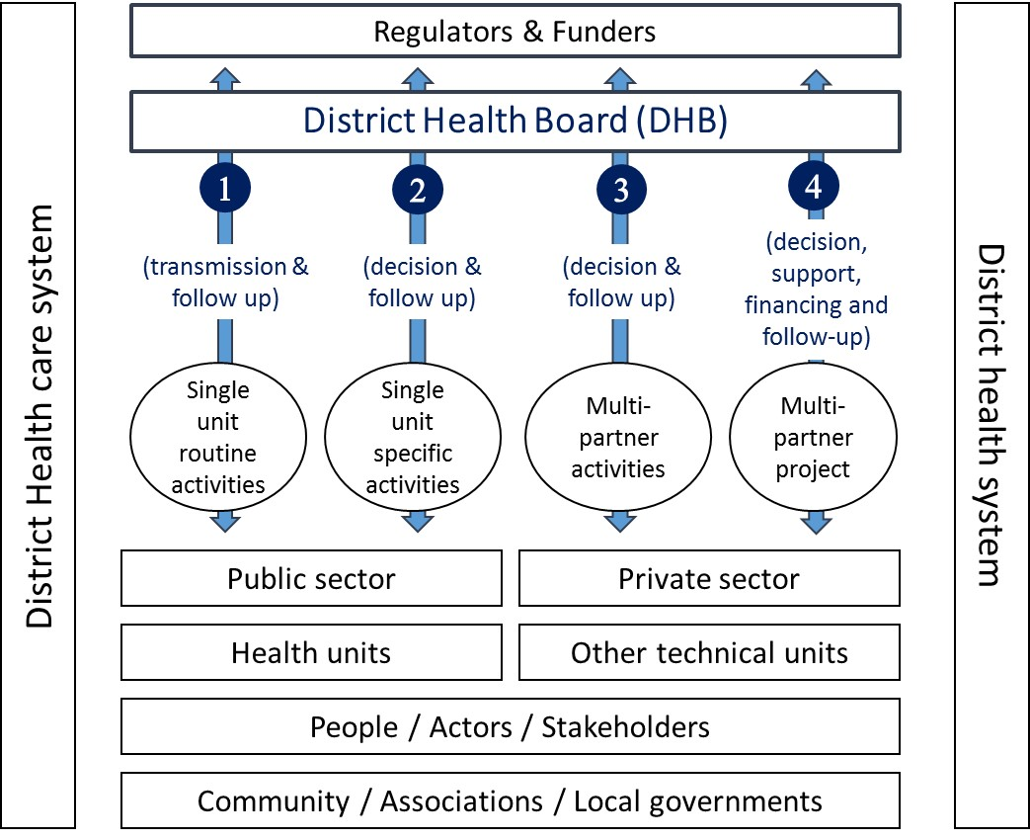
4
DHB: 4 main functions >>> facilitate INTEGRATIONS

Slide 46
Conclusions
CBL, DHML, PILA, FPL, DHB, FCT, and PCC have progressively been becoming common terminologies in the Thai health system.
Primary care strengthening in the context of district/local health system through:
  Administrative integration: DHB & DHML
  Operational integration: FCT-PCC & FPL
Several processes of continued training strategies support policy making:
  CBL, DHML, FPL, PILA …
  Demonstration visits for different actors including policy makers
  Exchange of experiences at different levels: district, provincial, regional and national levels
  Conversely, the new policies support capacity building process: CBL, FPL, DHML …
Challenges: Collaboration and synergistic interactions between CBL and formal health professions education
Notes:
Abbreviations that I have mentioned for examples CBL, DHML, PILA, FPL, DHB, and FCT have progressively been becoming common terminologies in the Thai health system.
2. PC strengthening in the context of DHS
for Administrative integration, we are now focusing more on DHB & DHML
for Operational integration, we are now focusing more on FCT & FPL
3. As we have several processes to support policy making for example CBL, DHML, FPL, PILA, … Conversely, now, these training strategies and methods are being supported by the policy.
And Finally, 4, Our challenges are still to develop further collaborations and synergistic interactions between Context Based Learning and formal health professions education

Slide 47
THANK YOU

